Slide 1
TO LEAD
June 4-28, 2018
Boys & Girls Club of Greater Kingsport • Bloomingdale Baptist Church • Colonial Heights United Methodist Church • Kingsport City Schools • Sullivan County Department of Education • United Way of Greater Kingsport

Slide 2
Last Year’s Successes (2017 Pilot):
2 locations--BGC and Colonial Heights UMC
Capacity for 30 students; regular attenders ~20
4 teachers; 3 KCS, 1 SCDE
100% of Regular Attenders maintained or improved reading levels over the 4-week program

Slide 3
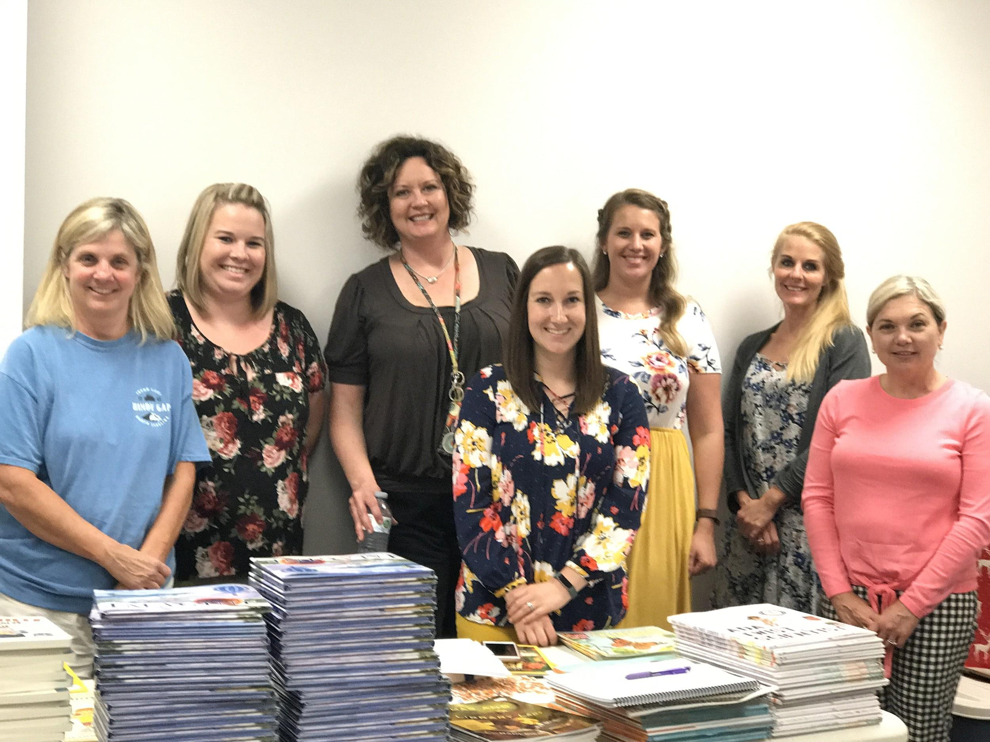
Changes / Additions for this year:
Expanded to 4 site locations--Bloomingdale Baptist, Colonial Heights UMC, and 2 classrooms at Boys & Girls Club’s Main location--with capacity to serve up to 60 students.
Teachers were able to attend Read to Be Ready Training.
Teachers group planned for all site locations to be the same.
Every week had off-site field trip.
Notes:
UWR Expanded to 4 site locations--Bloomingdale Baptist, Colonial Heights UMC, and 2 classrooms at Boys & Girls Club’s Main location--with capacity to serve up to 60 students.
Teachers were invited to participate in Read to Be Ready Training in Nashville with United WE READ. Five of the Seven teachers were able to attend along with United WE READ Manager and Boys & Girls Club Education Director.
Following Training, all 7 teachers met up to team-plan for the entire month. This allowed all four sites to have the same texts and programming.
All four weeks had an off-site field trip. Two classroom groups attended at a time, one AM and one PM.

Slide 4
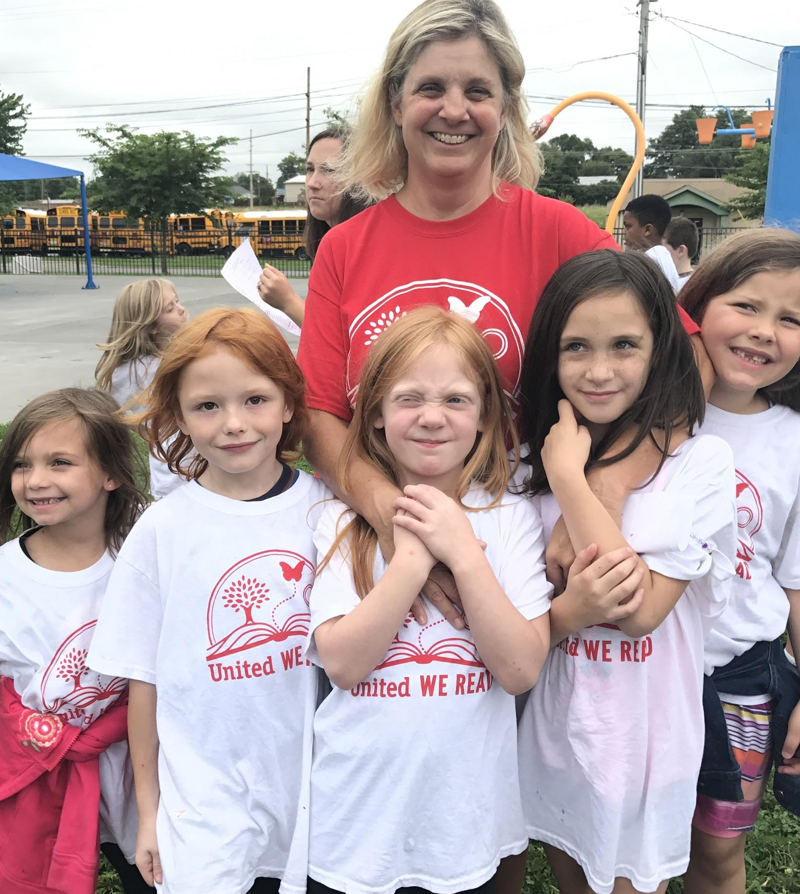
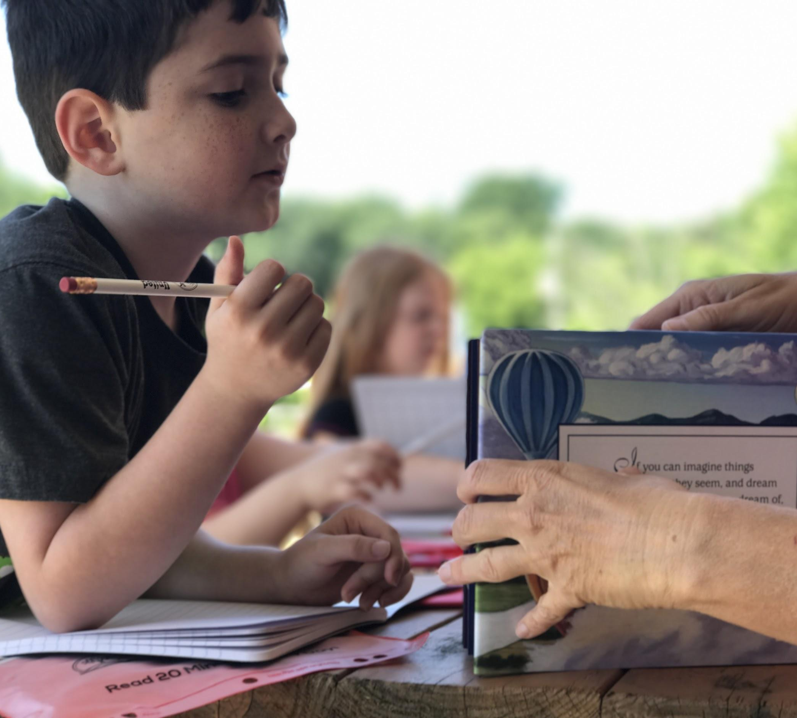
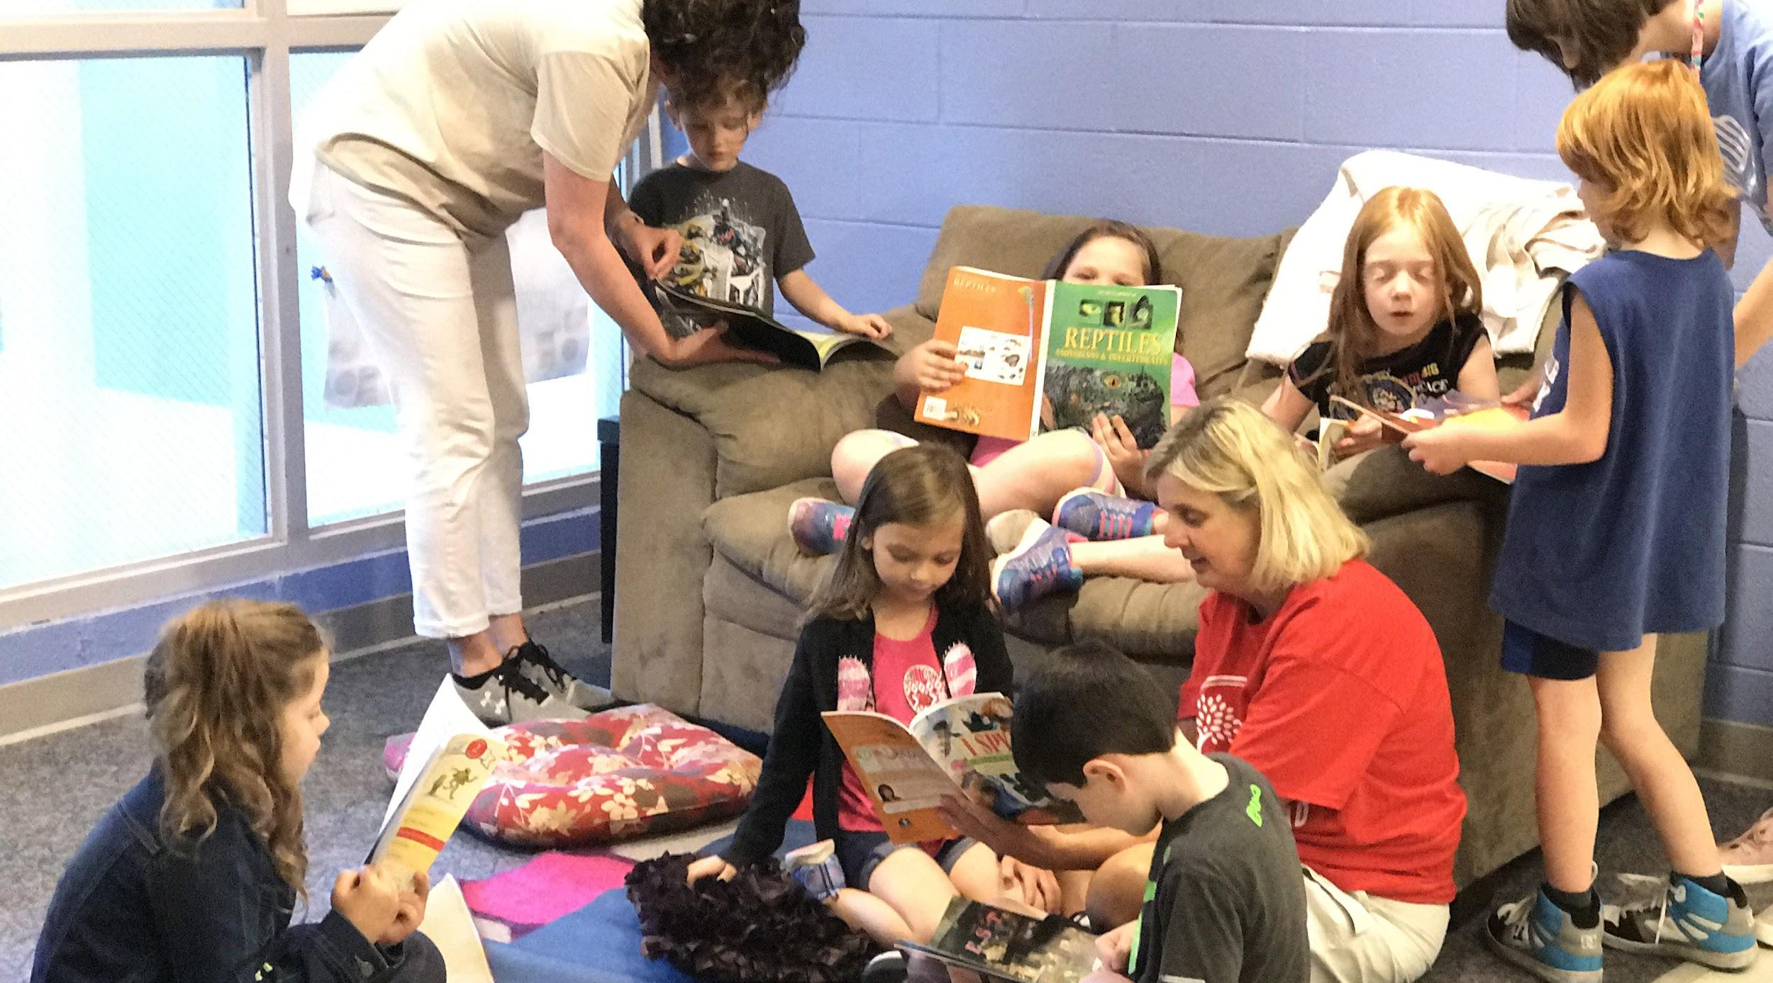
Boys & Girls Club Site--2 classes:
8:30-11:00
2 KCS Teachers in Classroom A, 1 KCS 1 SCDE Teacher in Classroom B
6-12 students in each

Slide 5
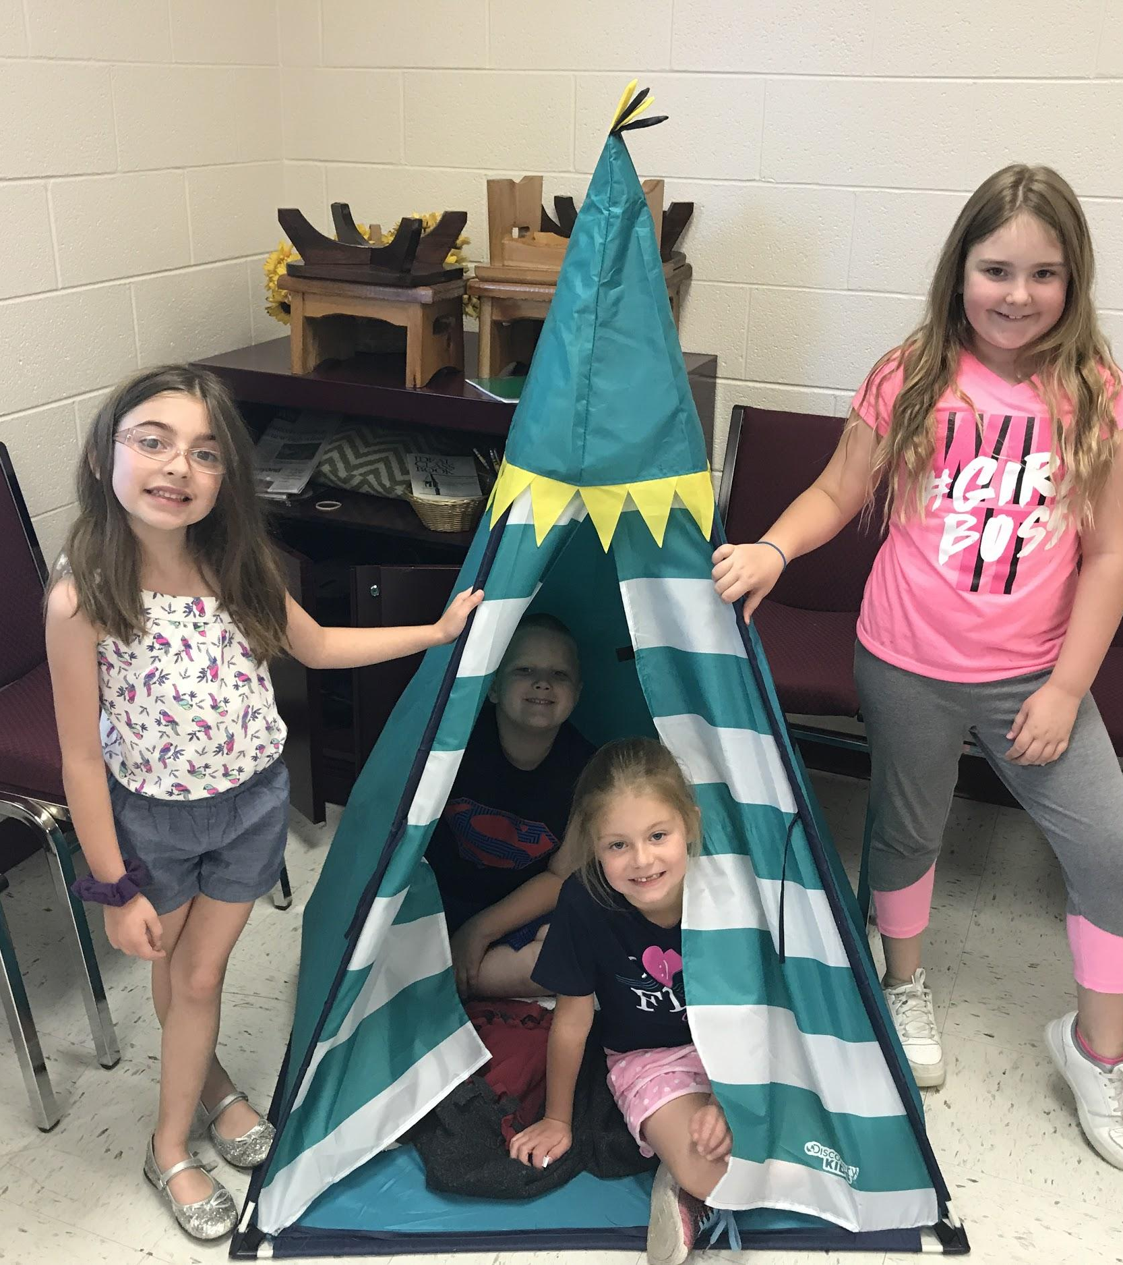
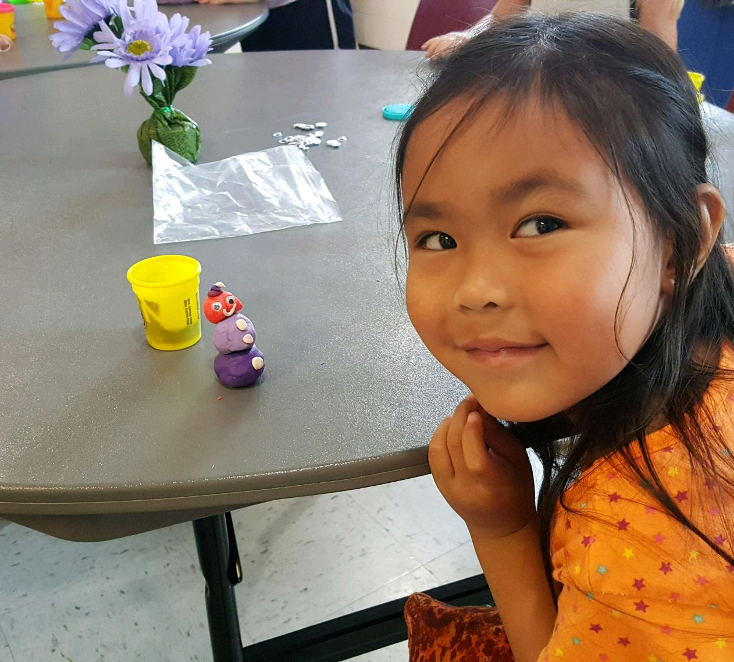
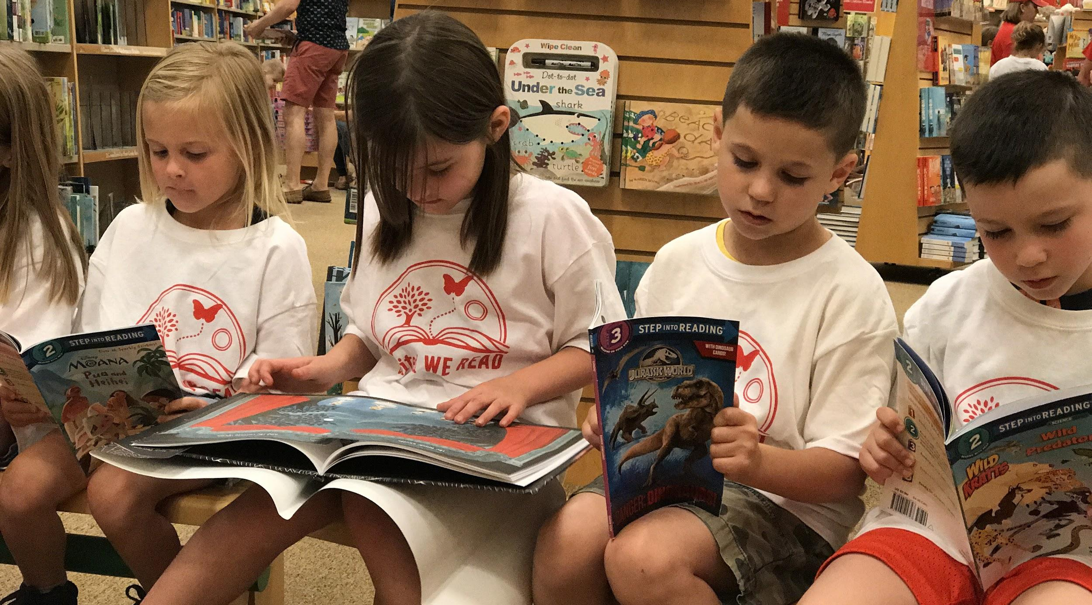
Colonial Heights UMC Site:
12:30-3:00
1 KCS 1 SCDE Teacher
10-12 students directly recruited from Rock Springs & Miller Perry Elementary

Slide 6
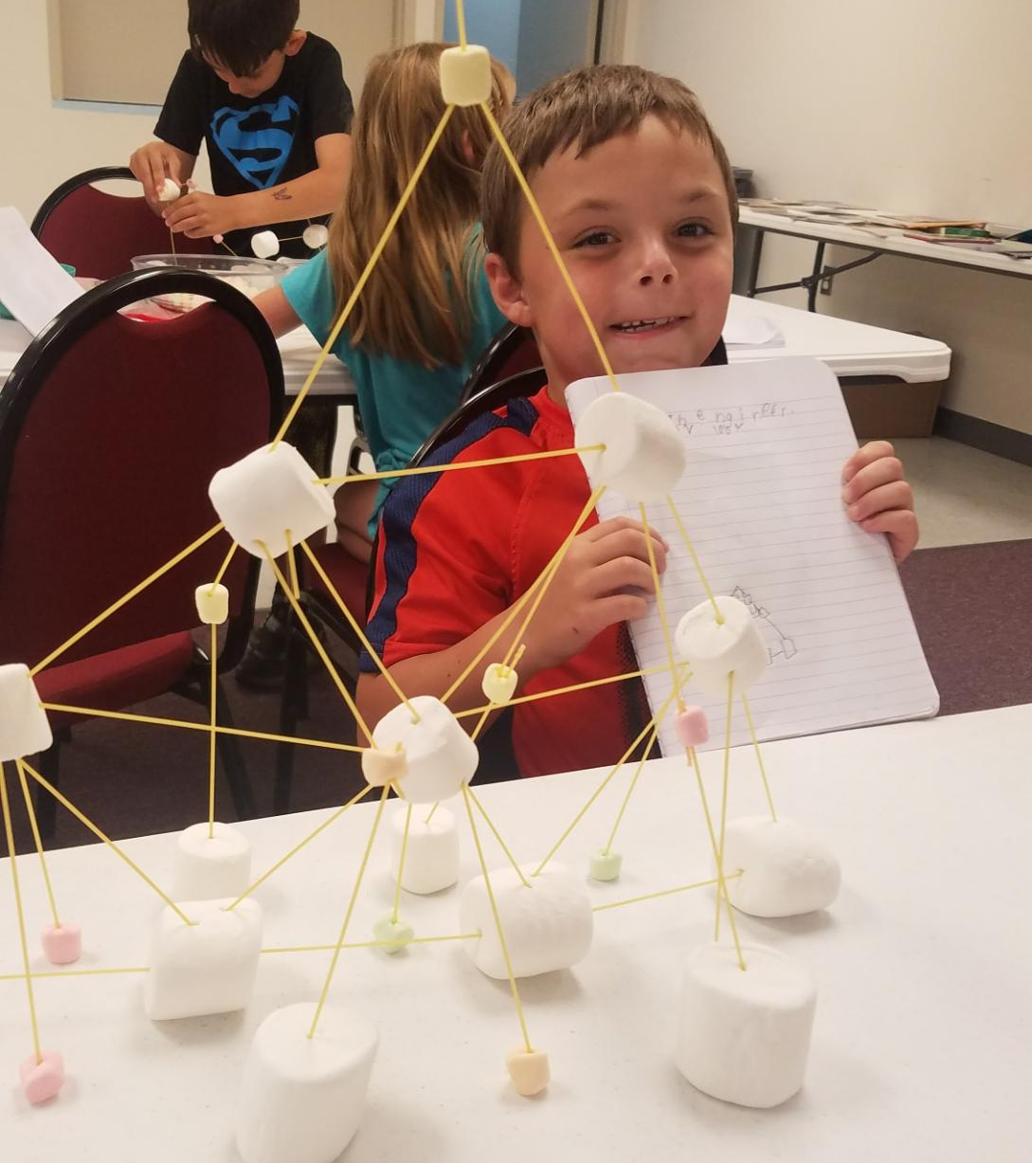
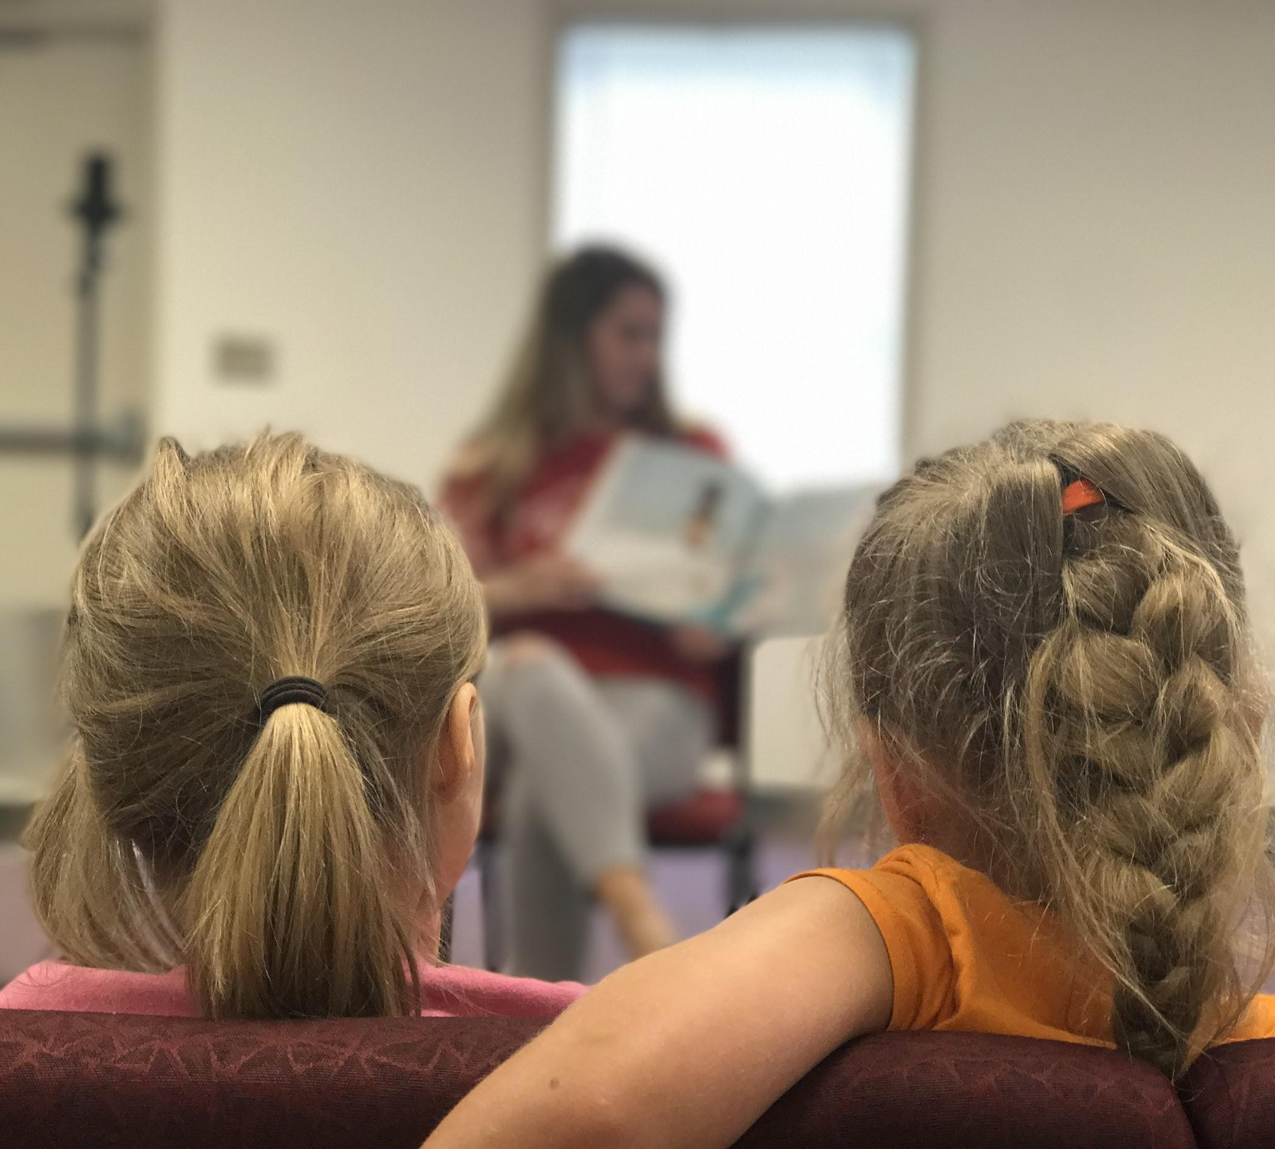
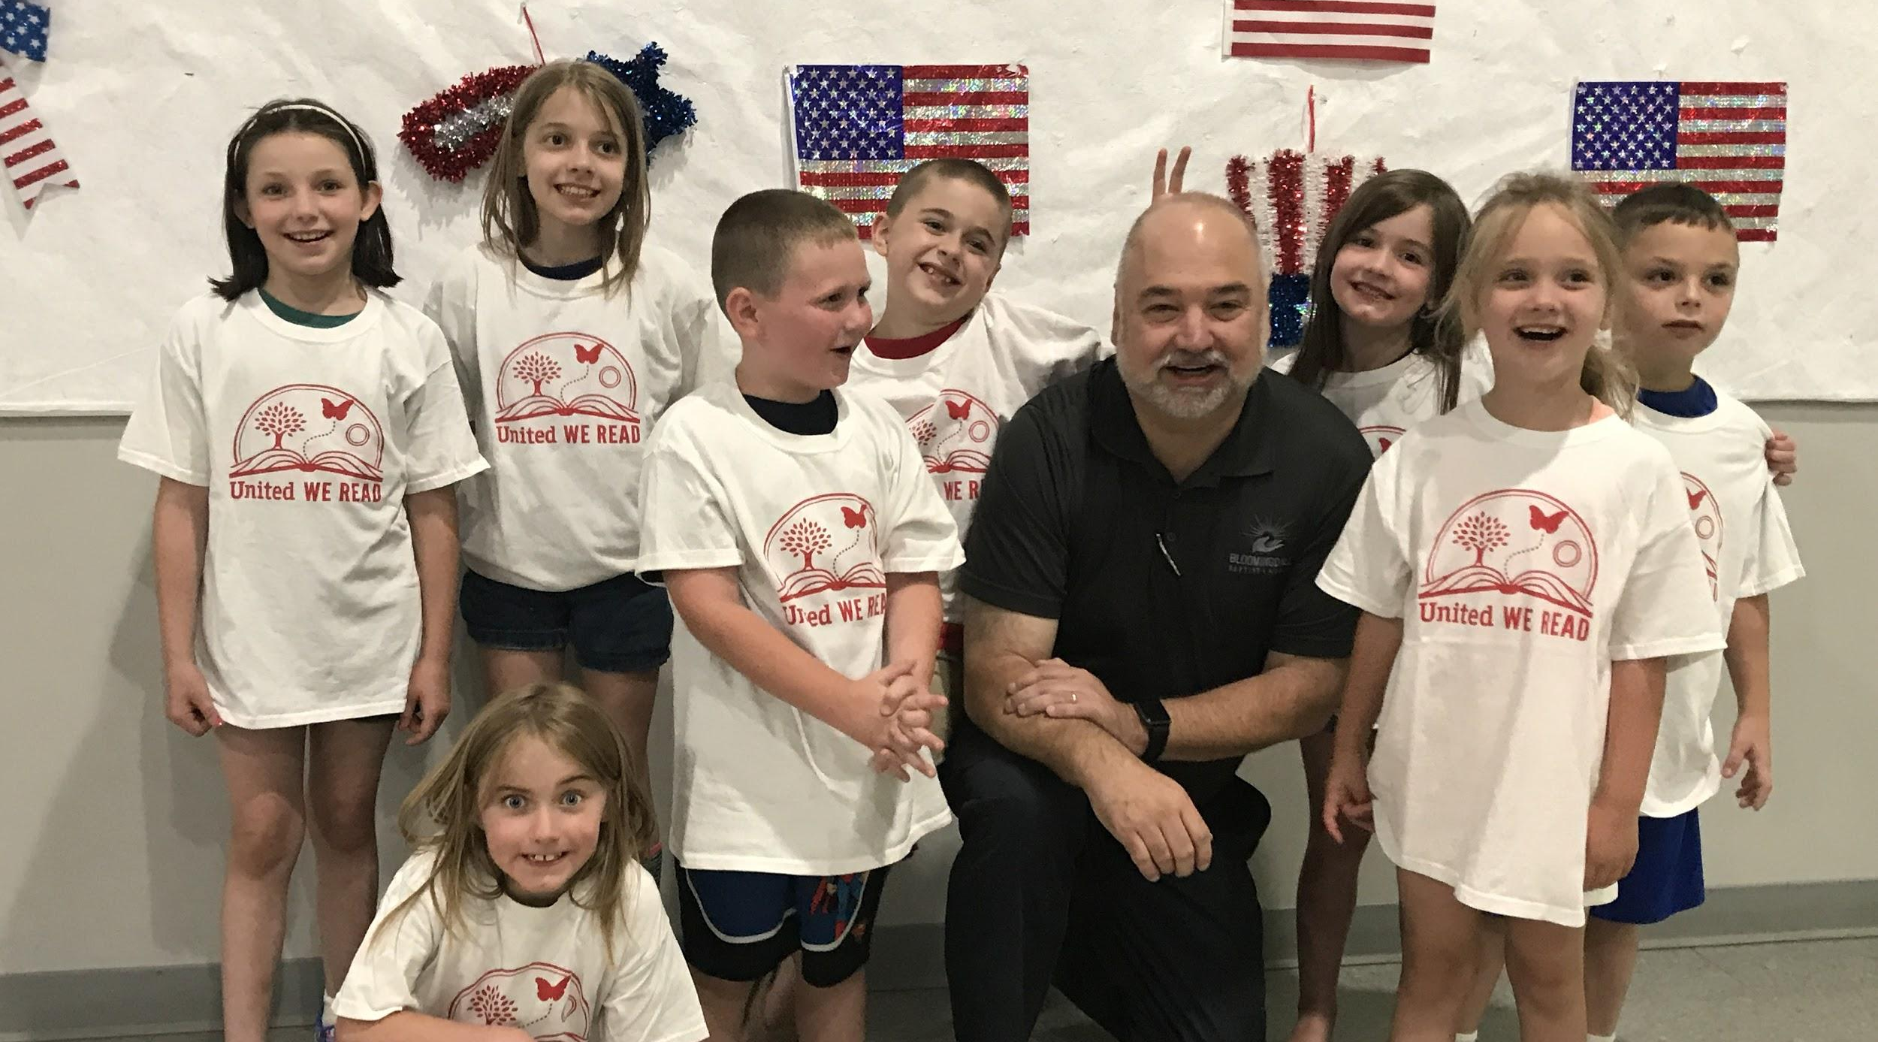
Bloomingdale Baptist Site:
12:30-3:00
1 KCS 1 SCDE Teacher
10-12 students directly recruited from Ketron & Sullivan Garden Elementary

Slide 7
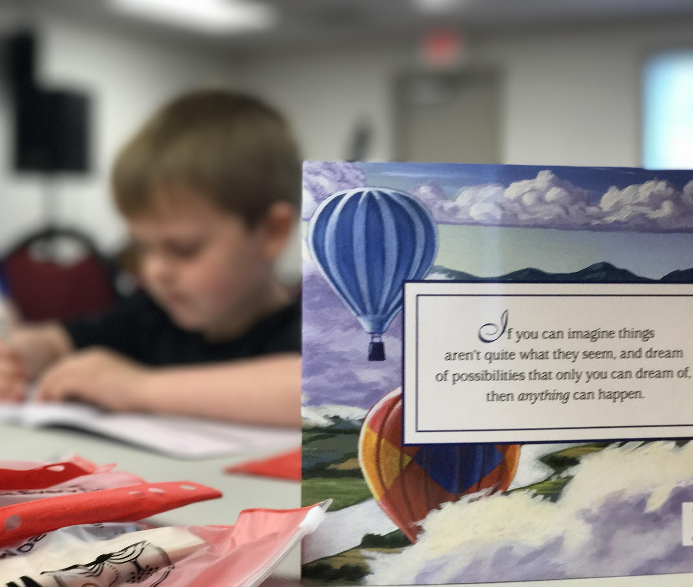
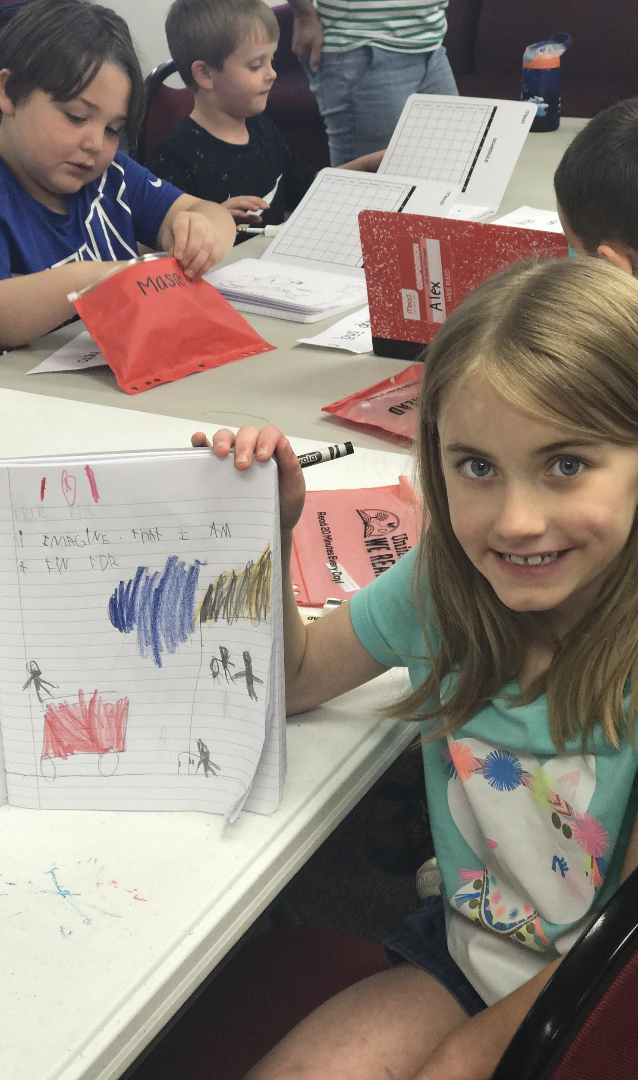
Week 1: Windows & Mirrors
I am a story. I am an author.

Slide 8
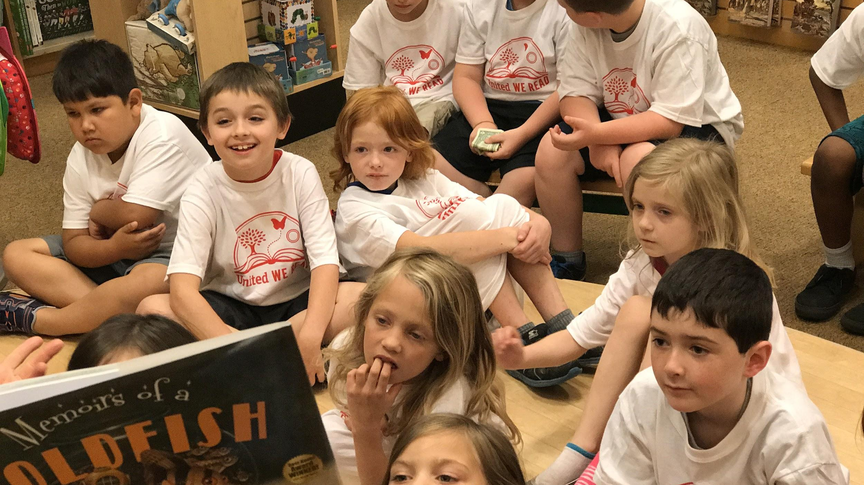
Week 1 Field Trip: Barnes & Noble
Store tour, read-aloud, pick out a book to take home, snack from the cafe.

Slide 9
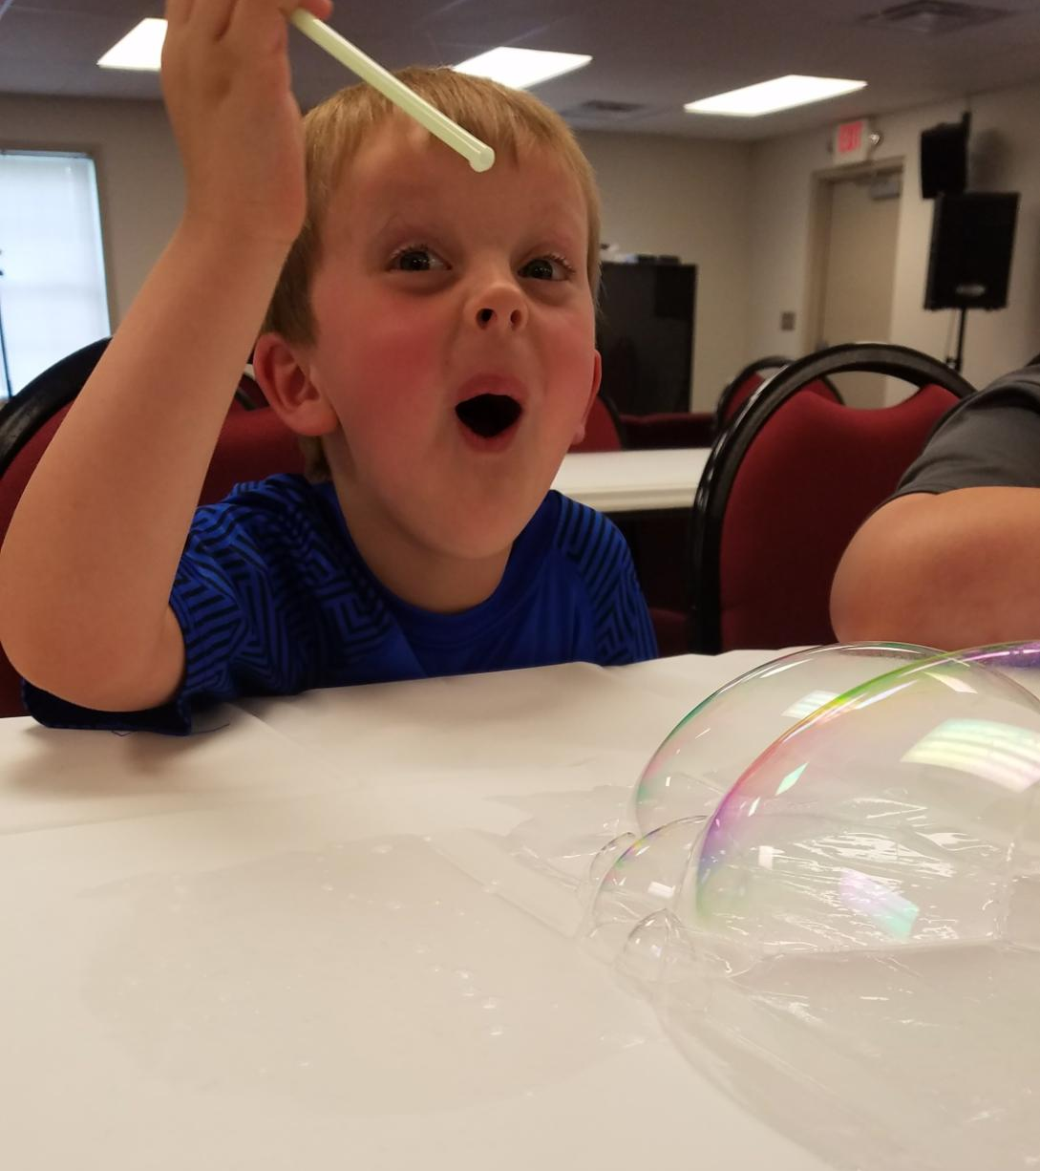
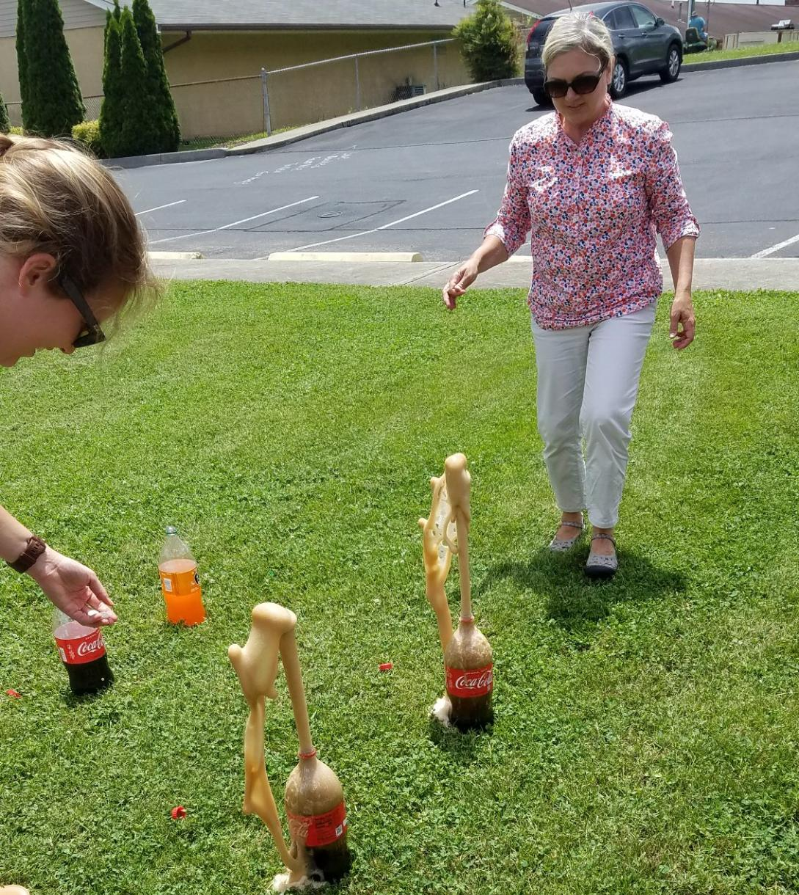
Week 2: Science & Community Helpers

Slide 10
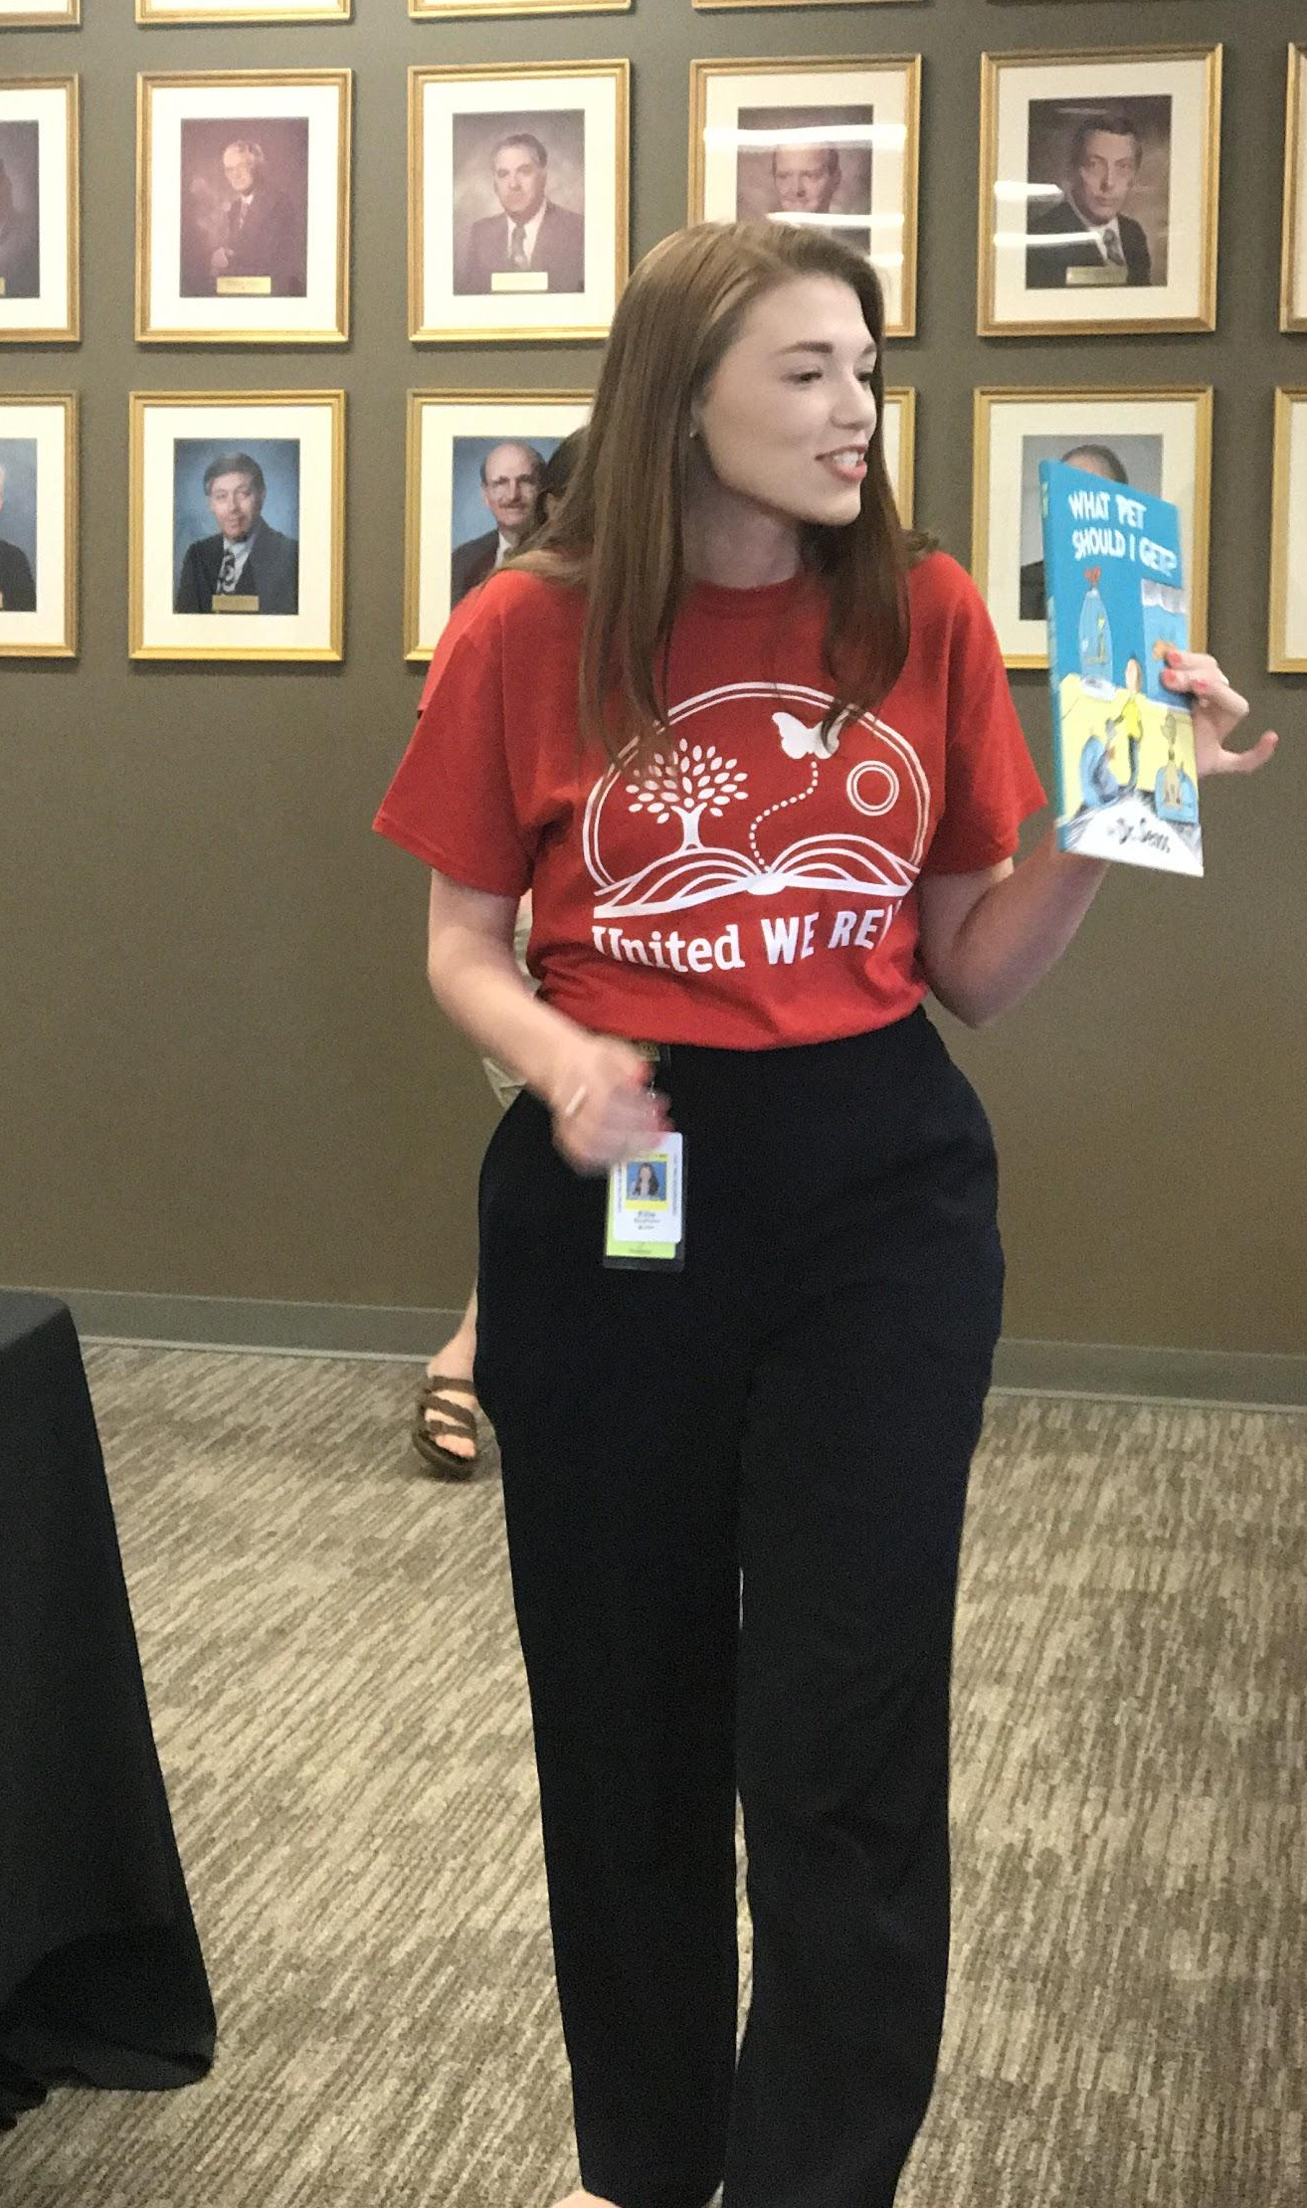
Week 2 Field Trip: Kingsport Chamber S.H.O.U.T. students & Domtar
Community helper activities, partner reading, and carousel ride

Slide 11
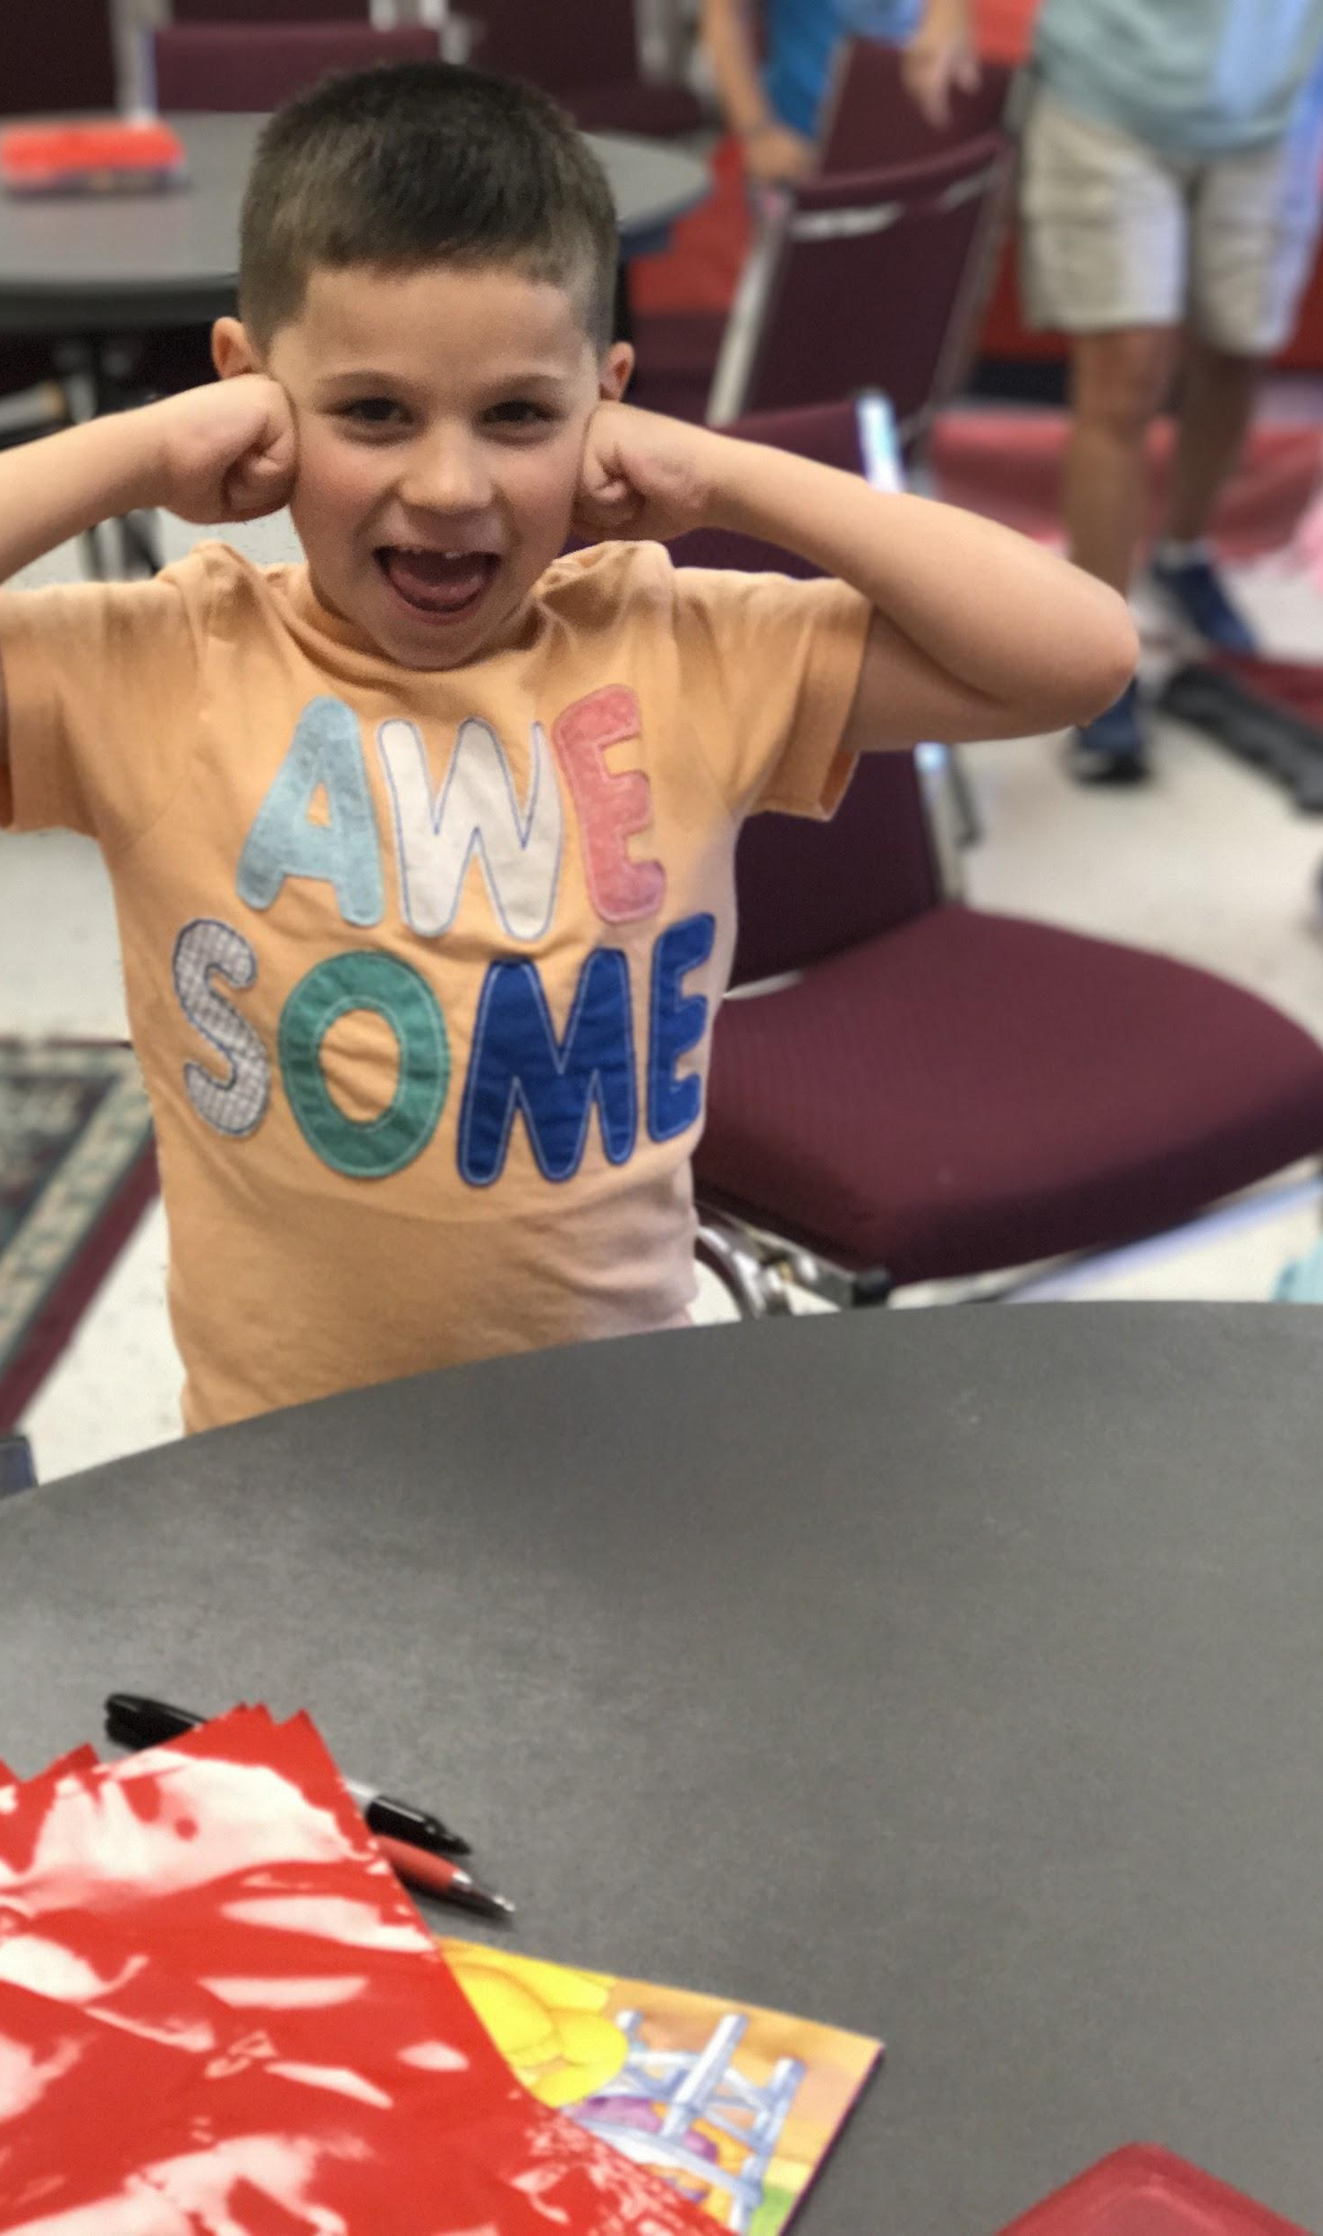
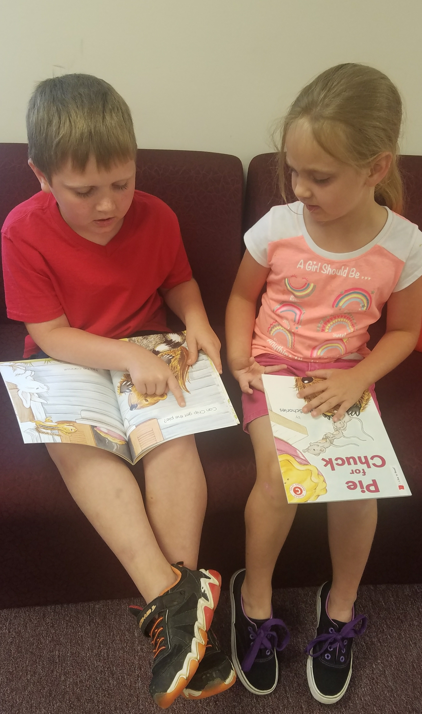
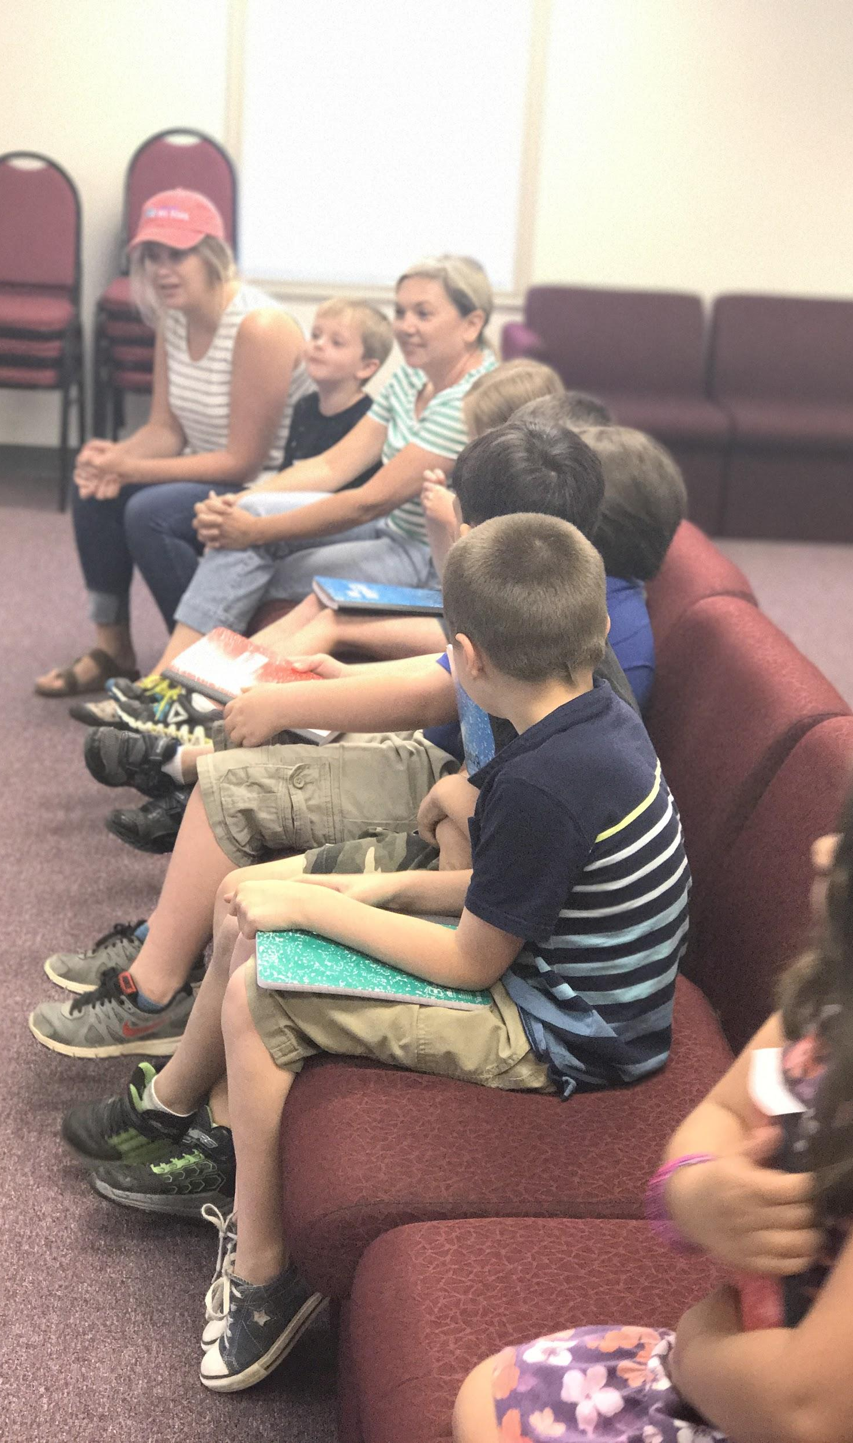
Week 3: Cooking

Slide 12
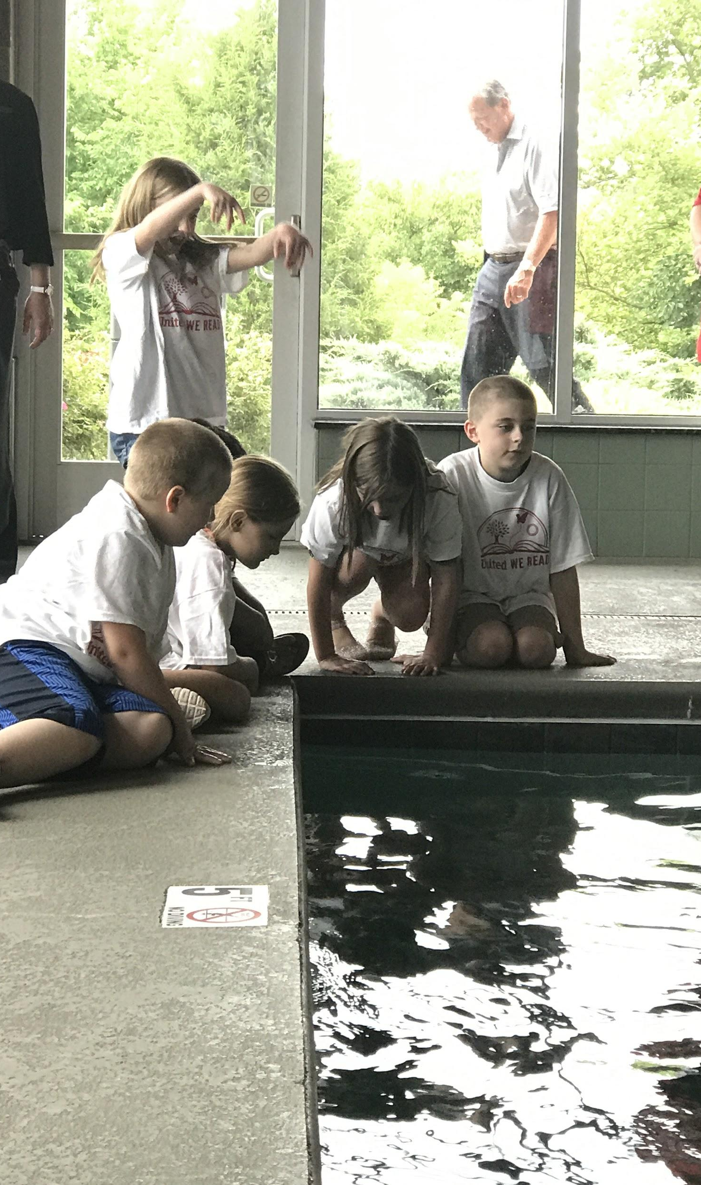
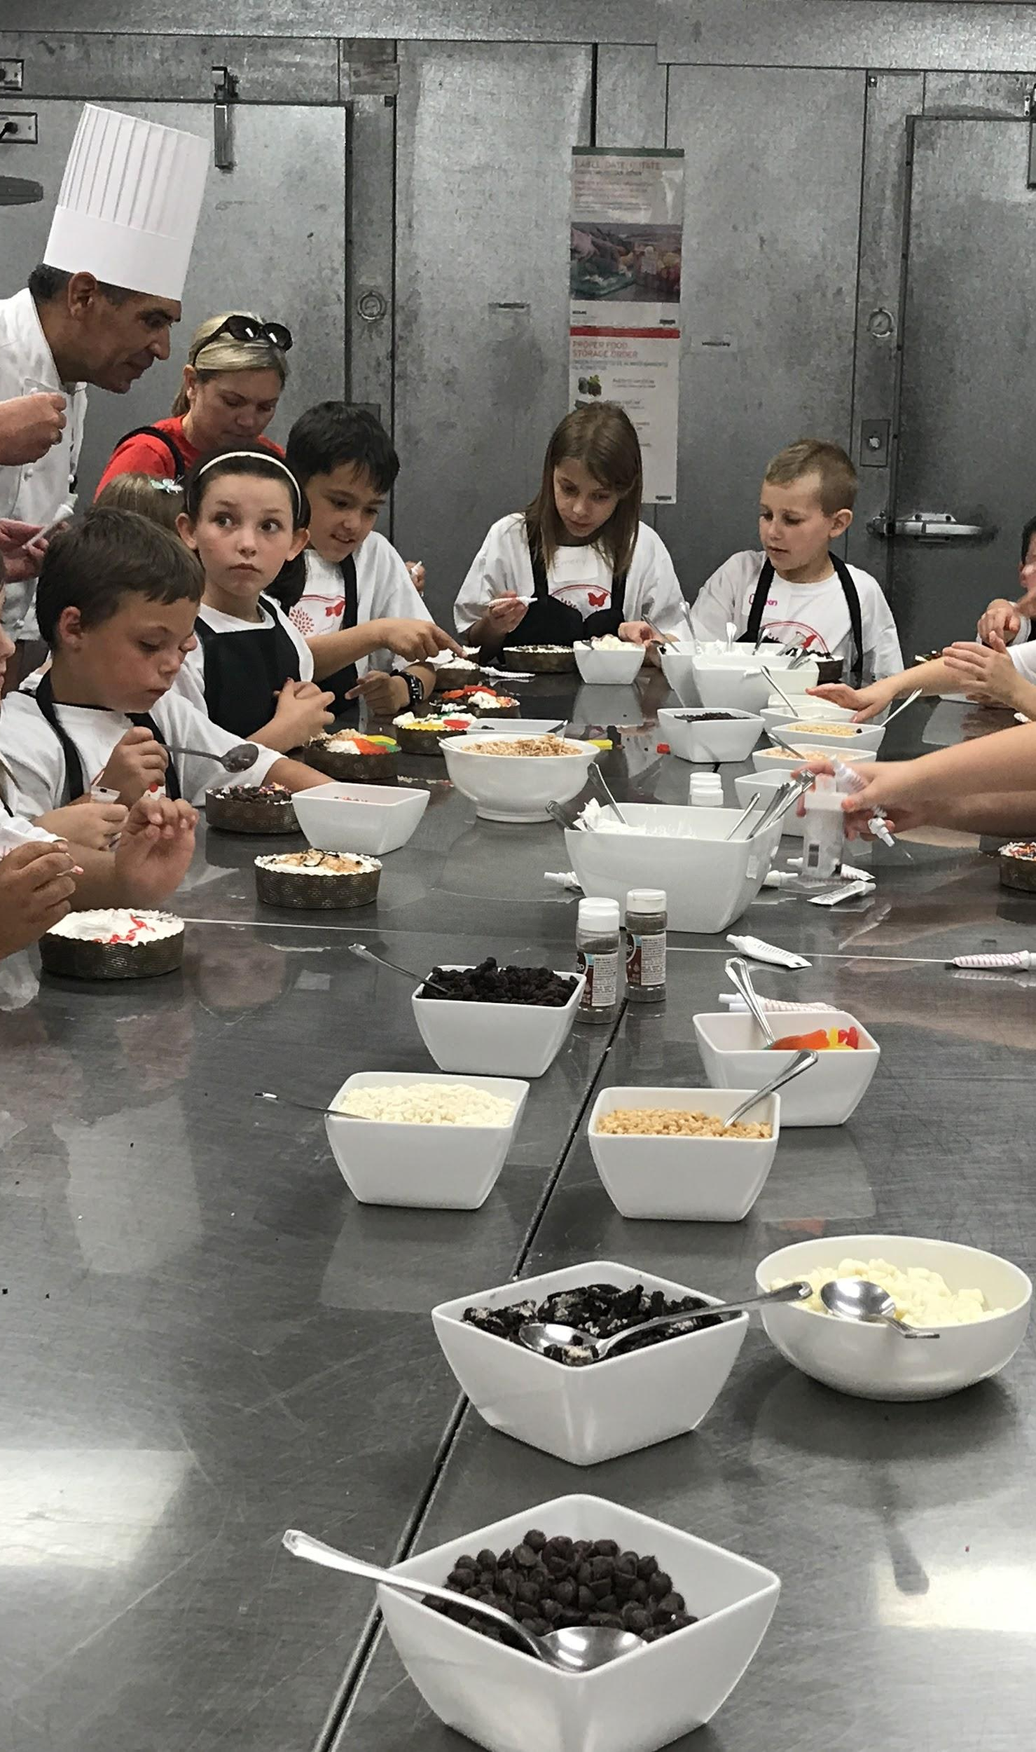
Week 3 Field Trip: Meadowview Marriott Hotel
Recipe / kitchen rules, cake decorating, & hotel tour

Slide 13
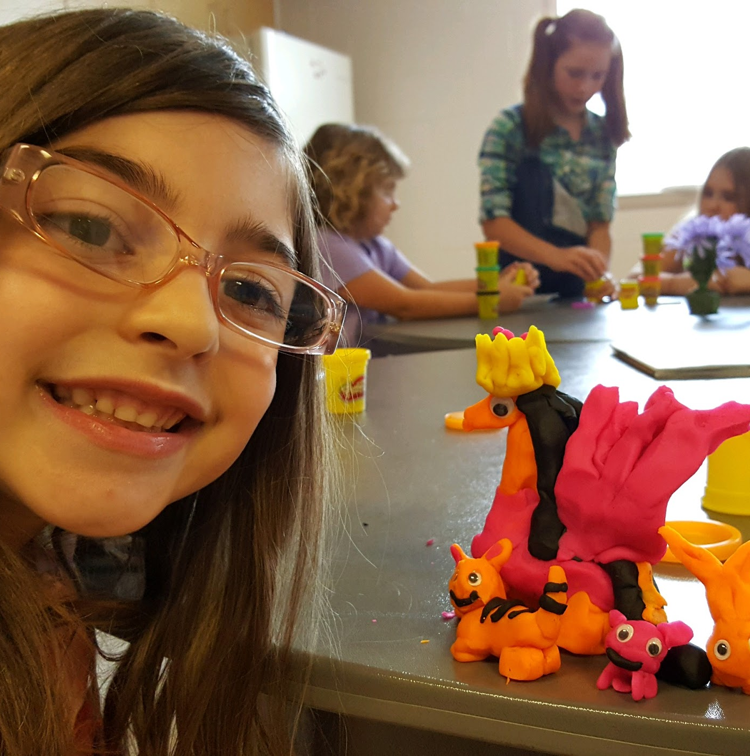
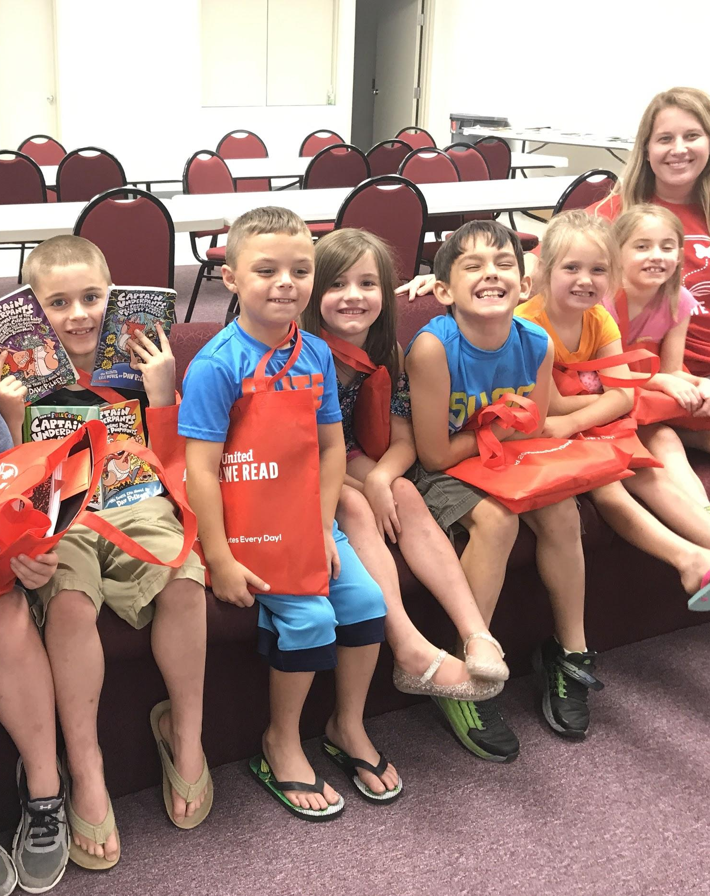
Week 4: Animals & The Farm

Slide 14
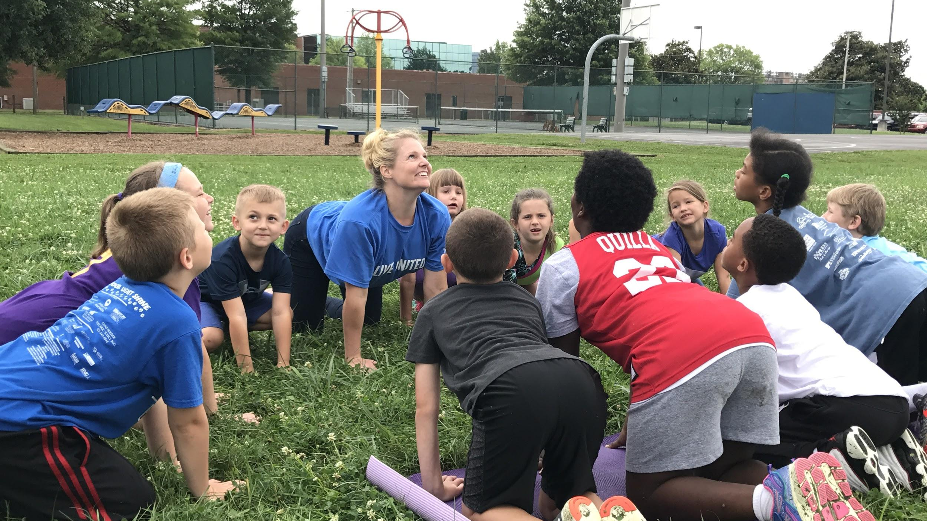
Week 4 Field Trip: United WE READ’s Summer Book Club Celebration (“Summer on the Farm” Field Day)

Slide 15
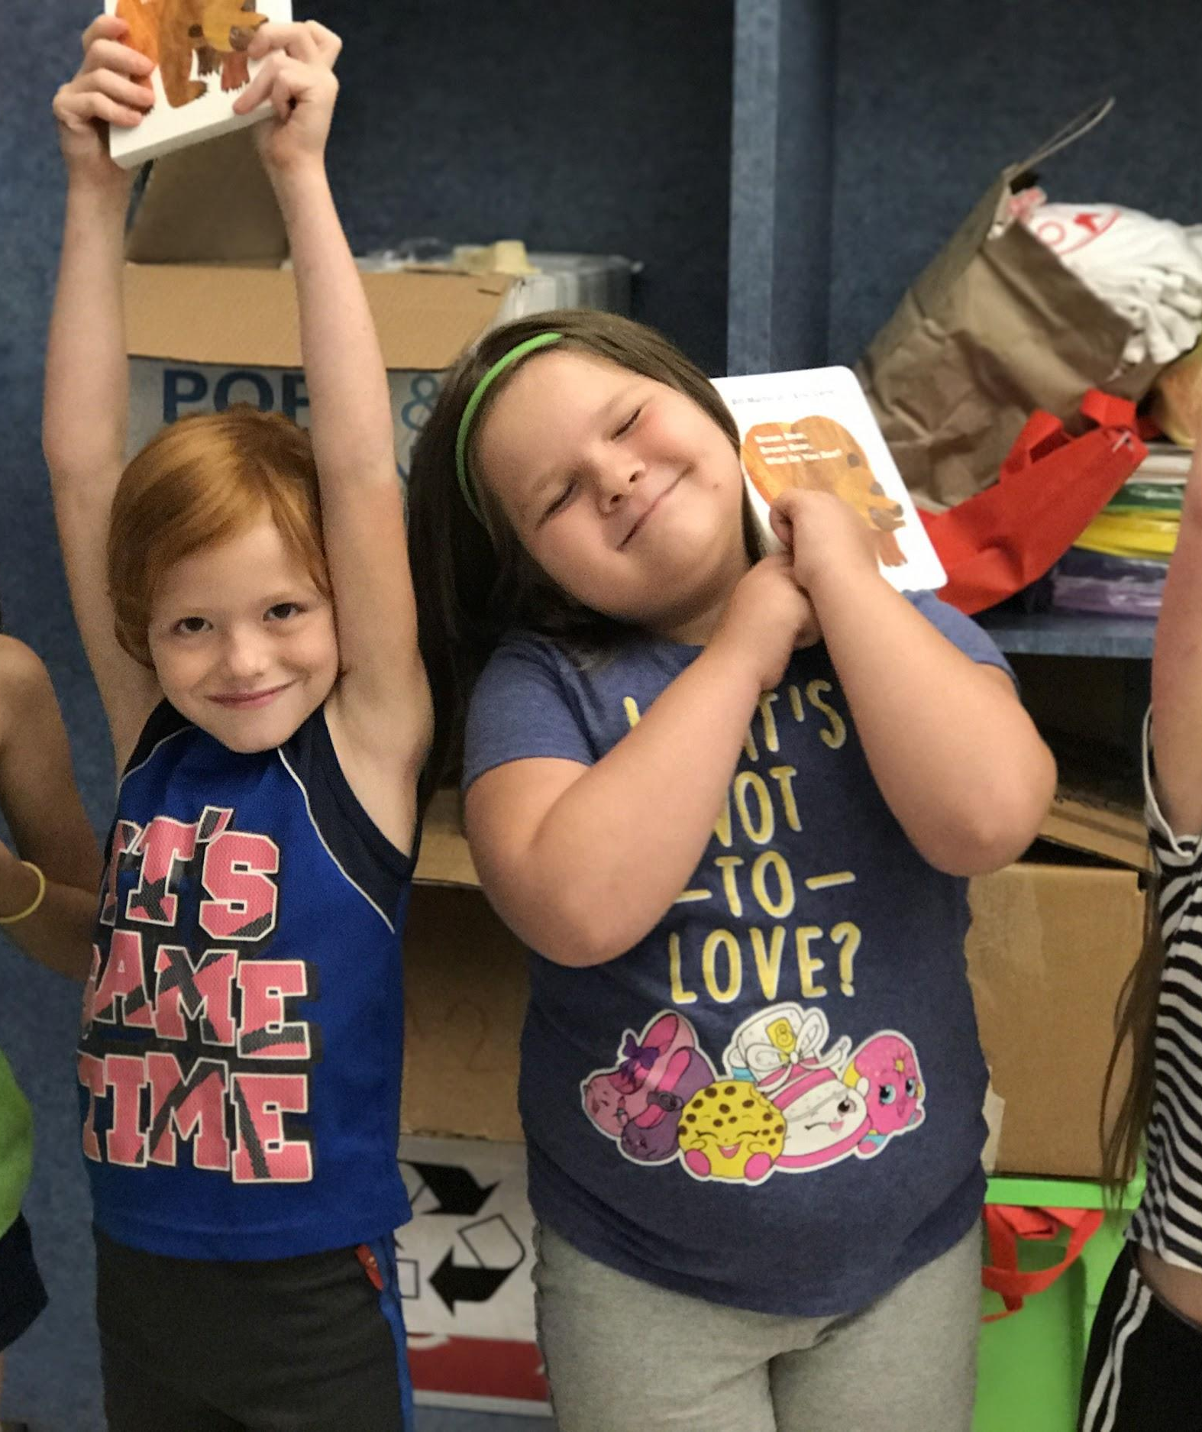
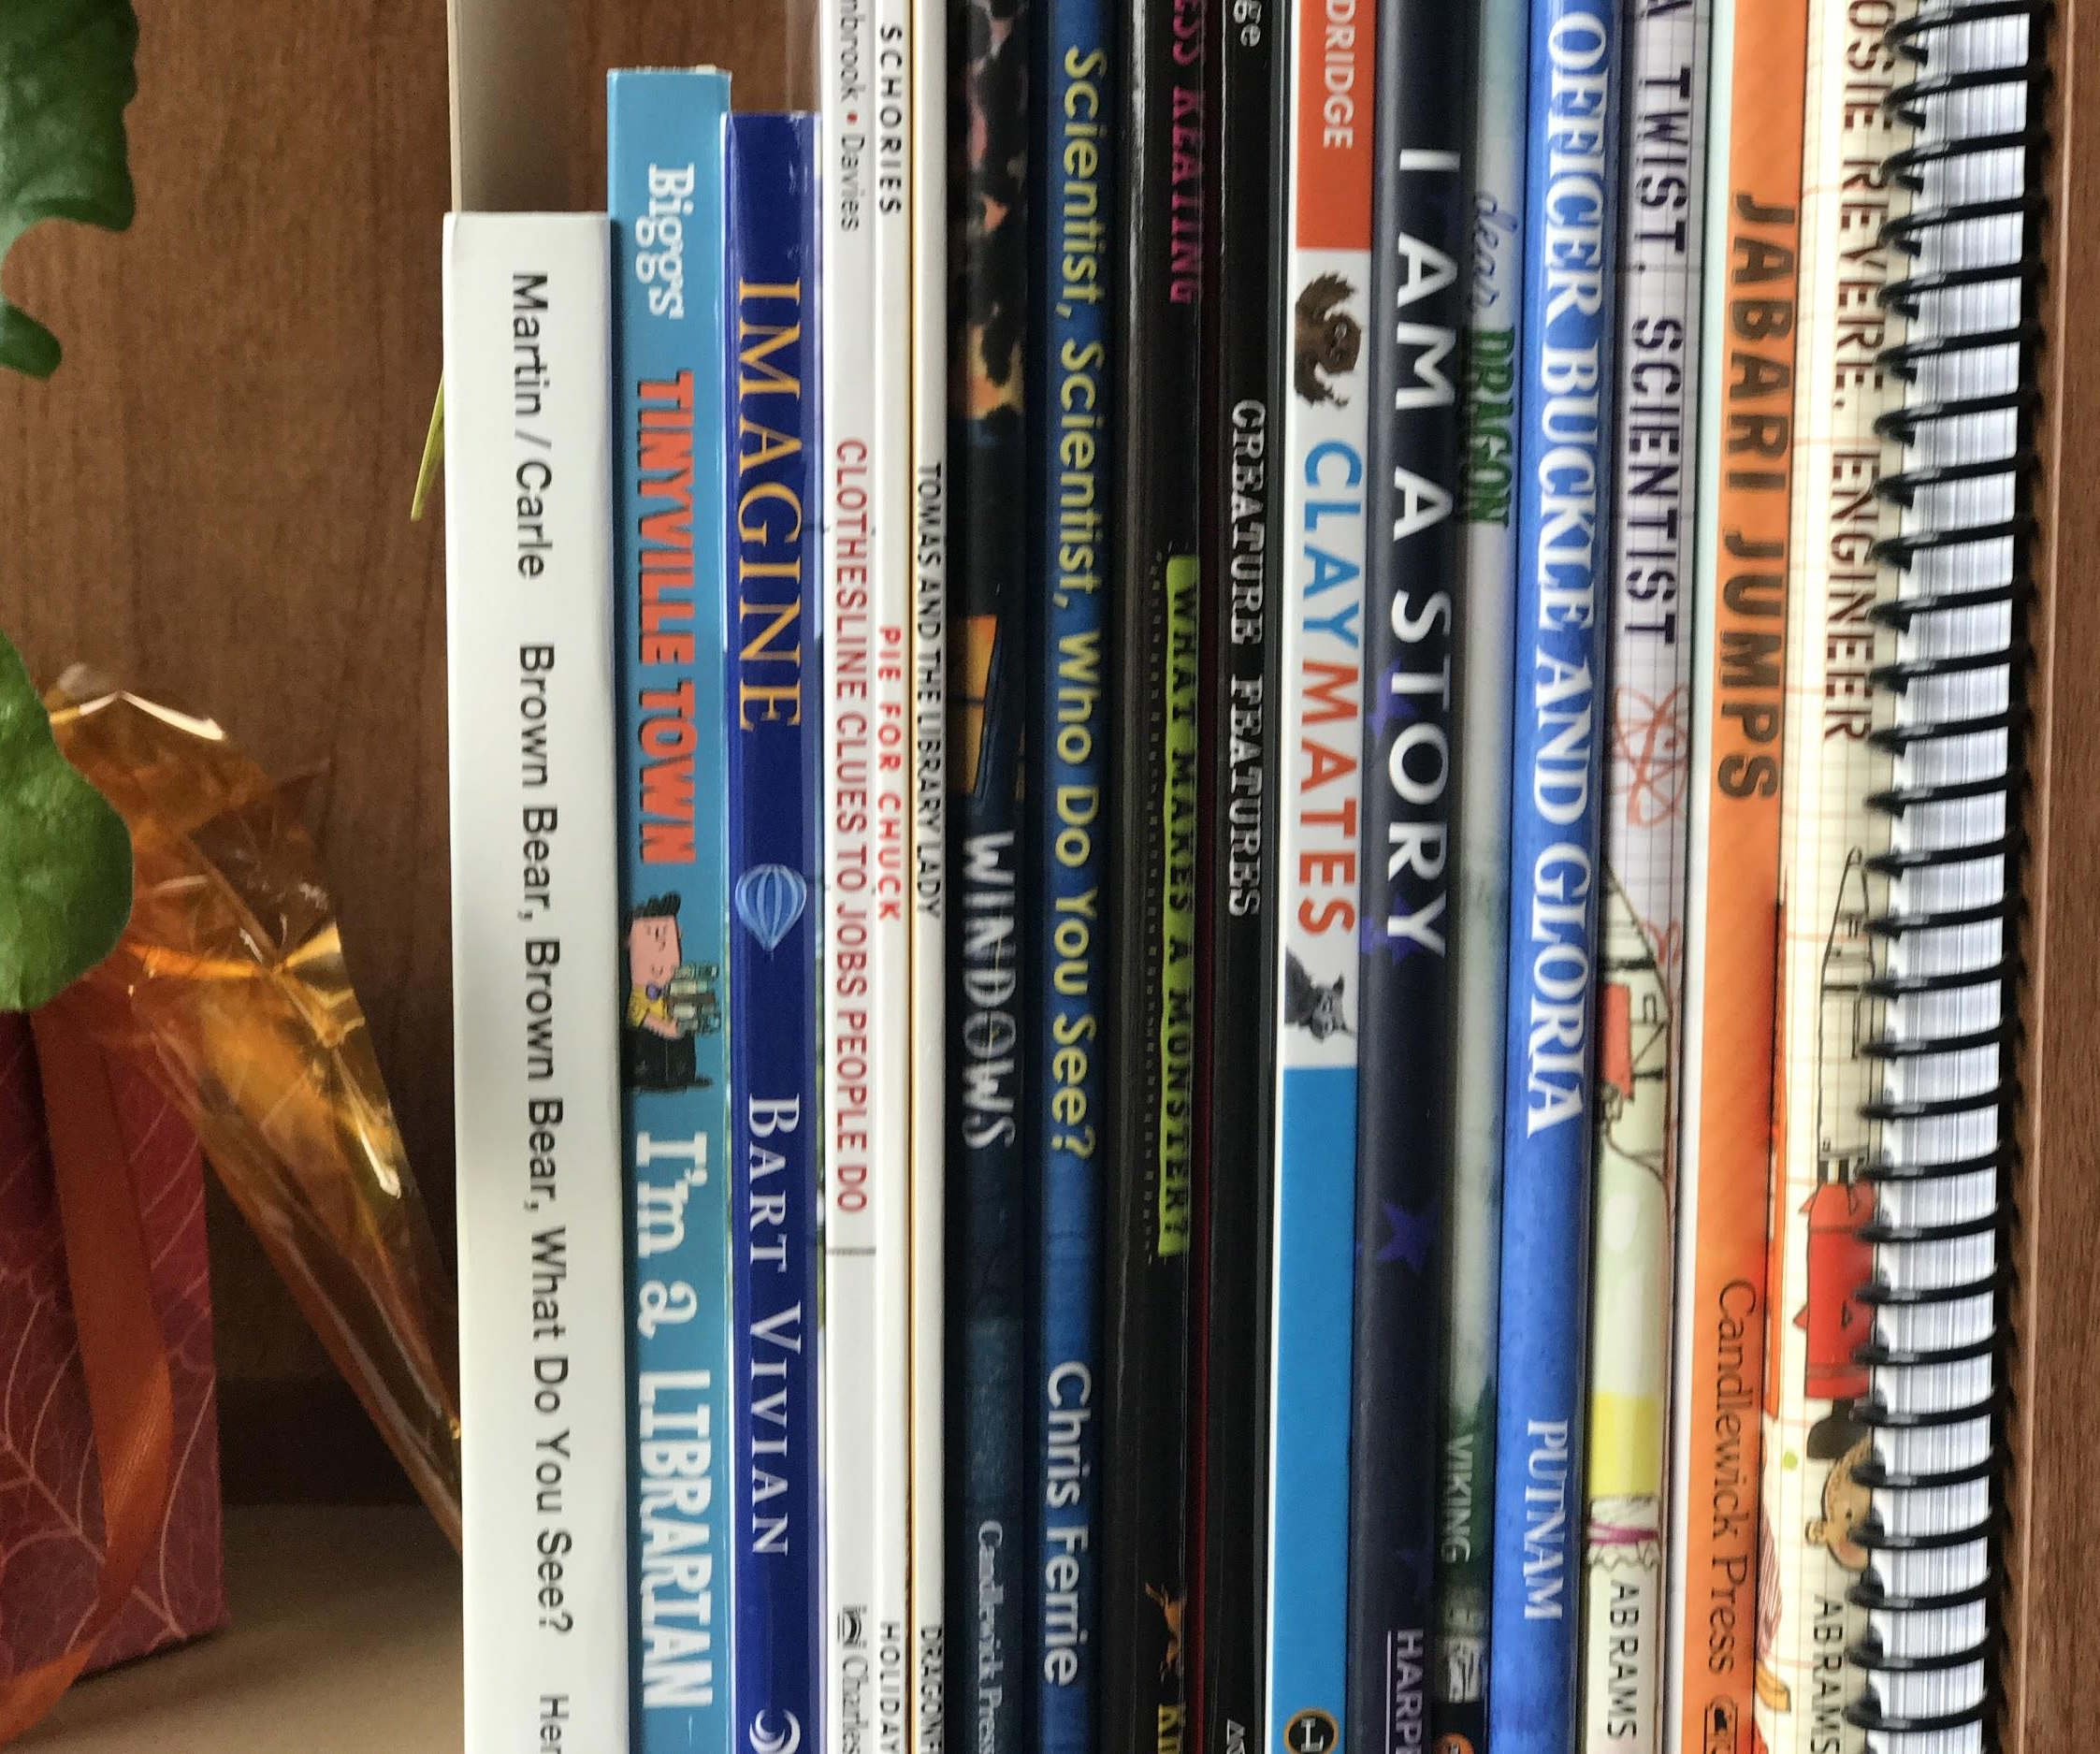
Students took home between 10-20 books each for their personal libraries, the majority of which were student choice, as well as other school supplies and materials from United WE READ.

Slide 16
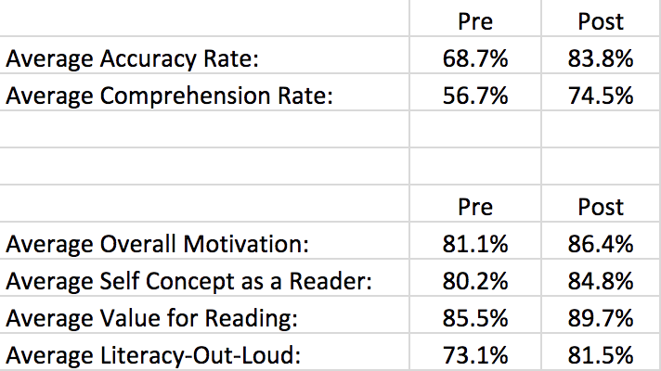
Student Improvement:
15%
18%
5%
5%
4%
8%

Slide 17
Student Improvement-Motivation Survey
What’s hard about reading?
PRE POST
When the pictures are wrong | Nothing!
I don’t want to! It’s hard! | Can’t tell the big words
I don’t know | Reading by myself
Taking care of the books and not ripping them | Sounding out the hard words
Still learning | nothing

Slide 18
Student Improvement-Motivation Survey
PRE PRE POST POST
What kind of books do you like to read? | What books do you want to read now? | What kind of books do you like to read? | What books do you want to read now?
Disney books | I Spy | Easy chapter books | Bigger chapter books
Cat In The Hat | Lego books | Lego books | Monster Truck books
Dr. Seuss | Dr. Seuss, LOTS | Sentence books, Descendants books | German Shepherd books
Nate the Great / Hop on Pop | New Nate the Great Books | Dr. Seuss | Magic Tree House
Disney books | Books about animals | Princess books | Bigger books

Slide 19
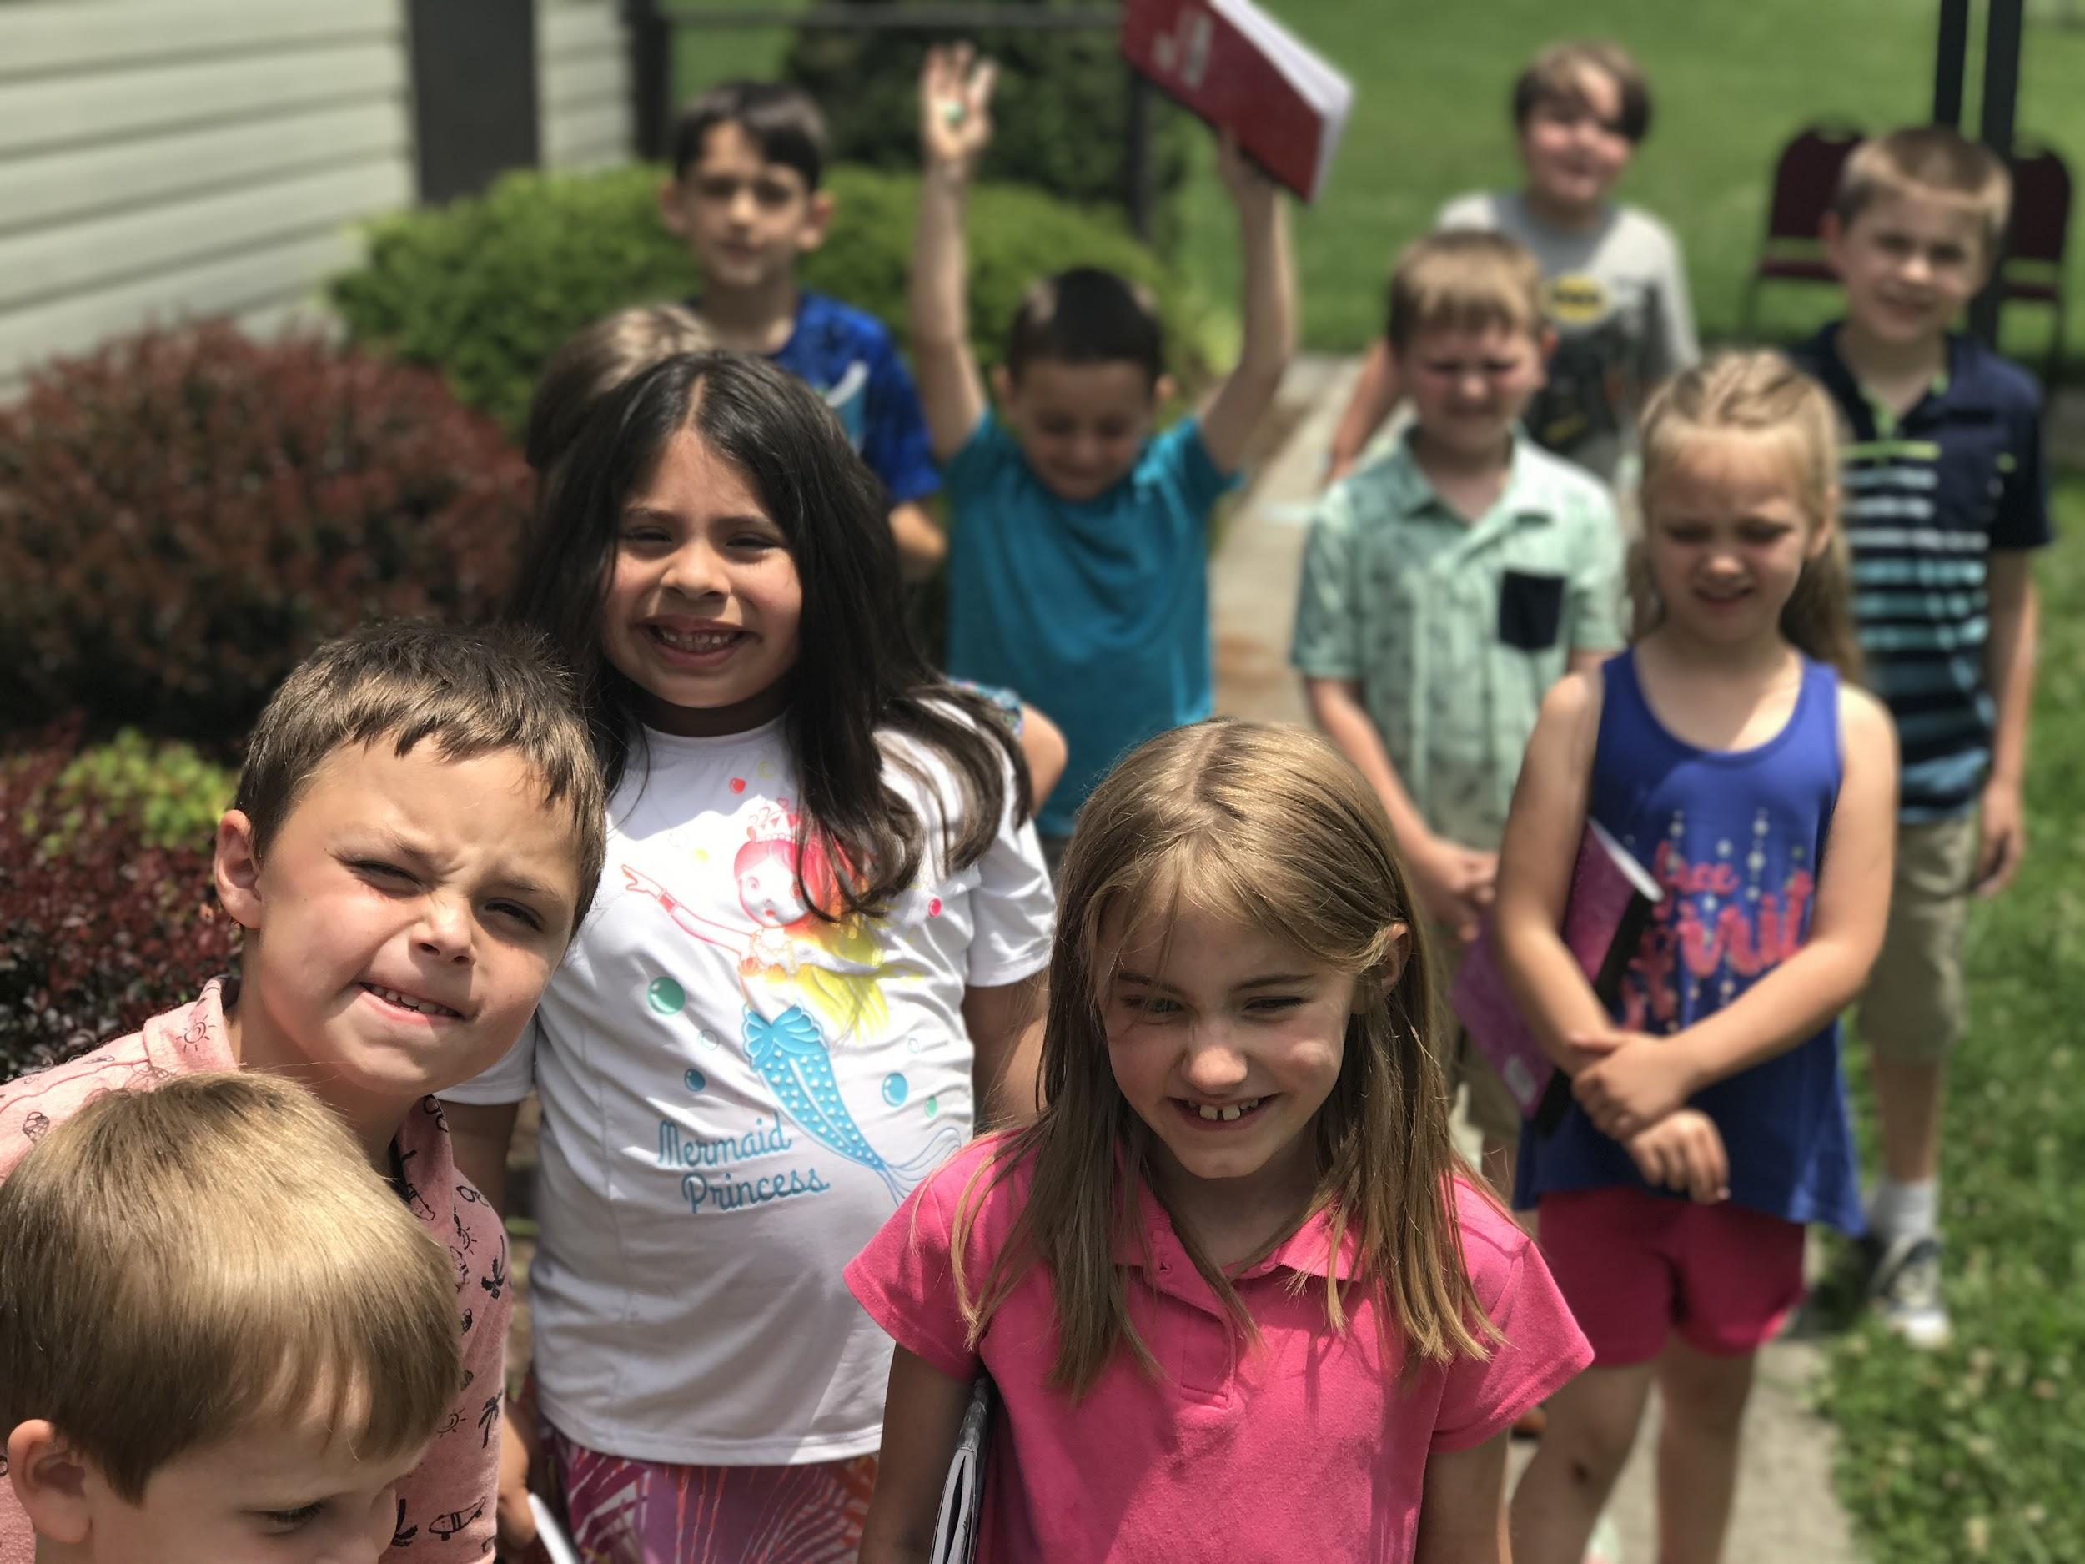
How could teachers help you become a better reader?
Read to us
Read with us
Give you free time to read
Teach sounds
Help us with words
By listening to me read
By giving you a book
Help us when we ask

Slide 20
Extra surprises & positives:
Teacher PD time - Read to Be Ready Training
Lunch provided by both church sites each day
Families eating lunch with students & teachers
Teacher overlap between sites
Collaboration & referrals with KCS
Benefit for families to have older students attend as well, and have care for ½ to full day, dependent on site
Returning teachers from UWR and KCS 2017 camps
All 7 teachers expressed interest to return in 2019!
Notes:
Teachers being allowed PD time to attend Read to Be Ready training was huge benefit to this year’s success.
Lunch provided by both church sites each day
Many families at Bloomingdale site began to eat lunch with their students as well, giving the teachers a chance to converse with them.
One teacher taught at 2 site locations: main BGC and Colonial Heights. Was great to have her perspective on both locations, and she enjoyed getting a “2nd run” on each day’s activities.
Collaboration with KCS to refer students back and forth to one another’s camps
Benefit for families to have older students attend as well, and have care for ½ to full day, dependent on site
One returning teacher from 2017 UWR and one returning teacher from 2017 KCS Read to Be Ready

Slide 21
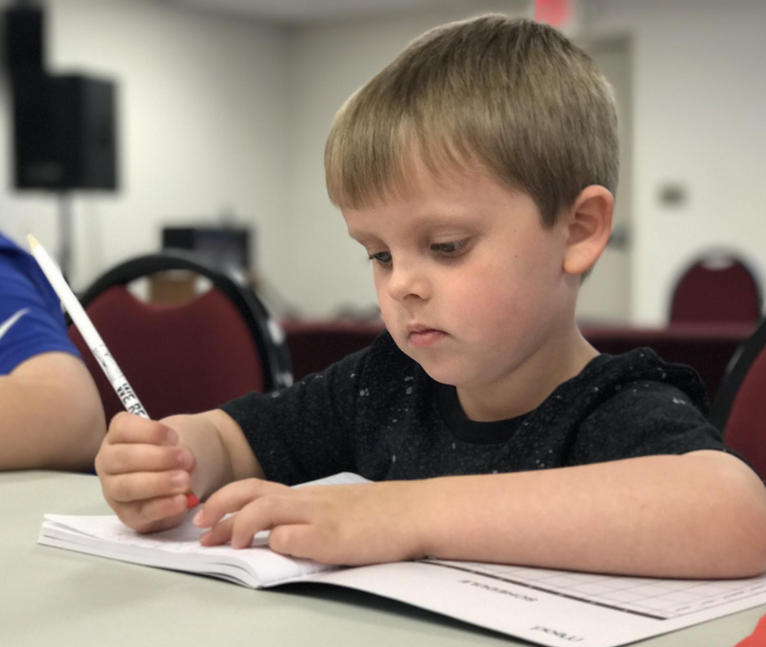
Our mission is to engage, empower, and equip all children, families, and the Greater Kingsport community with tools and strategies that build a literacy rich culture, and a pathway to lifelong success.
Leading to Read. Reading to Lead.

Slide 22
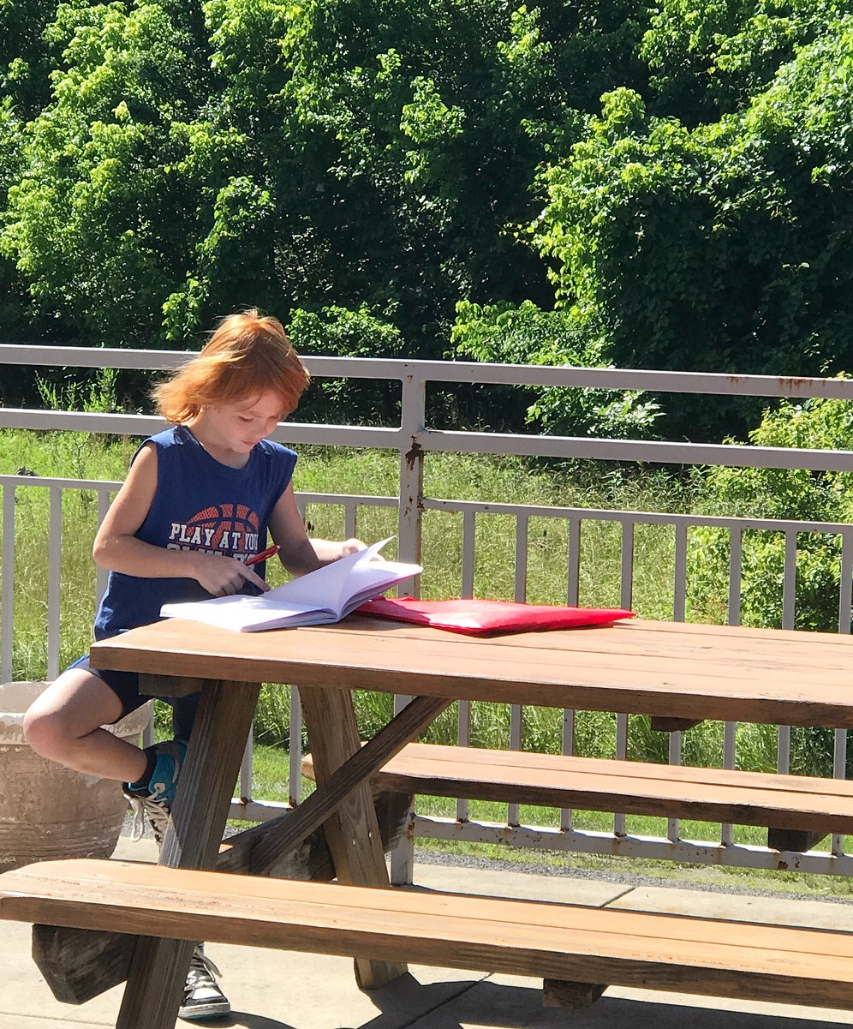
“Those are kids-most of [whom] wouldn’t have even seen a book, or been read to, or looked at a letter during those 4 weeks. The impact is huge.”
-2018 Read to Lead Teacher

