Slide 1

Learning Blade
2023

Slide 2
Data
Boys & Girls Club of the Hatchie River Region Classes Report
Start Date: 06/01/2023 End Date: 08/15/2023
Class Teacher –Stephanie Griggs
Number of Students -147
Number of Active Students-62
Number of Activities Completed -72
Time Spent in Activities(min) 1705.17
Participants ranged from grades (K-7th)

Slide 3
Obstacles
Tragedy
On March 31, 2023 our community was struck by a tornado. We lost two of our schools. We opened our Boys & Girls Club to the two schools that were destroyed.
Our staff and club members volunteered at our command center by packaging food for the victims.
Our internet was unstable. Our Learning Blade Pilot was pushed out to summer camp because of the lack of internet and the schools using our building.

Slide 4
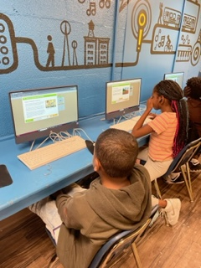
A new beginning with Learning Blade

Slide 5
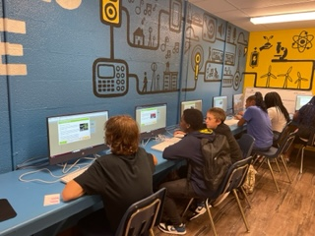
Club members enjoying Learning Blade

Slide 6
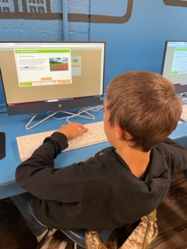
Learning Blade is fun

Slide 7
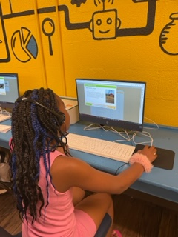
The Club members are engaged

Slide 8
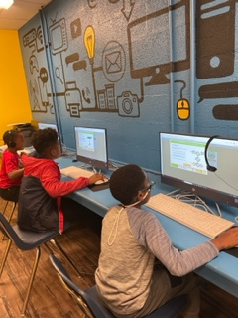
Learning Blade is fun

Slide 9
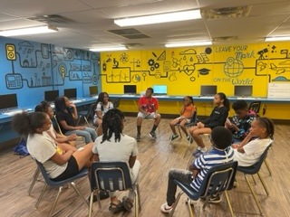
Discussion about Capstone Project

Slide 10
Capstone Project in the works……
The club members decided to plant a community garden! We had to find land for the club members to plant a garden.
Ed Doyle from Country Chevrolet notified us that he wanted to partner with us for a garden. We will have a 10X10 lot that the Learning Blade participants will be in charge of.
The ground breaking will be in March of 2024.
Stay tuned for pictures…………………………………..

