Slide 1
Replicable Service-Learning Strategies
Mary Graham
President and CEO, United Ways of Tennessee
Lead Staff, Tennessee Afterschool Network

Slide 2
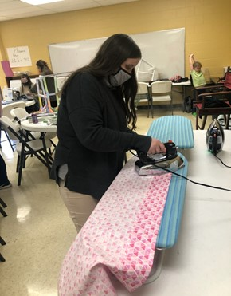
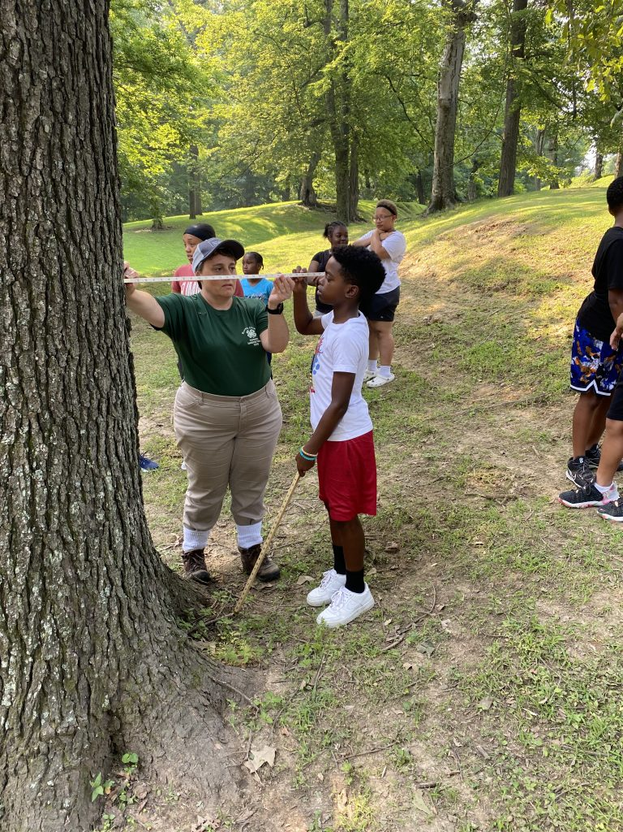
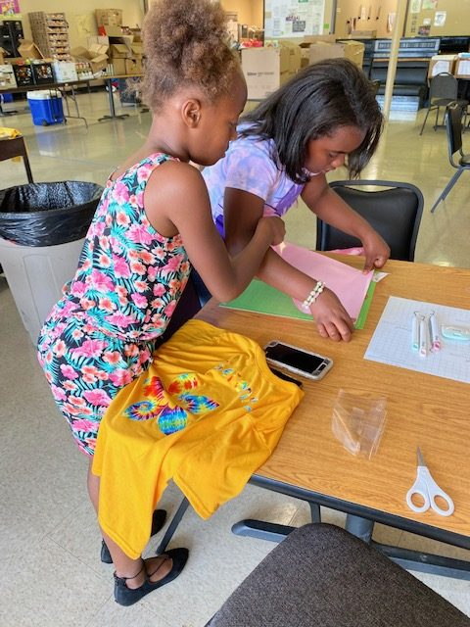
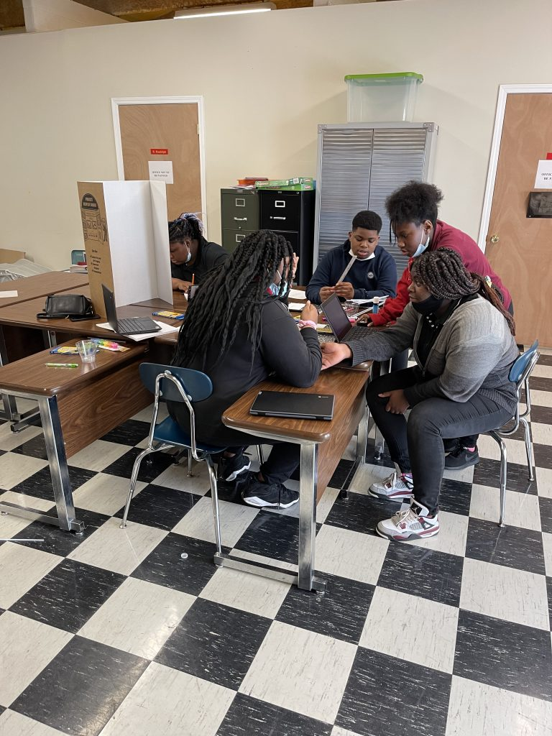
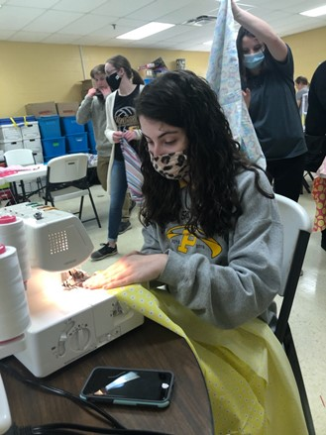
Afterschool Serves Tennessee

Slide 3
For more information or to join us
www.tnafterschool.org
Afterschool Serves TN - Tennessee Afterschool Network (tnafterschool.org)
Mary.graham@uwtn.org

Slide 4
Jennifer Gregory
State Manager

Slide 5
“Missions” involve a societal challenge that interests students
Mission Challenge Career Clusters
12
Car Manufacturing | Use modern manufacturing techniques to design and build a new concept car | Advanced Manufacturing
Dolphin Rescue | Help rescue rehabilitate an injured dolphin, including creating an artificial prosthetic tail | Biomedicine, Marine Science
Energy Sources | Evaluate alternative or upgraded energy sources for a city that currently has an old coal-fired power plant | Energy Production, Environment
Entrepreneurship | Set up a new business with a focus on entrepreneurship | Finance, Business
Flu Outbreak | How health and IT professionals can use data warehousing and analysis to predict flu outbreaks using GIS and social media data | Information Technology
Fresh Food | Consider methods to increase production of local foods in a community | Agriculture
Hack Attack | Learn about methods to create and protect website, apps and social media after a school’s website and media are hacked | Computer Science
Haiti Orphanage | Design and build an environmentally-sound orphanage for children left homeless by an earthquake in Haiti | Construction, Sustainability
Heart Surgery | Conduct heart surgery and therapy for a child with a heart defect; evaluate the use of artificial hearts or heart components | Medicine
Lightweight Aircraft | Design a lightweight and easily maintained aircraft for distant missions | Lightweight Metals Manufacturing
Rescue Robots | Explore technology used for robotics design, such as sensors, electrical circuits, industrial design and computers | Electronics, Computer Science
Transportation Congestion | Evaluate new transportation methods for a city that has a traffic congestion problem | Transportation
“Missions” that engage all students
Notes:
Which ones are jumping out to you?

Slide 6
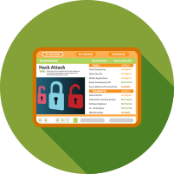
Each Mission includes an interactive toolbox of lessons and activities.
Interactive online lessons, ready-to-use lesson plans and activities for middle and high school students. Can be used by any teacher, anywhere. Validated and proven to increase STEM/CS/CTE career interest.
Interactive Lessons
Hands-On Projects
Design Thinking
Parent Discussions
Over 400 online lessons tied to academic standards
Mission challenges are project-based lessons using common materials
Solve complex problems with the 5-step creative thinking process
Handouts and easy experiments for at-home discussions
Career Videos
3D Printing Activities
Intro to Coding
Papercraft Figures
Introduce over 50 careers with real-life people
Create objects that demonstrate science principles
20-hour middle school course providing robust coding experiences
Students make origami-type figures of 100 careers and technologies

Slide 7
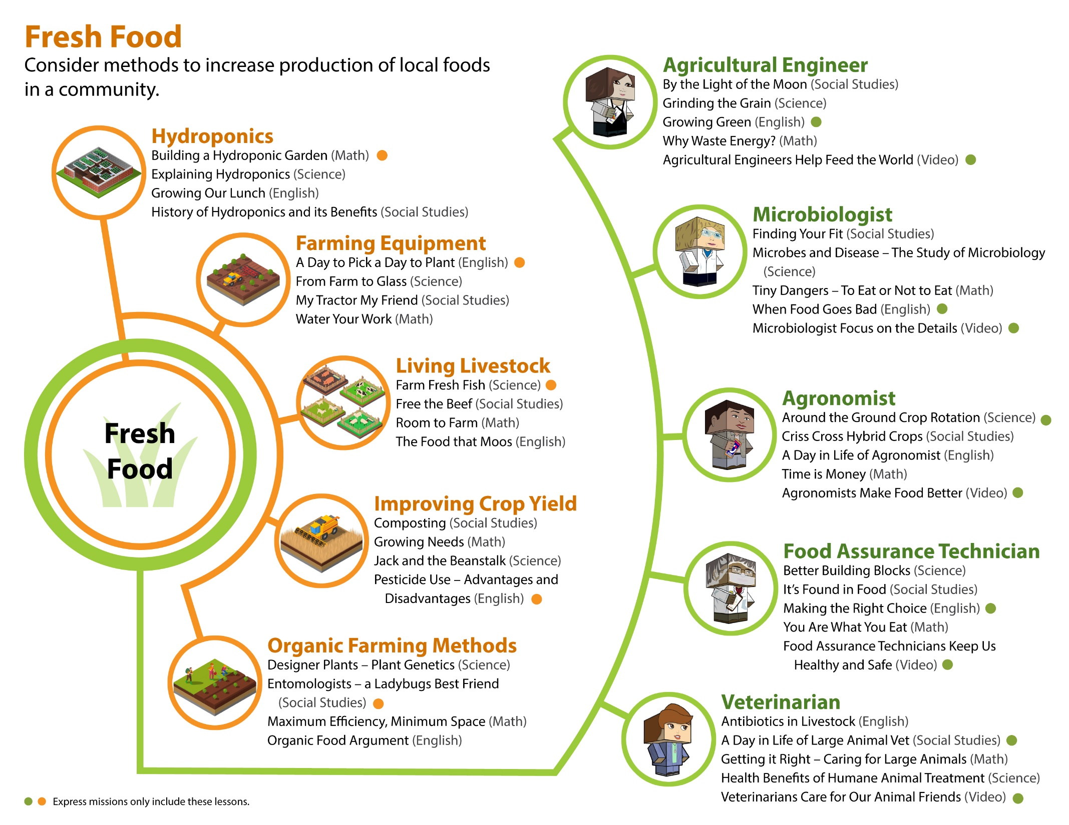

Slide 8
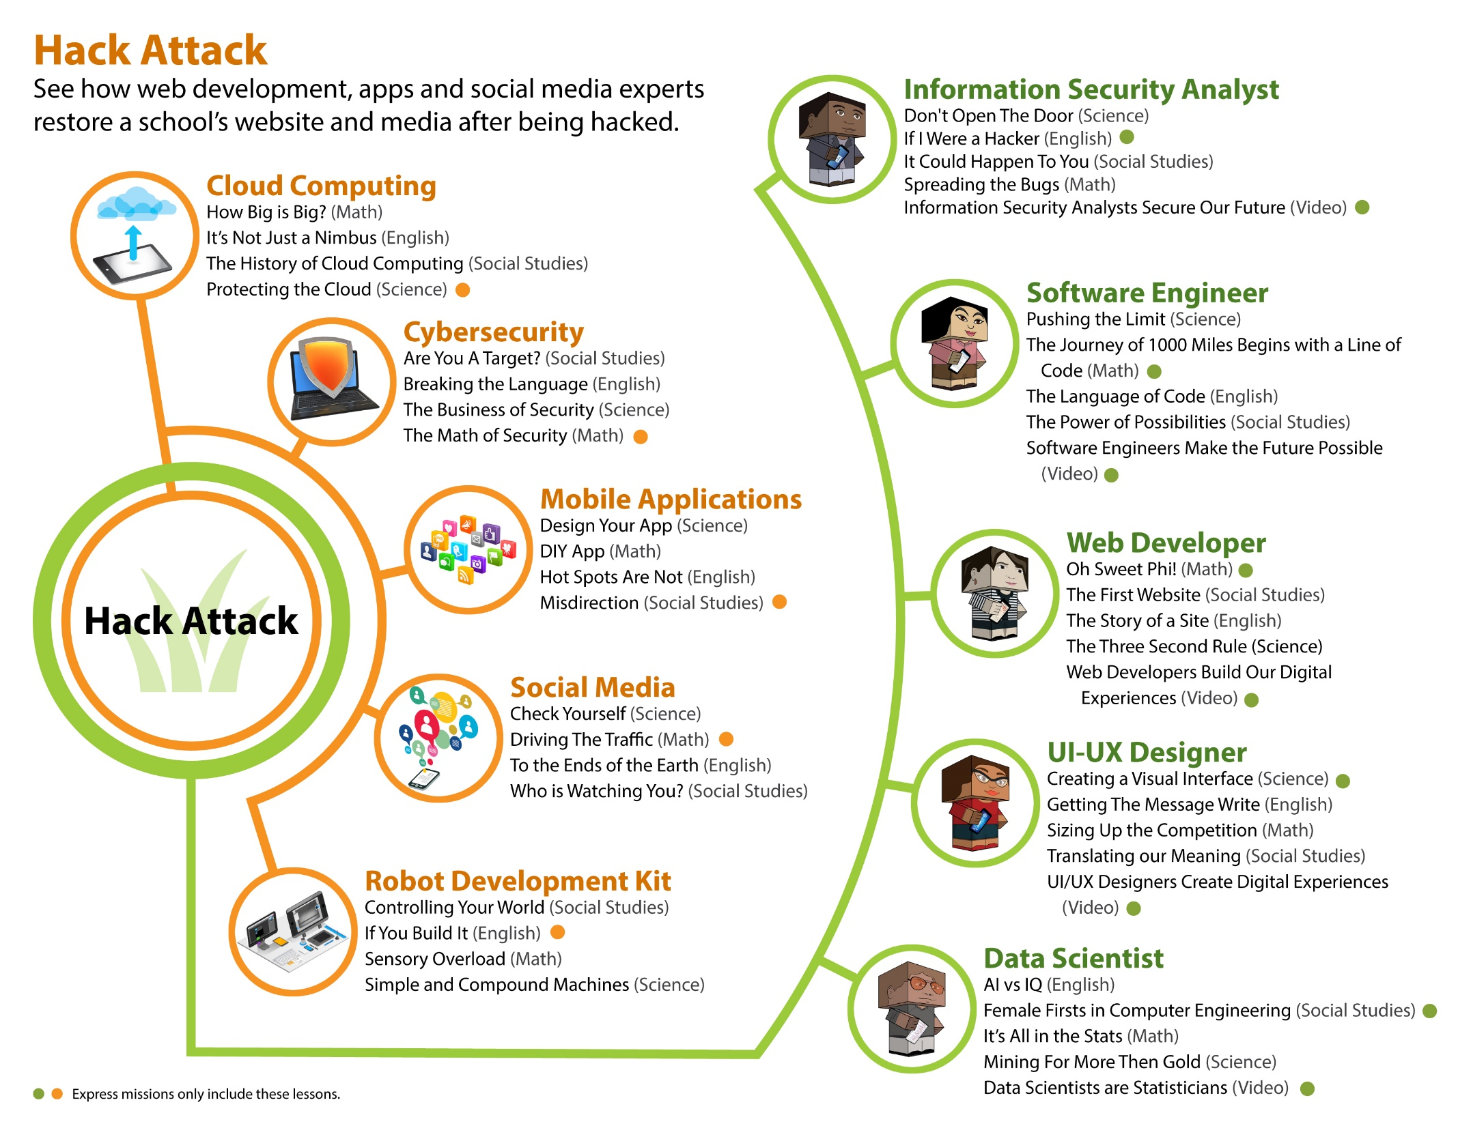

Slide 9
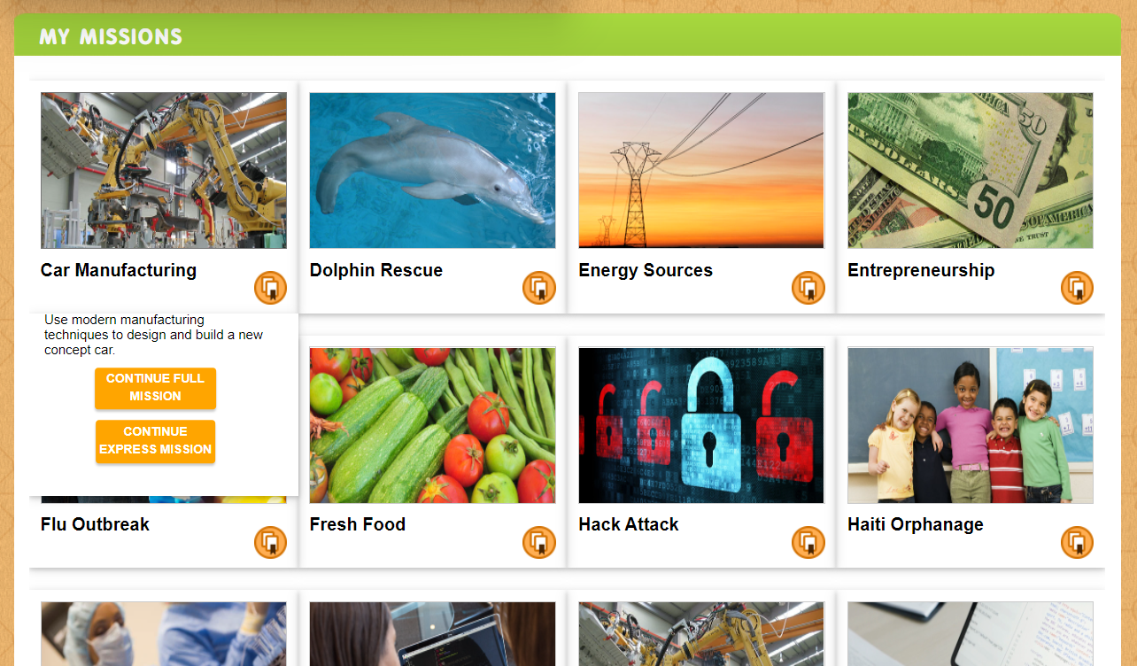
Students Can select a Mission, or teachers can assign specific Missions.

Slide 10
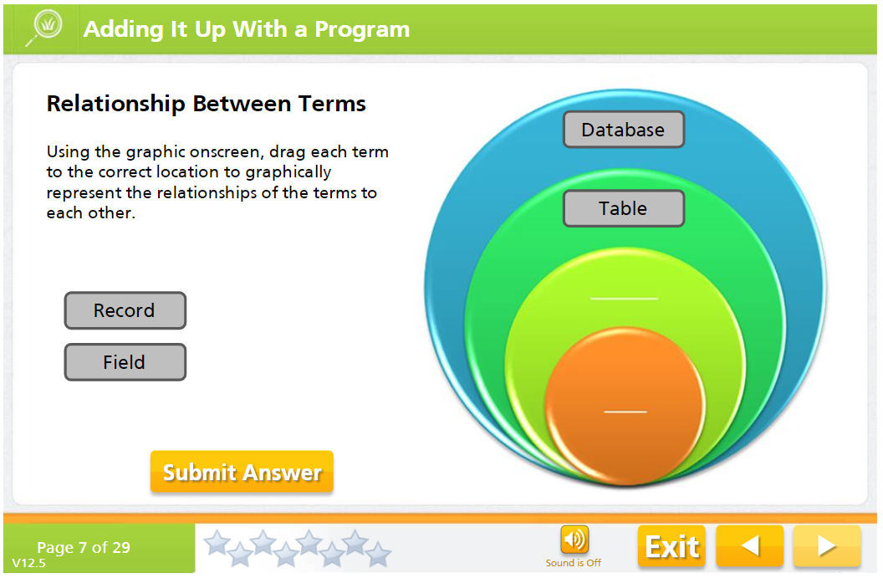
LB interactive lessons introduce careers while reviewing academics.

Slide 11
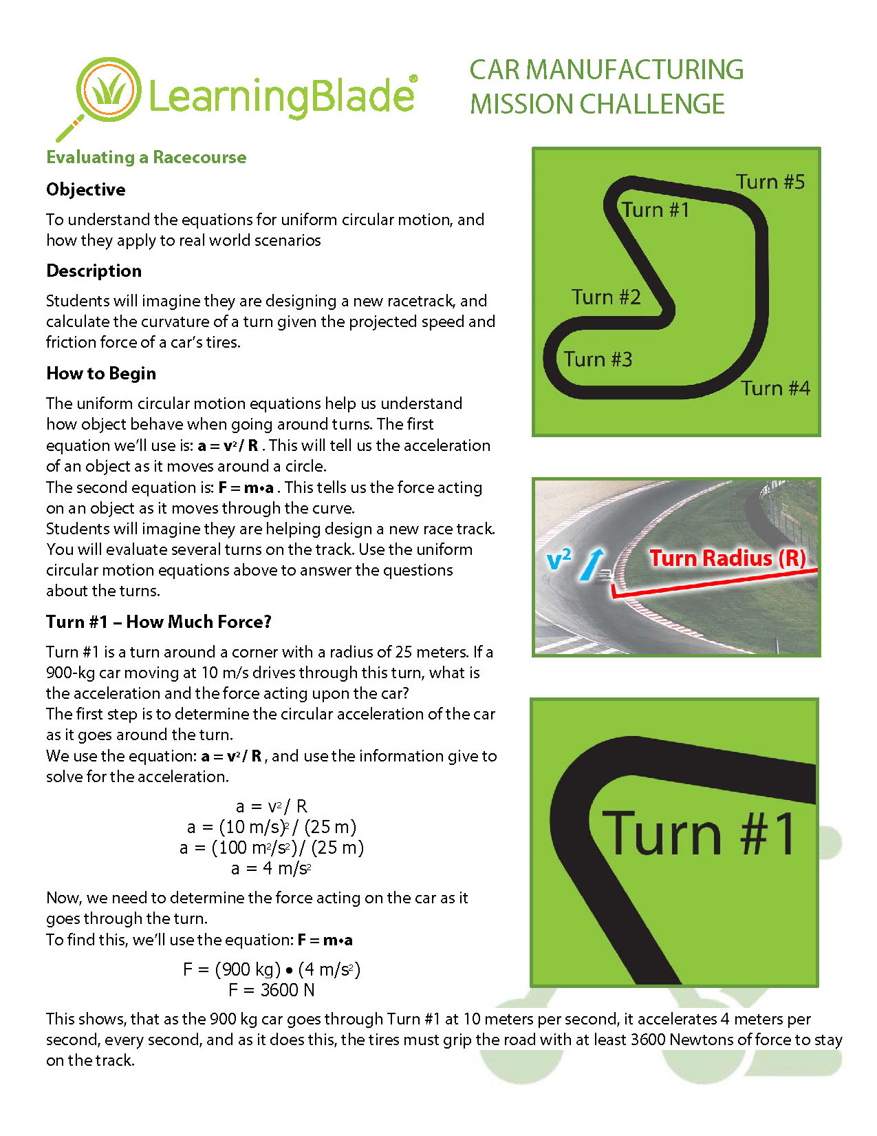
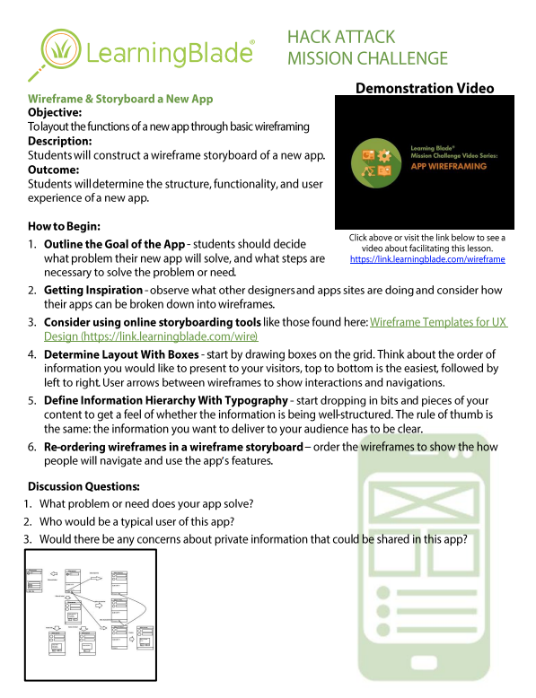
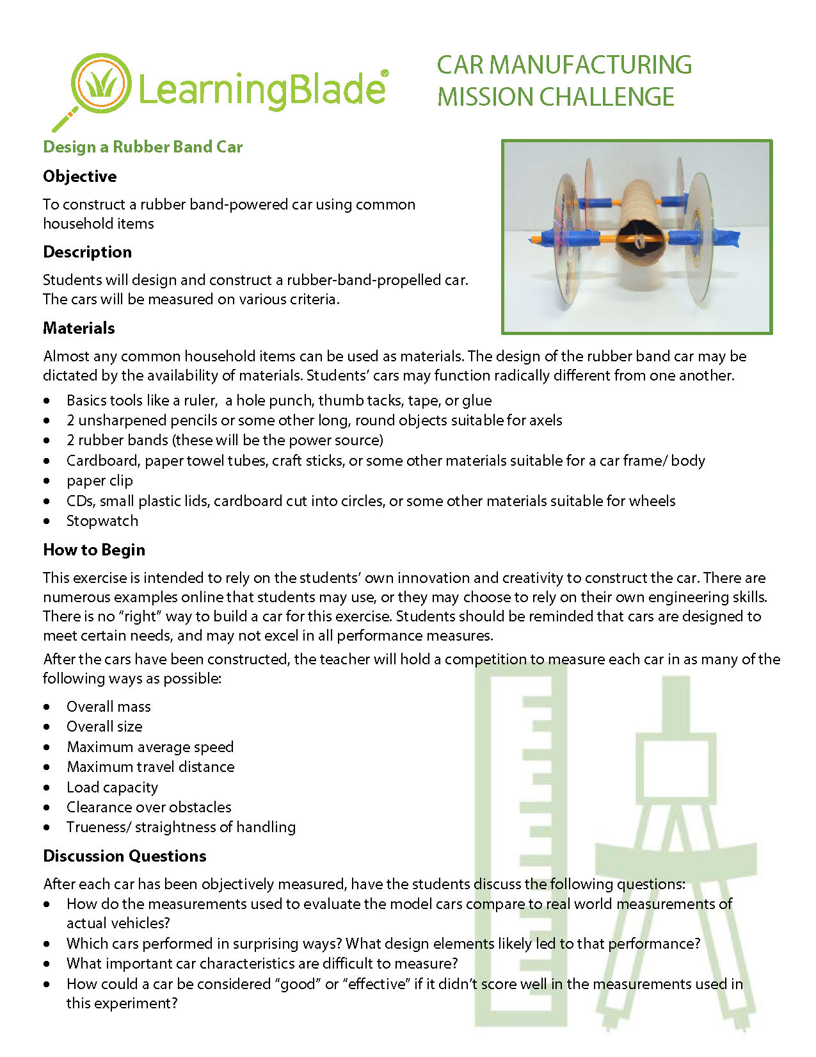
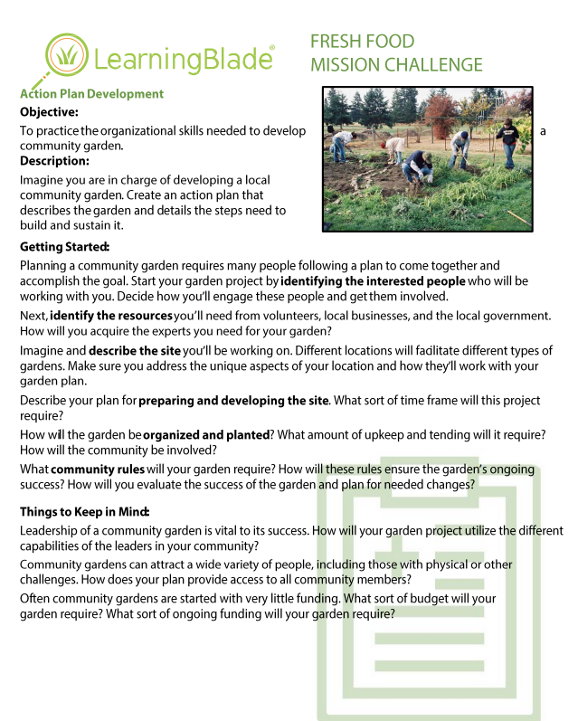
Mission Challenges include experiments, projects and presentations.
Mission Challenges
Each lesson includes:
Writing prompt
Presentation prompt
Manipulatives using common household or classroom materials
11

Slide 12
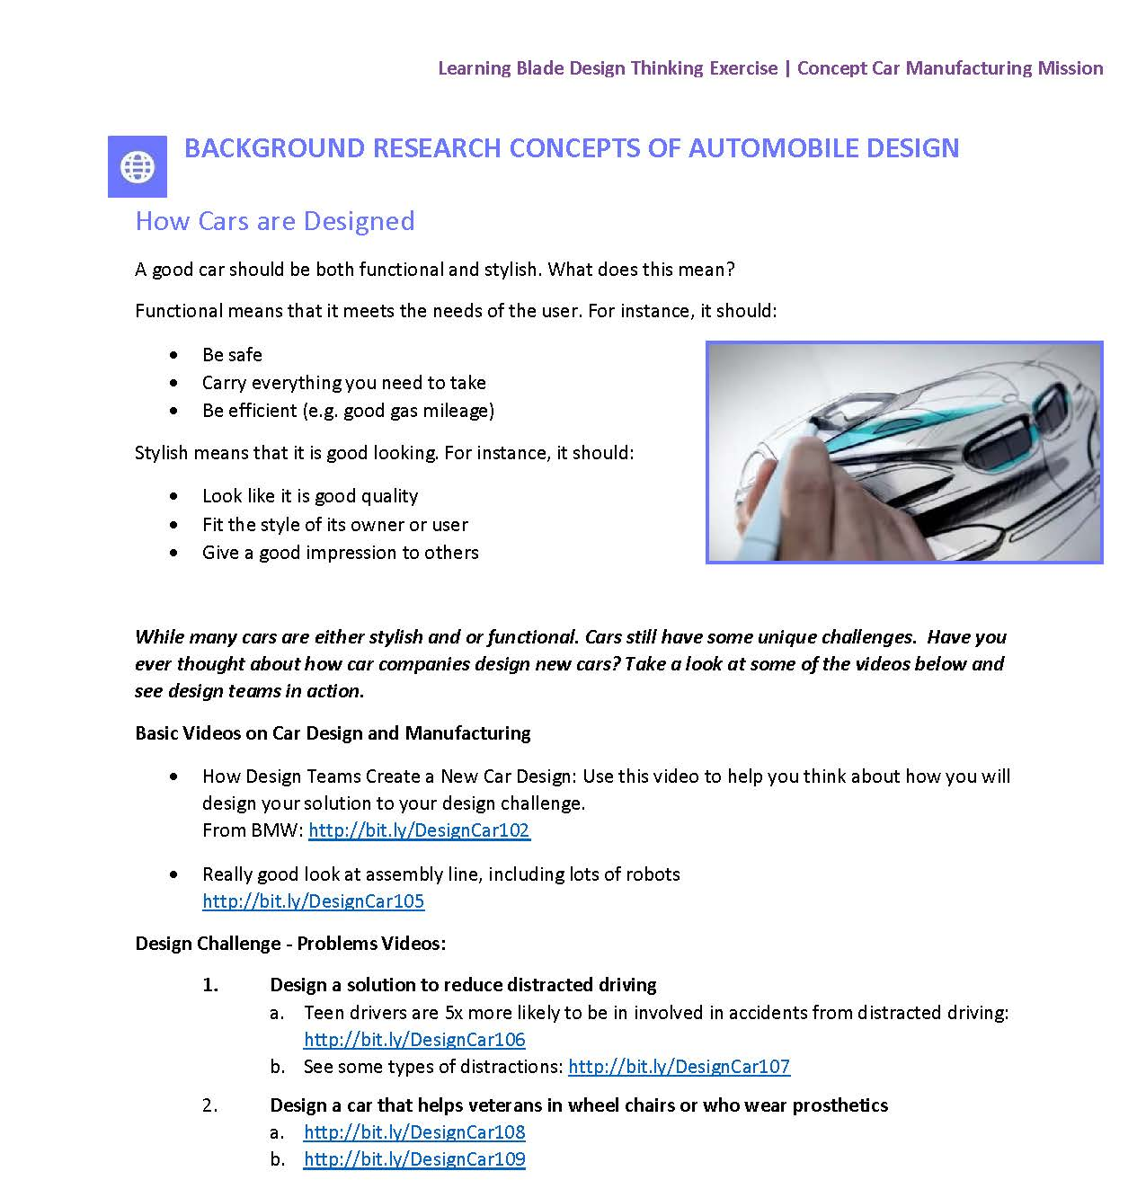
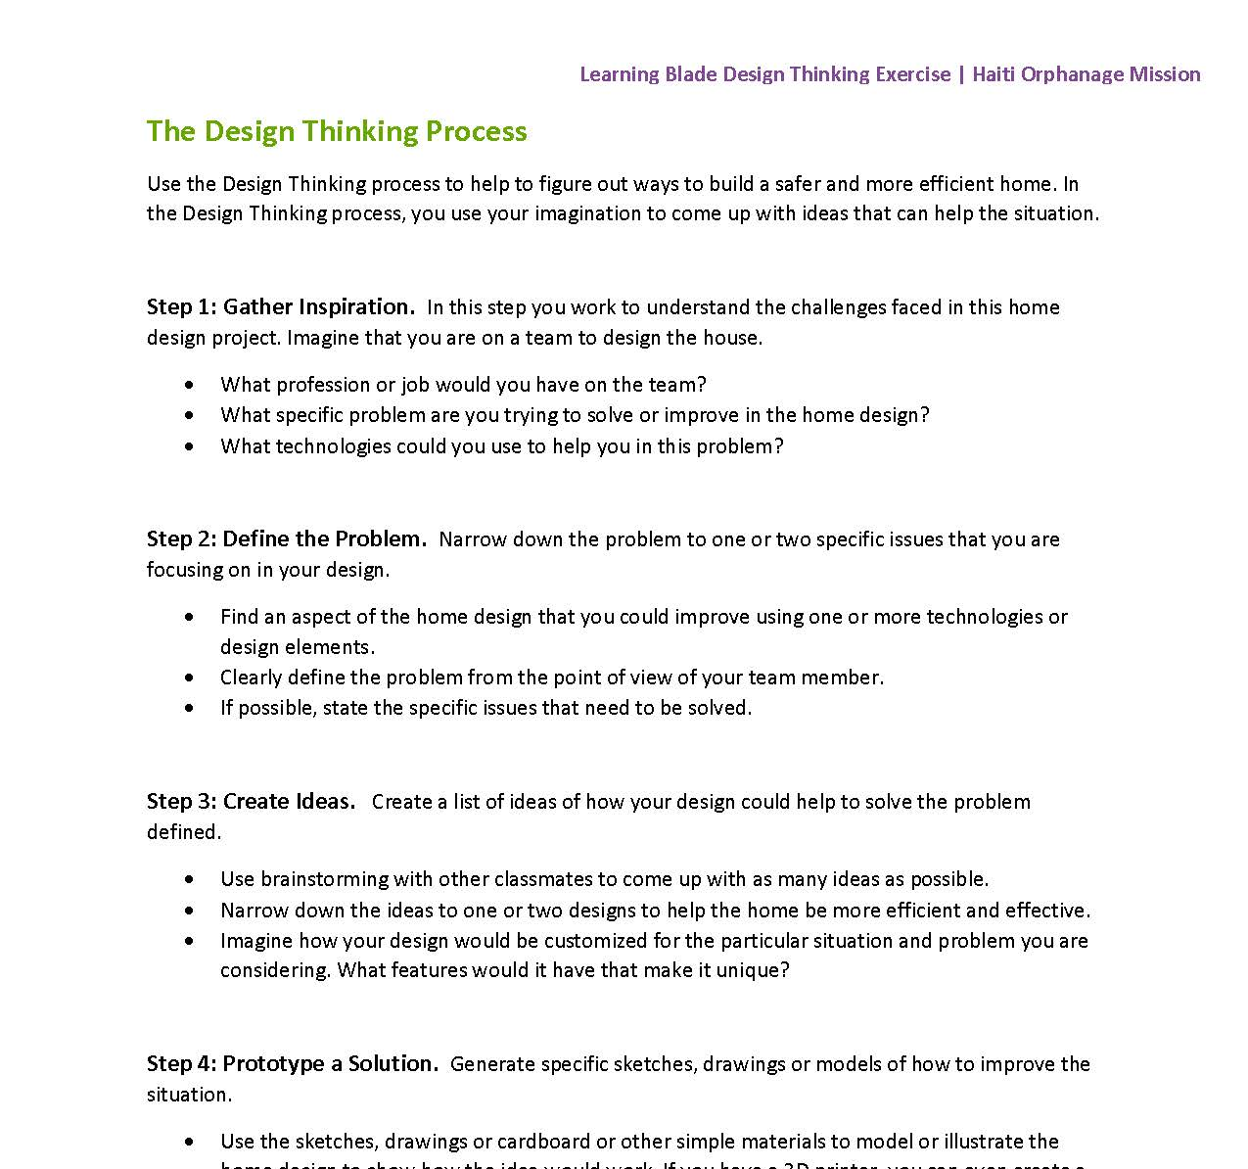
Design Thinking lessons let students create a solution to the Mission.
Design Thinking
New Design Thinking lessons encourage students to explore their own solutions to the problems related to each the mission, and to present their ideas in front of other students.
Each lesson includes:
Background research information
Suggestions for problem statements
Five-step design thinking process guides
Standards alignment
Teacher rubric
12

Slide 13
Multiple Statewide and District Implementations
Arkansas
Arkansas Department of Education, & The Arkansas Public School Resource Center
Missouri
Missouri Department of Elementary & Secondary Education (DESI)
South Carolina
South Carolina Department of Education, Office of Career & Technical Education
Louisiana
Louisiana Department of Education
Alabama
Department of Education Office of Career & Technical Education & Alabama Works
Idaho
Idaho STEM Action Center
Mississippi
University of Southern Mississippi, Mississippi Department of Education
Arizona
Office of the Governor Doug Duvey, AZonTrack, & Generation Schools Network
Tennessee
Tennessee Chamber of Commerce
New Hampshire
New Hampshire Department of Education
Also, Multiple Districts/Schools in:
Florida, Georgia, Kentucky, Maryland, North Carolina, Ohio

Slide 14
Sign up for your free account at:
www.LearningBlade.com/STATES
For more information, email us at:
info@LearningBlade.com

Slide 15
Service Learning
SHADES of Development
Sindy Dawkins-Schade
President/Executive Director

Slide 16
Community Service
Service Learning
One and done - usually a one time event where the project is completed in one day
Youth may select the project, vote on it and adults support and guide them
Often done in partnership with other community organizations, such as a food bank or Parks and Recreation
Impact is measured in terms of pounds of food collected, or bags of trash collected
Appropriate for younger youth still developing critical thinking, decision-making, and leadership skills
Long term project, often completed over the course of several months or years
Youth identify an issue they what to address, study that issue, and brainstorm solution to solve the issue
Youth investigate, research and vote on the best solution and devise a plan of action. Often this includes developing a proposal for county government, or other community organizations
Adults guide and support youth as they implement the solution
Impact is usually measured in terms of attitude or behavior change or economic value
Appropriate for older youth ready to take on more responsibility
VS

Slide 17
Both community service and service learning are important for young people. Using the service learning model even with younger youth participating in traditional community service projects sets the stage for service minded growth.
Why it matters?
Young people are uniquely suited to solve problems through service
High quality service learning leads to increased academic engagement and success
Volunteering improves career and workforce readiness
People who volunteer when they are young donate more to philanthropic causes when they are older. (They are also more likely to volunteer and to vote as adults)

Slide 18
K-12 Service Learning Quality Standards
NYLC K-12
Progress Monitoring
Service-learning engages participants in an ongoing process to assess the quality of implementation and progress toward meeting specified goals, and uses results for improvement and sustainability
Meaningful Service
Service-learning actively engages participants in meaningful and personally relevant service activities.
Link to Curriculum
Service-learning is intentionally used as an instructional strategy to meet learning goals and/or content standards.
Reflection
Service-learning incorporates multiple challenging reflection activities that are ongoing and that prompt deep thinking and analysis about oneself and one’s relationship to society
Duration and Intensity
Service-learning has sufficient duration and intensity to address community needs and meet specified outcomes.
Youth Voice
Service-learning provides youth with a strong voice in planning, implementing, and evaluating service-learning experiences with guidance from adults.
Diversity
Service-learning promotes understanding of diversity and mutual respect among all participants.
Partnerships
Service-learning partnerships are collaborative, mutually beneficial, and address community needs.

Slide 19
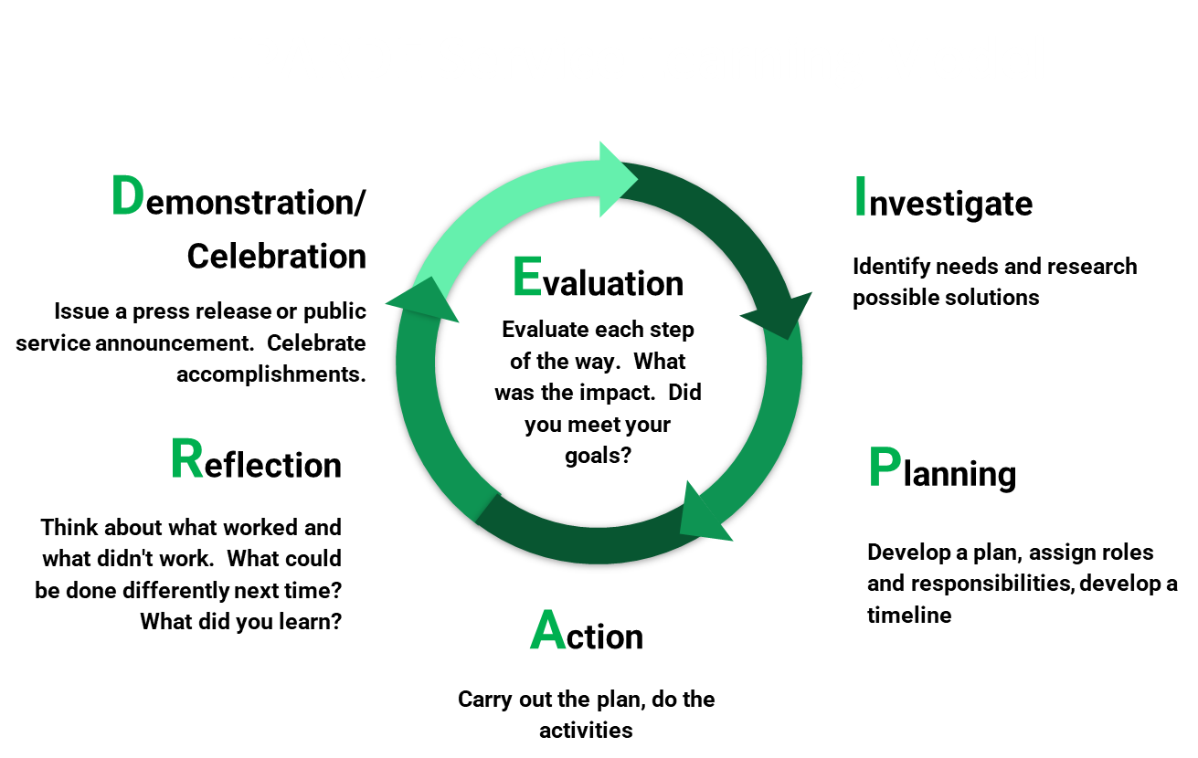
IPARDE Service Learning Model

Slide 20
Types of Service
Direct Service
Indirect Service
Advocacy
Research
Direct Service is service that directly affects the people, animals or parks we want to impact. This may include volunteering or cleaning up a park.
Indirect Service might take the form of fundraising or collections. It is the type of service in which you are not in the presence of the person or thing you are impacting.
Advocacy is speaking up for or against an issue or solution. When we use our voices, we are being advocates.
Research involves finding out new information that informs or demands action. For example, collecting scientific data or surveying a group.

Slide 21
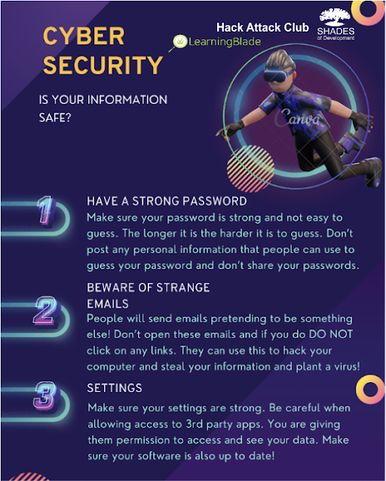
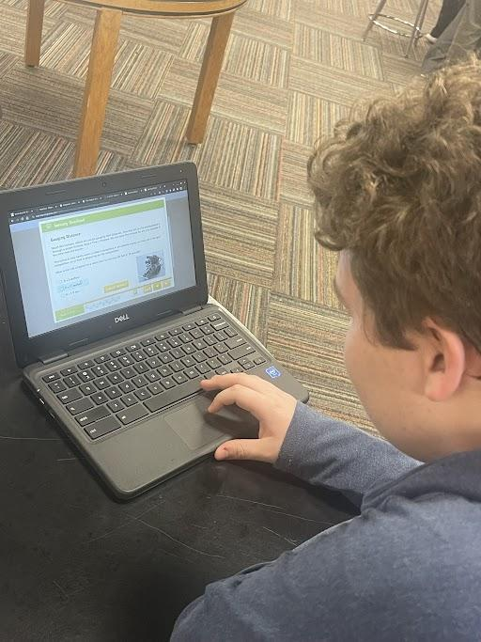
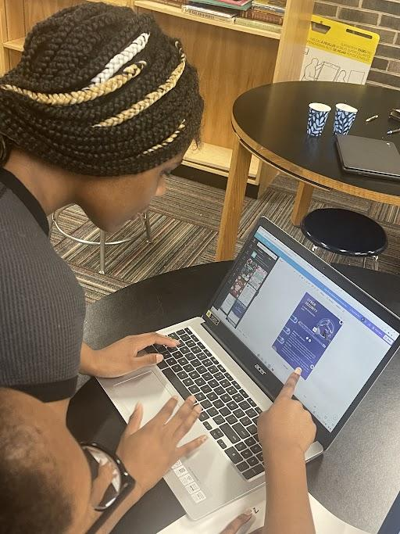
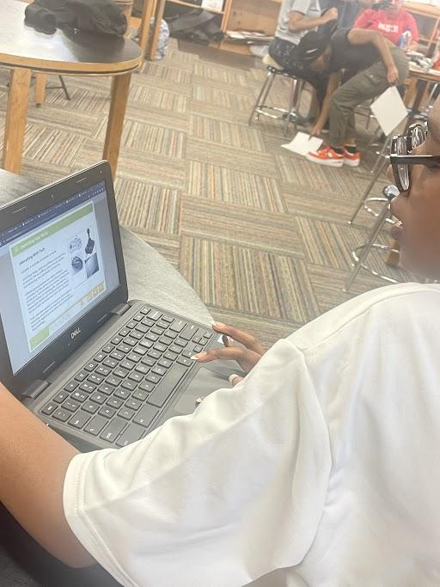
Learning Blade Service Learning Project
South Doyle SHADES students learned about Cyber Security information provided by Learning Blade.

Slide 22
Youth Voice Community Wide Service Learning
A year in the making with United Way, KAAN, TAN, Youth Service America, and OST Programs

Slide 23
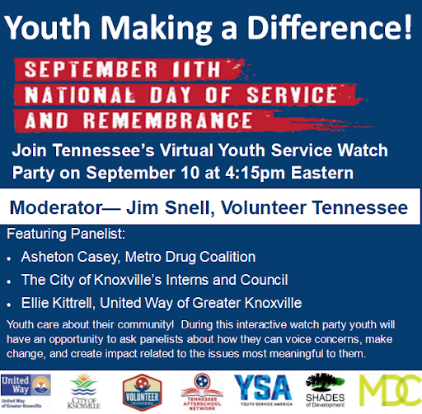
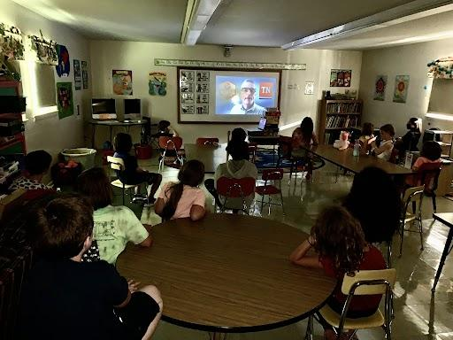
Youth Service Kickoff Watch Party

Slide 24
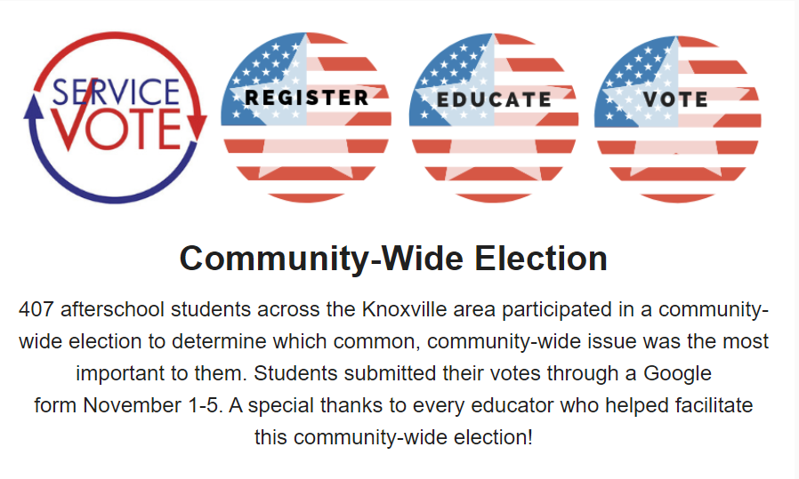
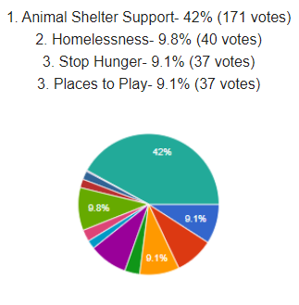
Youth Service Vote
And the winner is… Animal Shelter Support

Slide 25
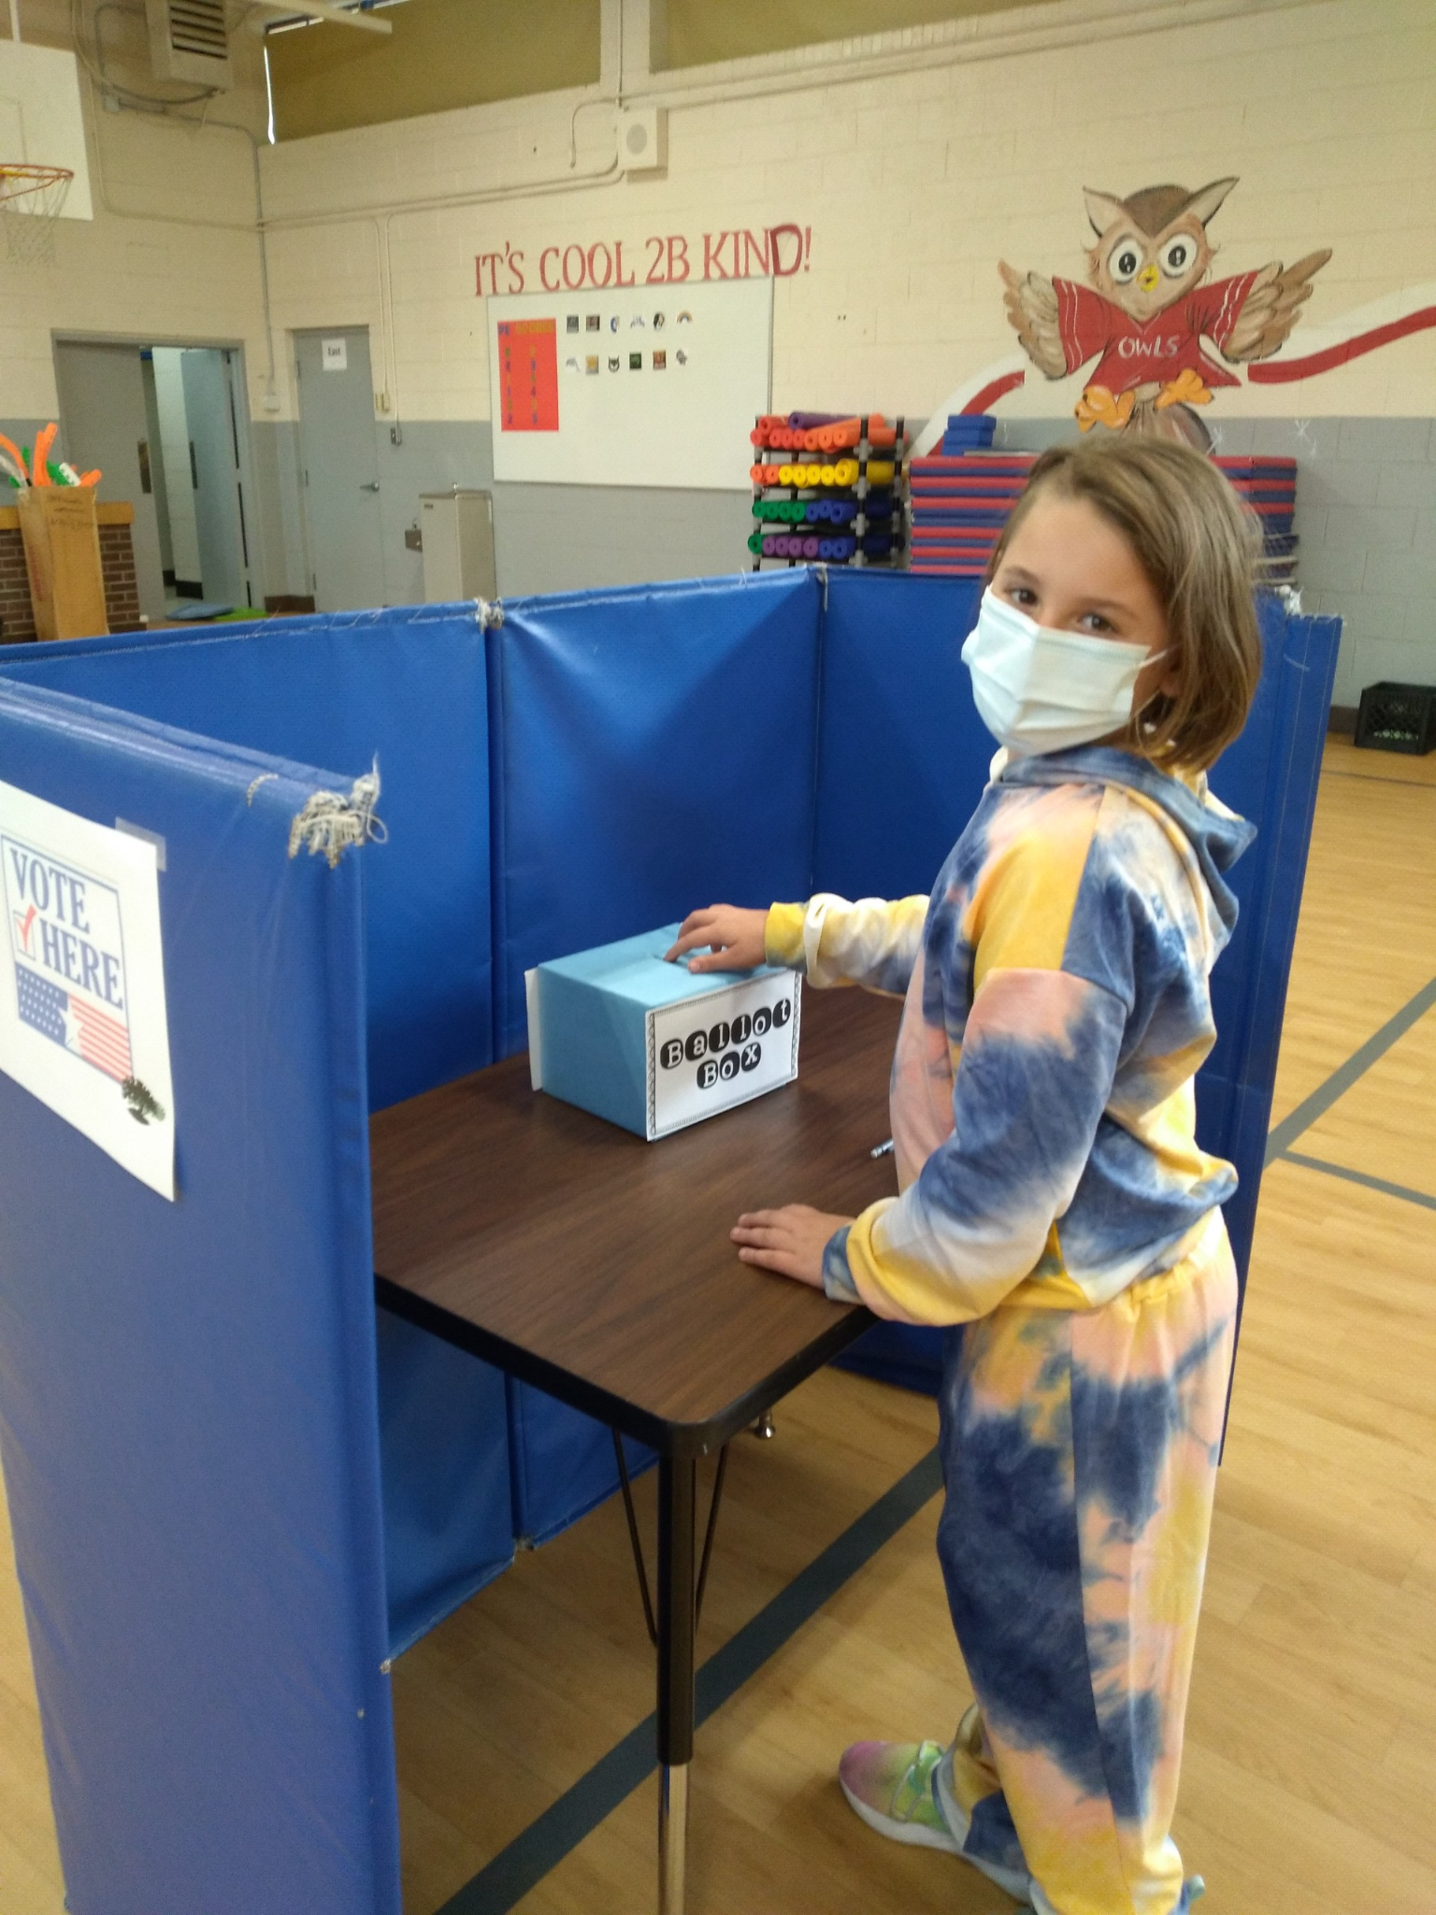
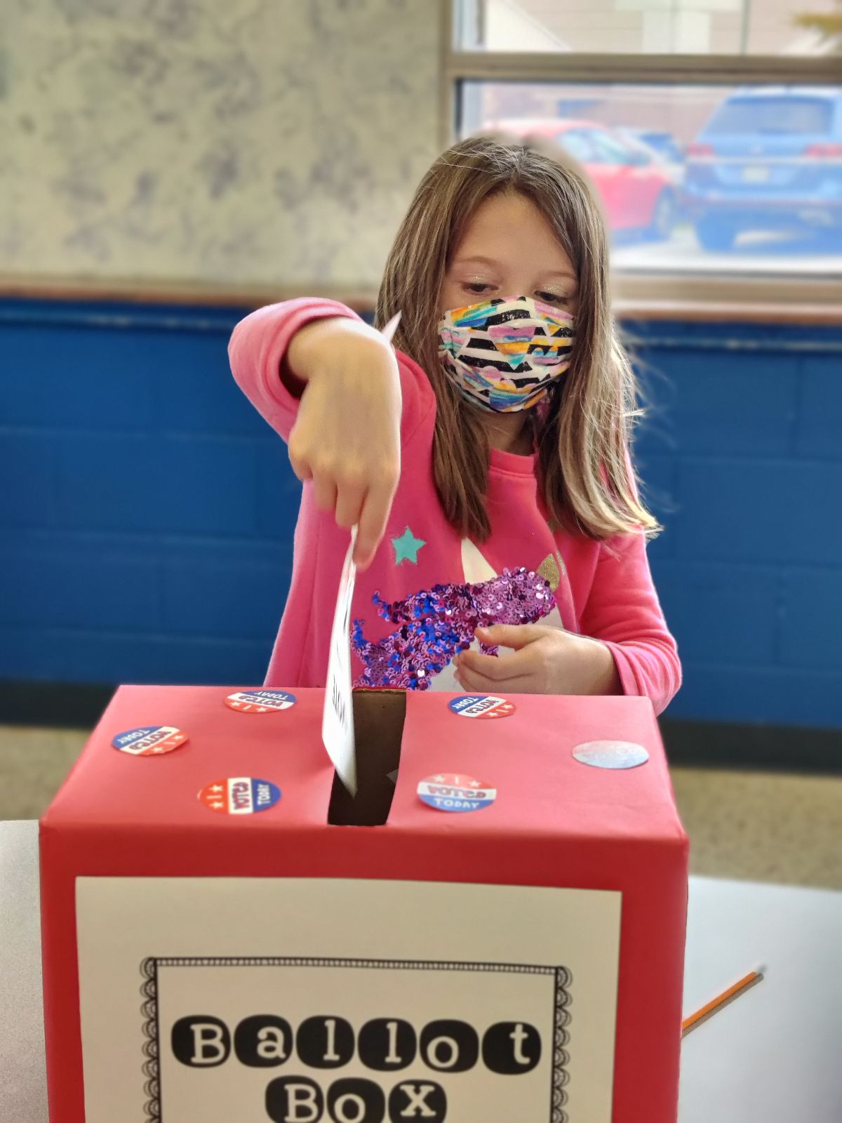
Youth Vote in Action

Slide 26
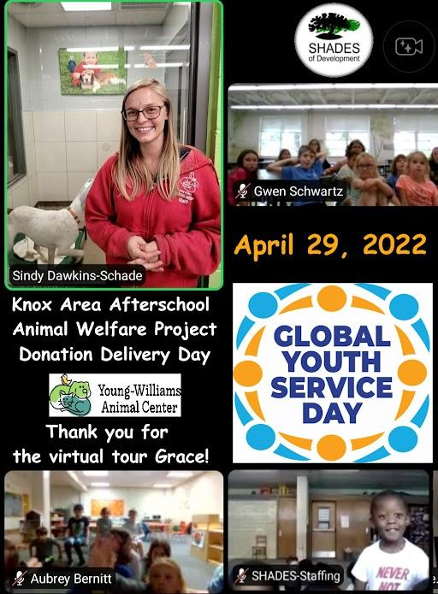
Global Youth Service Day
Animal Shelter Support was voted as the focus for Global Youth Service Day. Items were made and collected, then donated to Young Williams Animal Shelter and a virtual tour was provided so all the SHADES sites could be part of donation day.

Slide 27
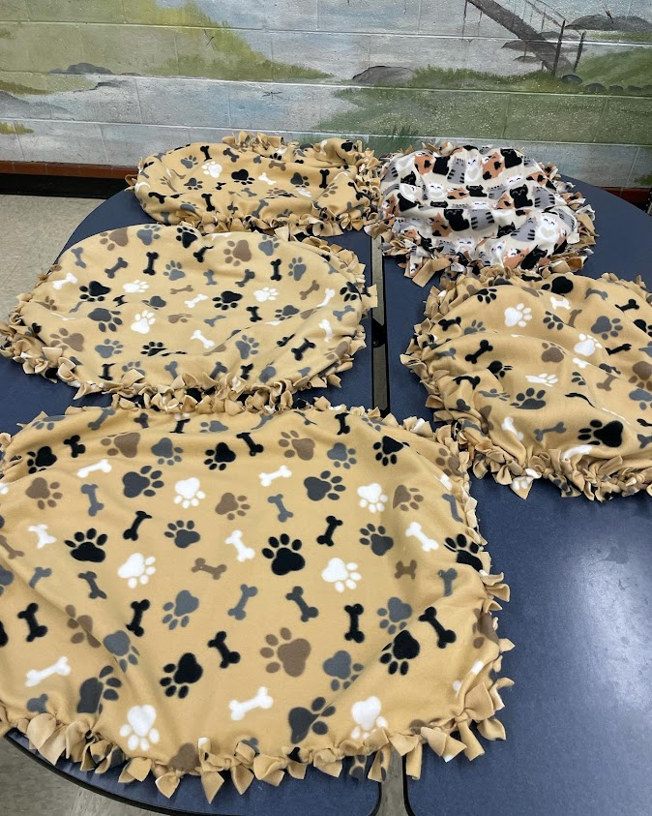
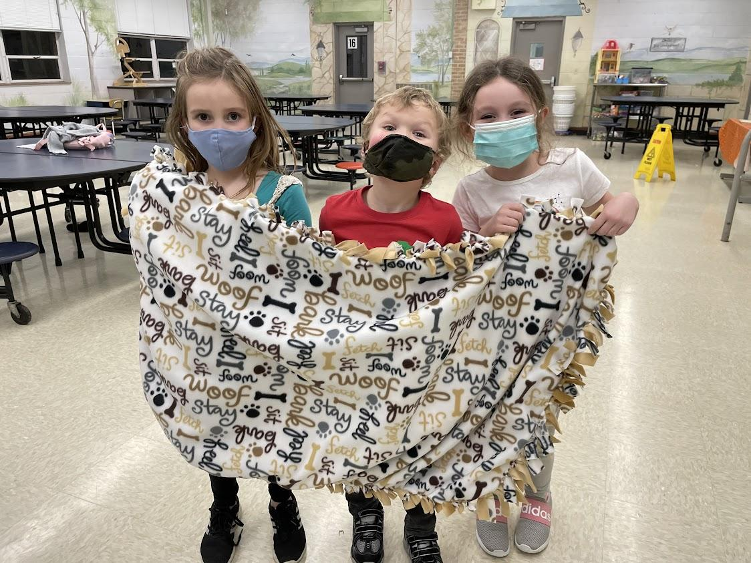
Months in the Making
SHADES Students made blankets and dog treats.

Slide 28
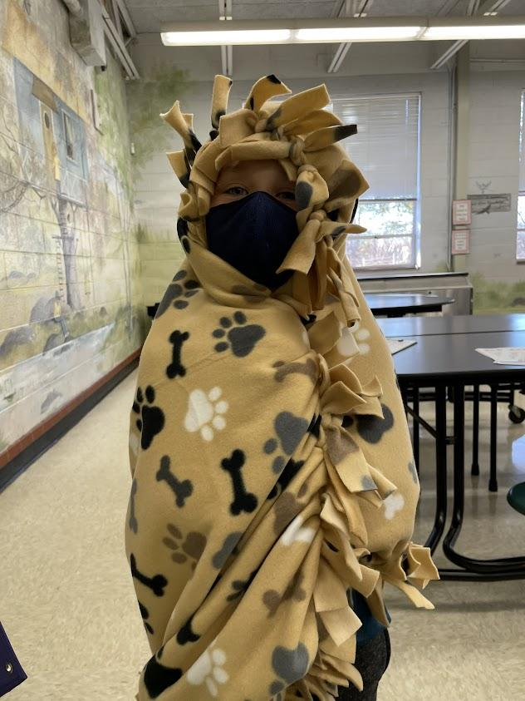
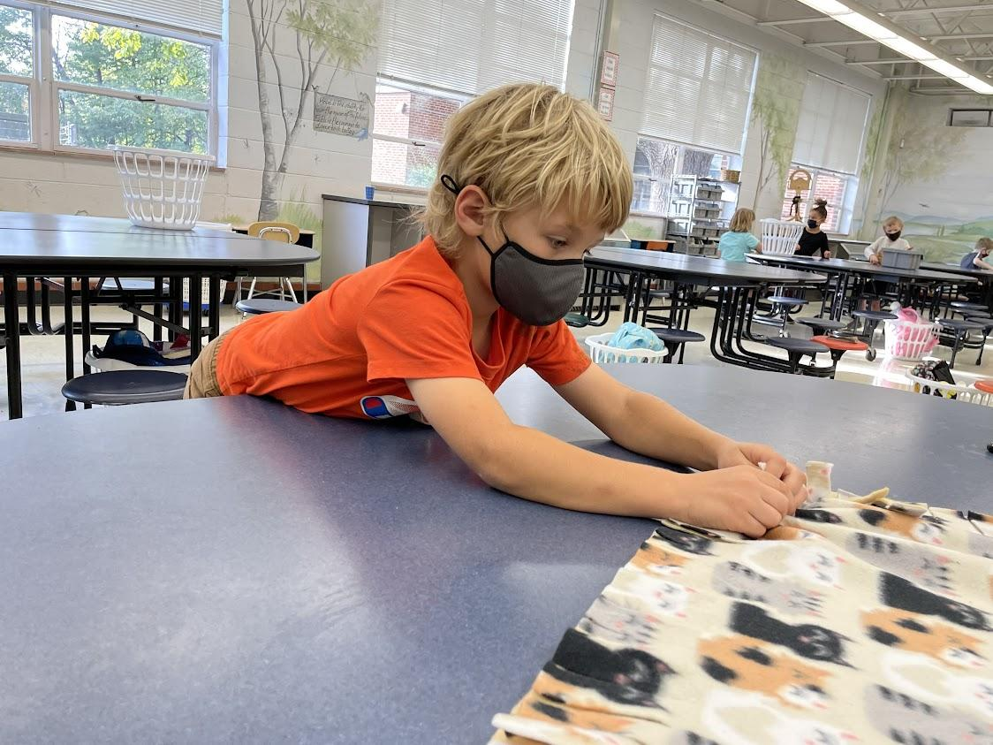
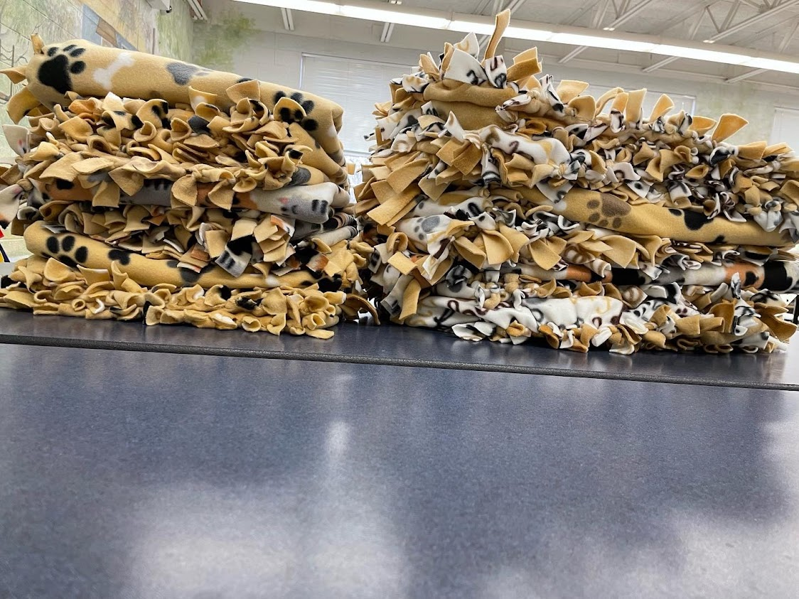

Slide 29
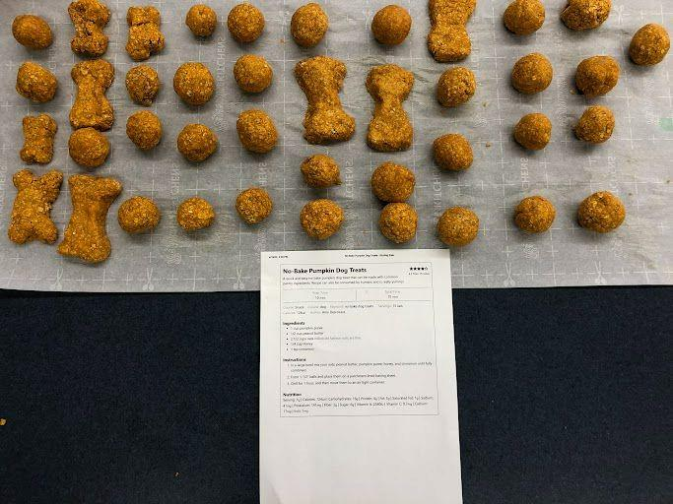
SHADES students made dog treats from scratch to donate to Young Williams Animal Shelter.

Slide 30
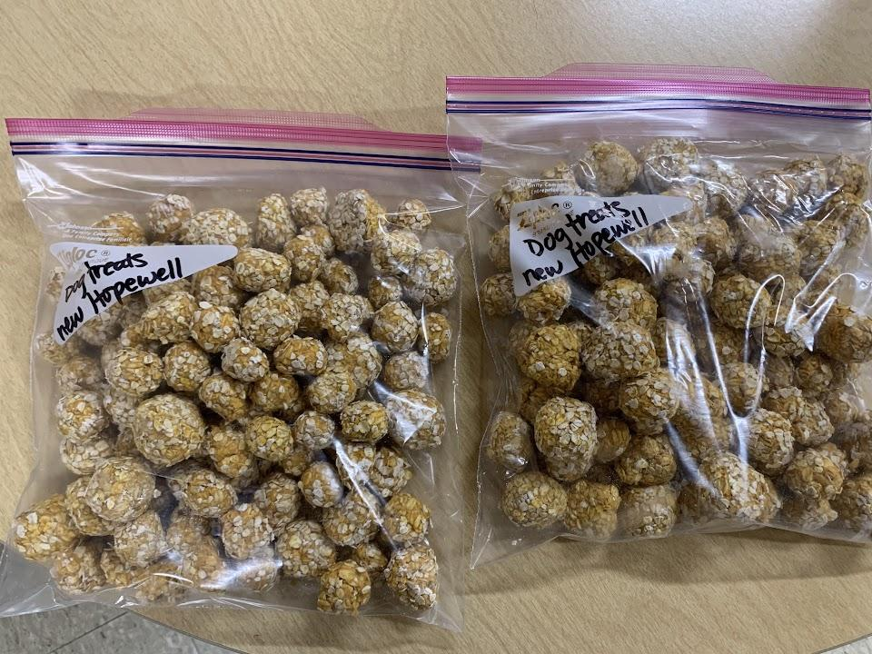
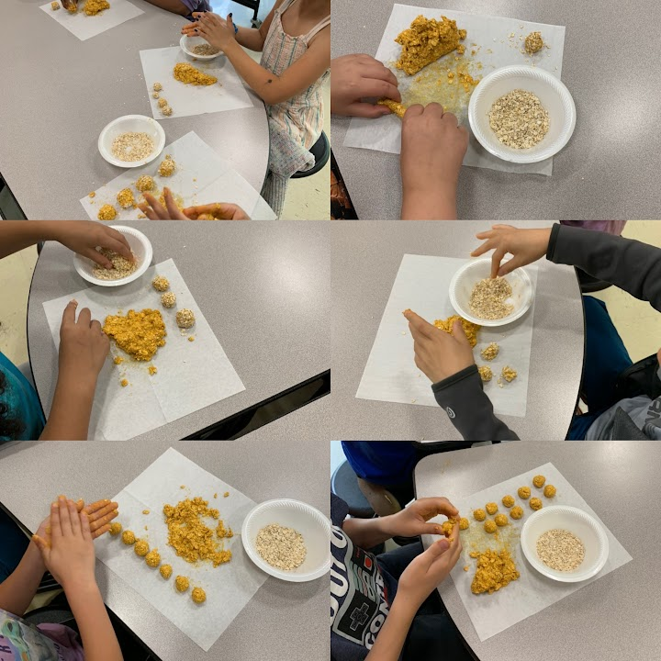
More homemade dog treats for a local animal shelter.

Slide 31
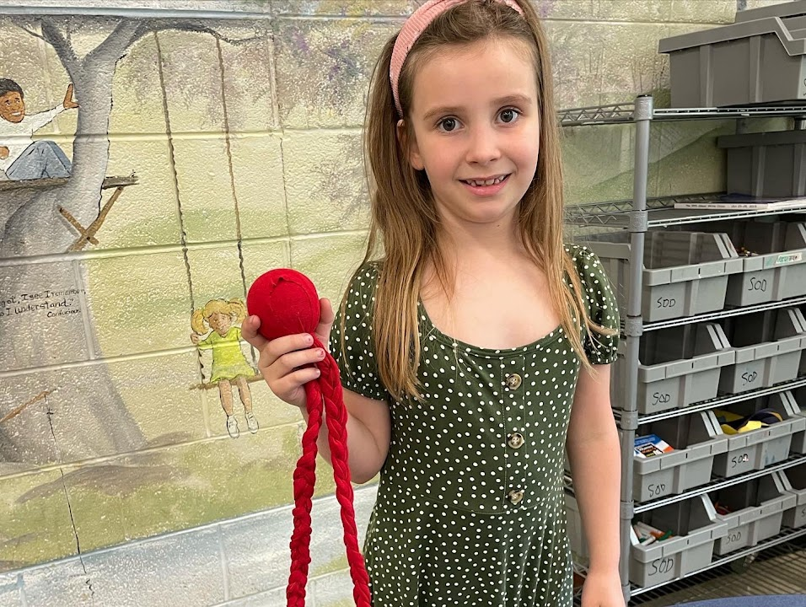
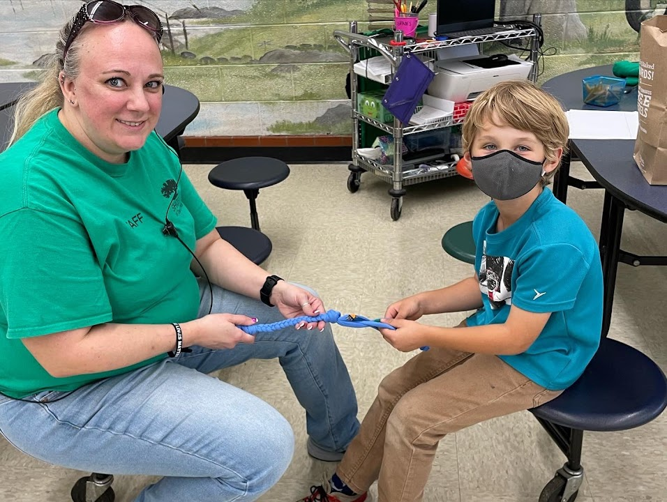
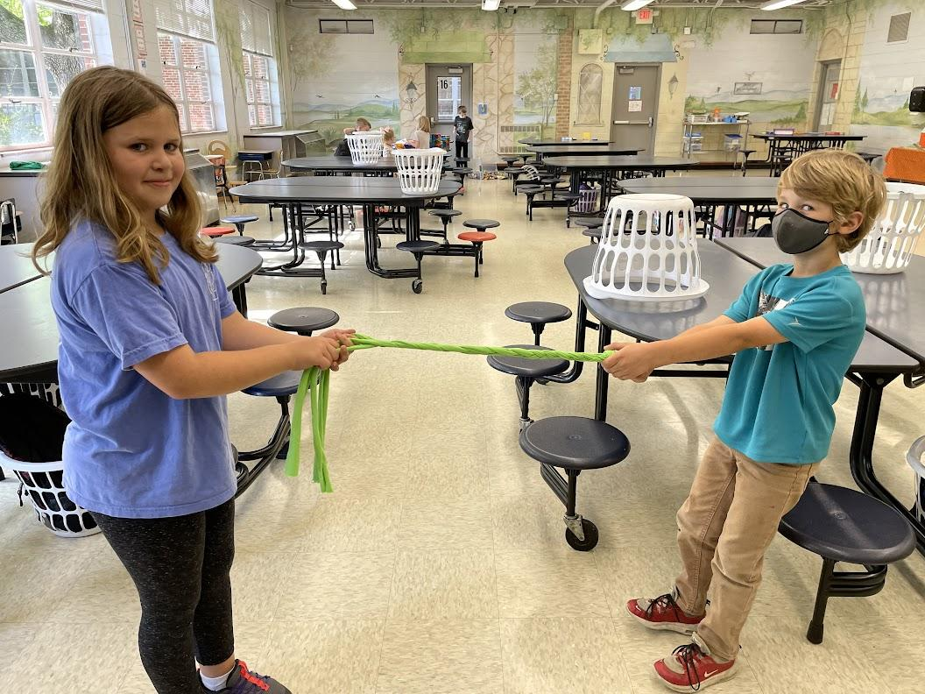
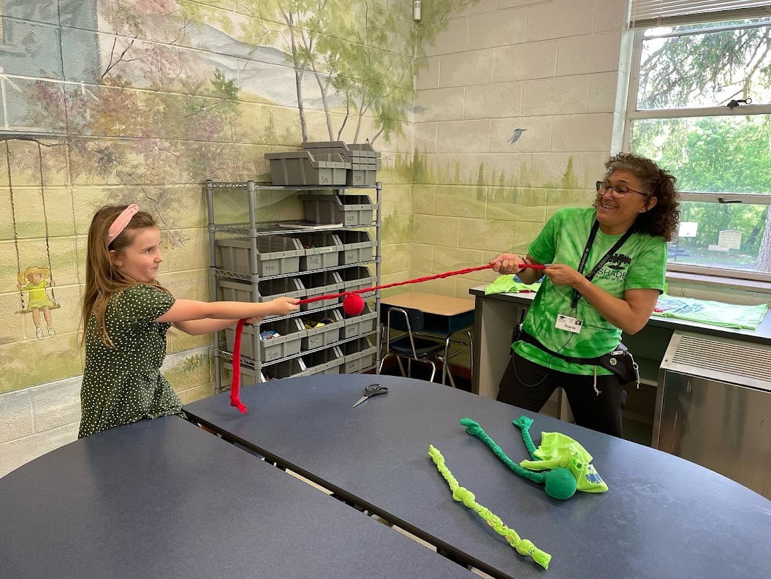
SHADES students made dog toys to distribute at a local animal shelter.

Slide 32
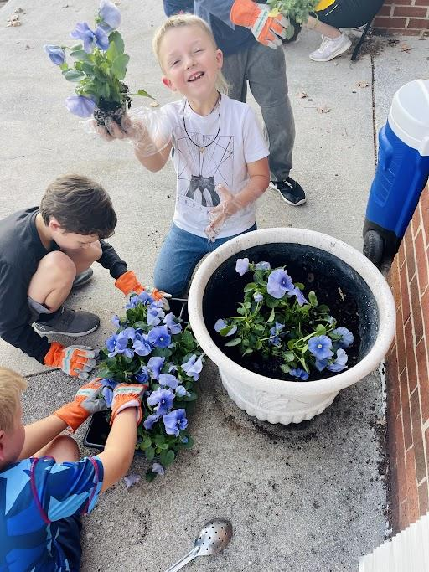
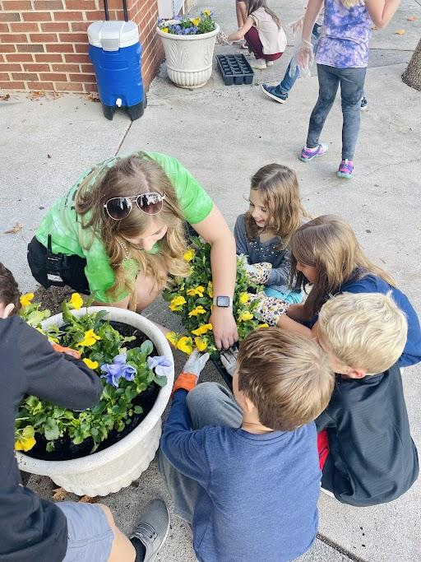
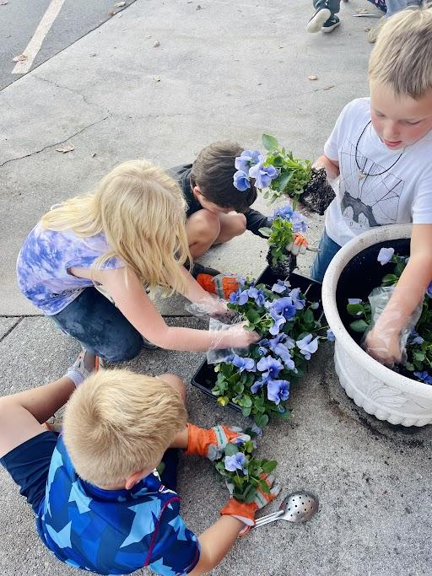
Karns SHADES grounds beautification project.

Slide 33
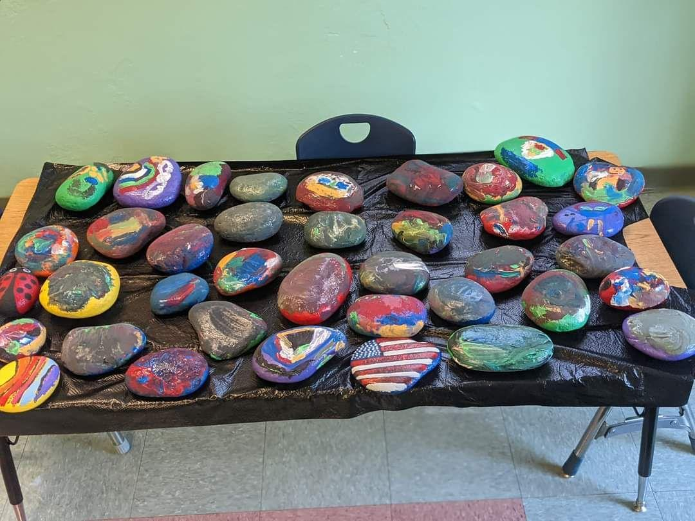
Fair Garden’s lending library project partnered with Regions Bank Day of Service for a collaborative service/beautification project.

Slide 34
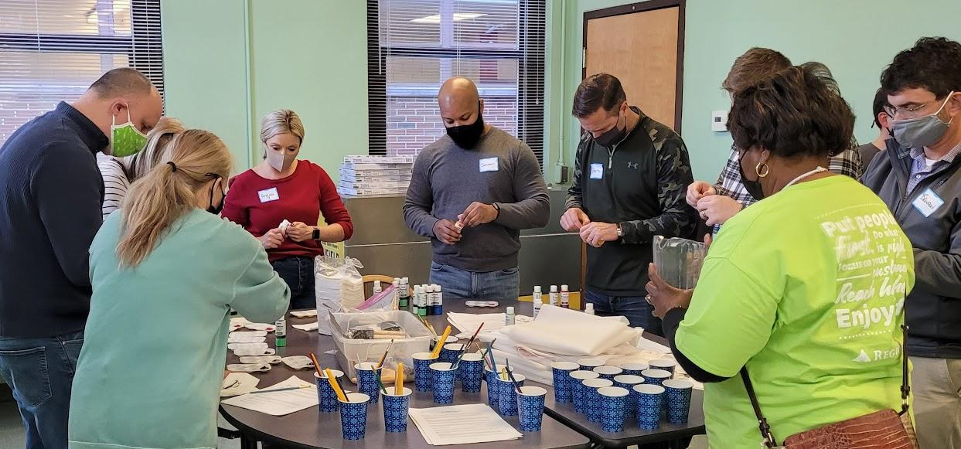
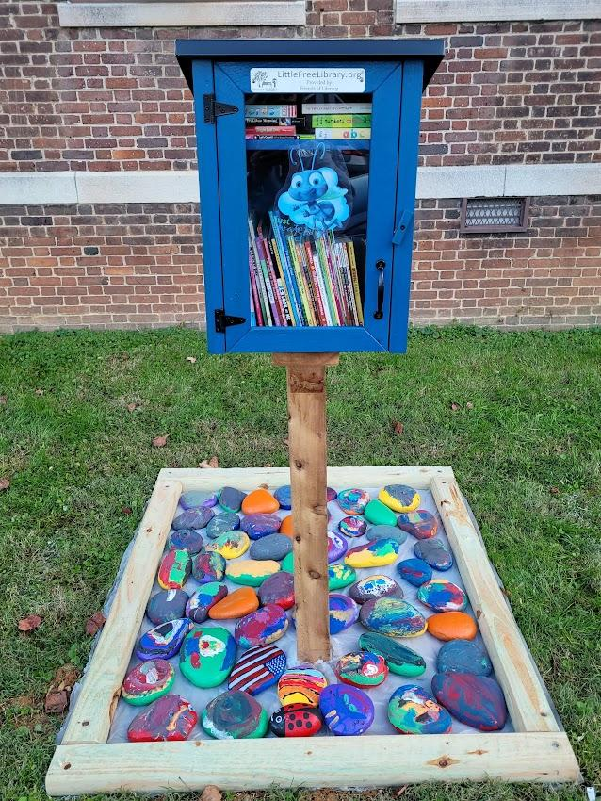
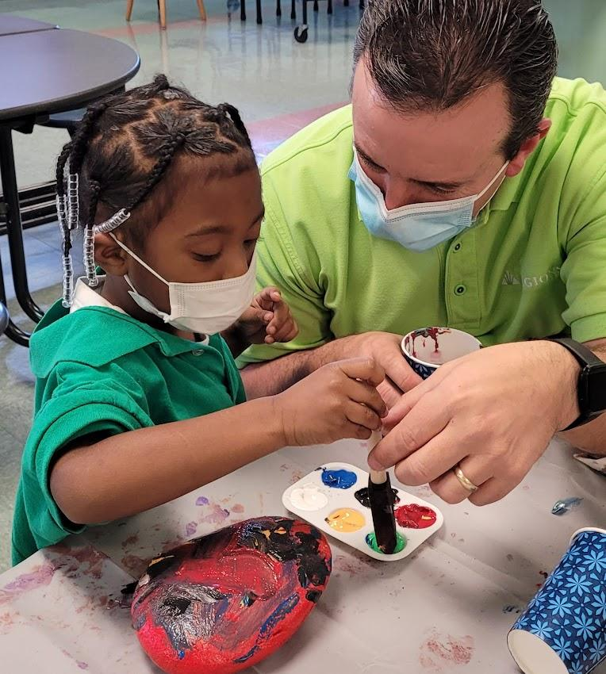
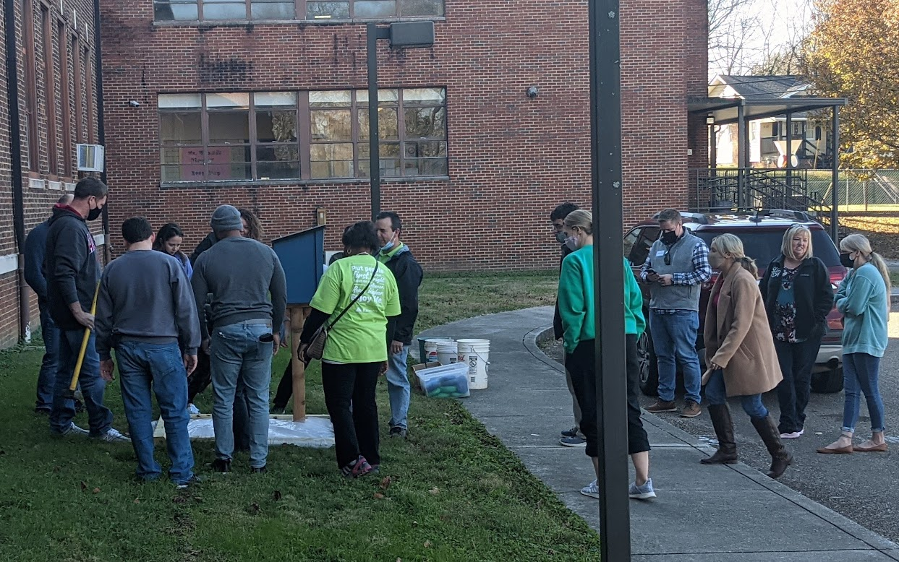
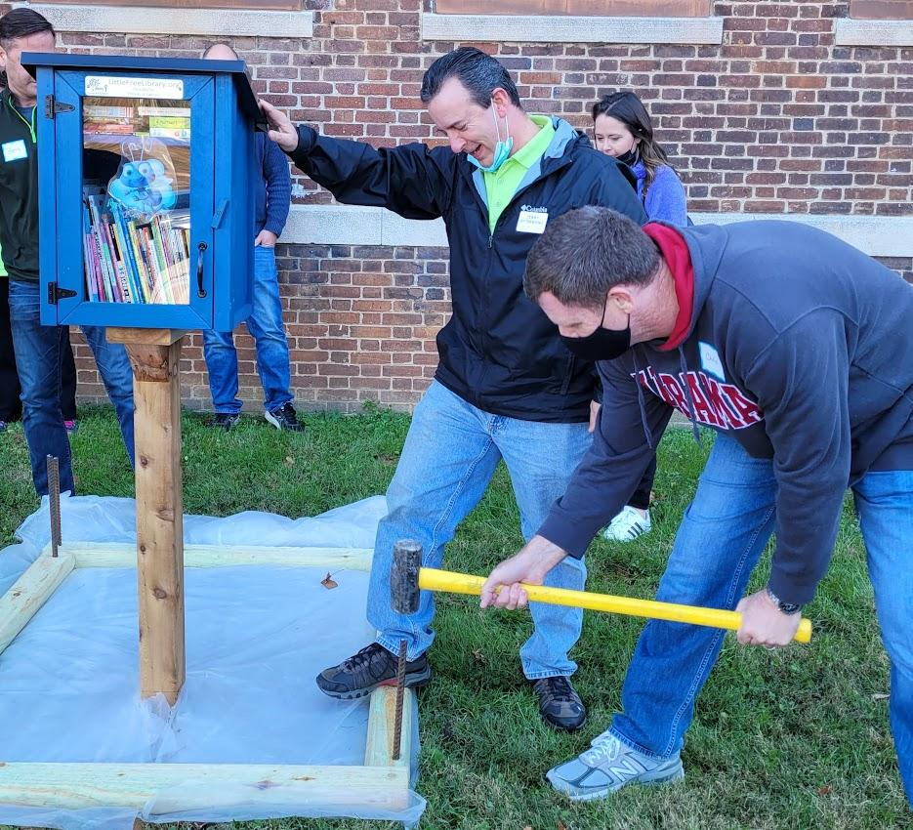

Slide 35
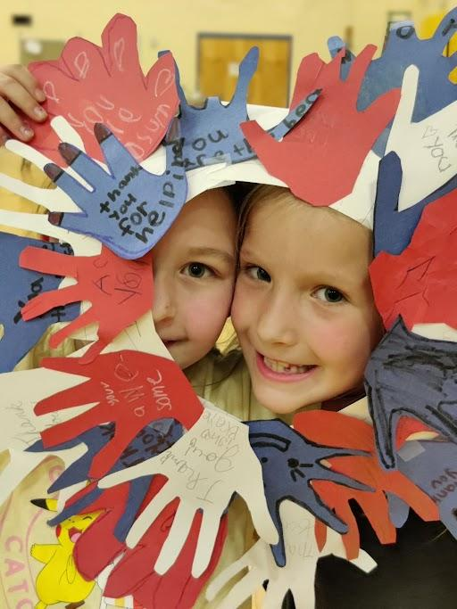
SHADES Brickey Bears made a wreath of thanks for Resource Officer Jones.

Slide 37
Karns Pink Room made a sign of appreciation for our officers at Knoxville Police Department.

Slide 38
Sunnyview SHADES decorated this tree to auction. They used money they raised from the auctioned tree to buy and donate items to the homeless, the elderly and The Ronald McDonald House.

Slide 40
SHADES Brickey conducted a playground cleanup day for one of their service learning projects.

Slide 41
Reduce - Reuse - Recycle

Slide 42
Karns made letters to veterans thanking them for their service.

Slide 43
SHADES Sunnyview made Christmas cards to brighten up the days of some residents in an assisted living facility.

Slide 44
Socks, lotions, treats and these beautiful flowers were collected and delivered to Holston Healthcare and St. John’s Assisted Living Facility.

Slide 45
Bullying Awareness posters made by our friends at SHADES Brickey.

Slide 46
Donations and cards hand delivered to Morning Pointe Assisted Living Facility.

Slide 47
Karns SHADES made cards for firefighters and police officers.

Slide 48
Items collected for TN Valley Coalition for the homeless.

Slide 49
Brickey SHADES collected blankets and various items for the homeless.
spread kindness

Slide 50
Some dog food and cards were delivered to Asheville Highway Animal Hospital.

Slide 51
Gloves and hats collected for the homeless for Angelic Ministries.

Slide 52
Our Karns friends cleaning up their playground for a service learning project.

Slide 53
New Hopewell K-2nd made a card for Resource Officer Morse.

Slide 54
Mt. Olive made “Love Bugs” that were delivered to a local nursing home for Valentine’s Day.

Slide 56
Thomas Chappelle, III
Chief Academic Officer

Slide 70
www.nylc.org/gettingstarted
Julie Rogers Bascom
NYLC Director of
Training & Leadership
Development
For teachers/ practitioners
Walk through stages
Fillable pdf
Examples

Slide 71
Textbook for Educators
Educational pedagogy
Process based on Understanding by Design, Wiggins and McTighe (aka backwards planning)

Slide 72
Engage: A Service-Learning Handbook for After-School Service-Learning Programs
Age/grade-specific
Step by step
14-weeks of activities

Slide 73
Sustainable Development Goals (SDGs)- Focused
Service-Learning Handbooks for After-School Service-Learning Programs
Ages 14-18
Specific to SDG
Process oriented
Step by step
14-weeks of activities

Slide 74
To learn more, visit nylc.org
Julie Rogers Bascom
Director of Learning and Leadership
jrbascom@nylc.org
Notes:
(Julie)
For more support/info:
-- How to access (with SL Network) nylc.org
-- Service-Learning Network
-- Customized Trainings

Slide 75
TO DOWNLOAD
THIS POWER POINT PRESENTATION,
PLEASE GO TO
www.tnafterschool.org/service-learning-strategies-to-replicate/
AND CLICK ON THE LINK

