Slide 1
ALICE IN THE CROSSCURRENTS:
COVID AND FINANCIAL HARDSHIP IN TENNESSEE
Notes:
​
For this cover slide and all the slides that follow, please replace the United Way of NNJ logo with your own (horizontal version) by adjusting the top slide in the Slide Master view. (View → Slide Master)

Slide 2
Who is ALICE – and Did They Weather the Storm?
ALICE: Asset Limited, Income Constrained, Employed
Notes:
The COVID-19 pandemic, a global health and economic crisis, upended life as we knew it three years ago. It claimed the lives of millions and unleashed a storm of competing economic forces – which was a phenomenon rarely seen. ​
​
Among those in the eye of the storm was a population that the media, government officials, influencers, and many others refer to as the invisible, the forgotten. People who, hidden in plain sight, struggle daily to afford basics. We have a name and a specific measure for this group – and that is ALICE. ALICE stands for Asset Limited, Income Constrained, Employed. ALICE can be a family member, a friend, or a neighbor. ALICE workers – including our childcare providers, waiters, retail clerks, gas station attendants, and others – are the engine that keeps our economy running. They earn above the Federal Poverty Level, but because their wages can’t keep up with the rising costs of necessities, they’re forced to make impossible choices to try to make ends meet. ​
​
In the next few slides, we’ll explore how Tennessee's vulnerable ALICE families fared financially during the pandemic, and warning signs that point to stress on the horizon in the years to come.​

Slide 3
Caught in the Crosscurrents of
Competing Forces
MIGRATION
JOB DISRUPTION
INFLATION
WAGE INCREASES
PANDEMIC ASSISTANCE
Notes:
Throughout the pandemic, economic forces such as job disruption, inflation, wage increases, pandemic assistance, and migration worked both with and against each other. Negatively impacting household income, businesses and schools closed or went remote for months after the pandemic hit. In the two years that followed, millions of workers lost their jobs, while millions more had their hours and wages reduced. Initially, costs for many basics declined, but then as the pandemic continued, disruptions to the supply chain and higher wages to retain workers pushed prices up across the board.​
​
At the same time, there were forces that benefited household income for many below the ALICE Threshold – which means, ALICE households and households in poverty combined. As I mentioned, wages and salaries increased as business owners scrambled to retain their workers. In addition, there were various temporary pandemic supports that provided a much-needed cushion for these struggling households. ​
​
The pandemic also sparked changes in household size and location. To minimize expenses, many older children returned home, and some households added roommates. And for a variety of reasons, many households moved to warmer, less expensive, and/or less densely populated locations. ​

Slide 4
Caught in the Crosscurrents of Competing Forces
Households Below the ALICE Threshold:
2019: 1,211,160 2021: 1,196,900
Notes:
As a result of all these economic forces at play at the same time, from 2019 through 2021, Tennessee saw a slight decrease in the total number of households below the ALICE Threshold from 46% to 44% of households unable to afford the basics. Of these additional struggling households, 380,879 were in poverty, while 816,021 – (more than twice as many) – were ALICE.​

Slide 5
Demographics of Households in Hardship
High Levels of Hardship
Lowest Levels of Hardship
Black 59% ALICE or Poverty
Asian 31% ALICE or Poverty
Hispanic 55% ALICE or Poverty
White 41% ALICE or Poverty
Under 25 Years 71% ALICE or Poverty
45 to 64 Years 37% ALICE or Poverty
Notes:
ALICE households exist across all ages, genders, races, ethnicities, and geographies. Yet, some groups are disproportionately ALICE as a result of systemic barriers to education, homeownership, health care, and financial wealth and savings, among others. ​
​
Taking a closer look at the demographics of struggling households in Tennessee, we can see that the impact of the pandemic’s competing economic forces played out differently across demographic groups. In many cases, the pandemic exposed and widened gaps in rates of hardship by race and ethnicity, and age (group 1 – Black, Hispanic, and younger. households) were more likely to be ALICE or in poverty, while (group 2 – Asian, White and 45-65 households) were more likely to be financially stable. ​
​
​

Slide 6
The 20 Most Common Jobs in Tennessee
70% OF THE
TOP 20 JOBS IN
Tennessee
STILL PAID LESS THAN
$20 PER HOUR IN 2021
Notes:
For households that struggle to make ends meet across all demographic groups, the crux of the problem is a mismatch between earnings and the cost of basics. Despite an increase in the median wage among the 20 most common jobs in the state, by 2021, 70 of these top 20 jobs still paid less than $20 per hour. Earning less than $20 hourly wasn’t enough for many workers to keep pace with the rising costs of essentials. As a result, many of these top jobs still had a substantial percentage of workers who were either ALICE or in poverty. As an example, 14% of Tennessee’s cooks (occupation) – (one of the most common occupations/the most common occupation) in the state – were below the ALICE Threshold in 2021.​

Slide 7
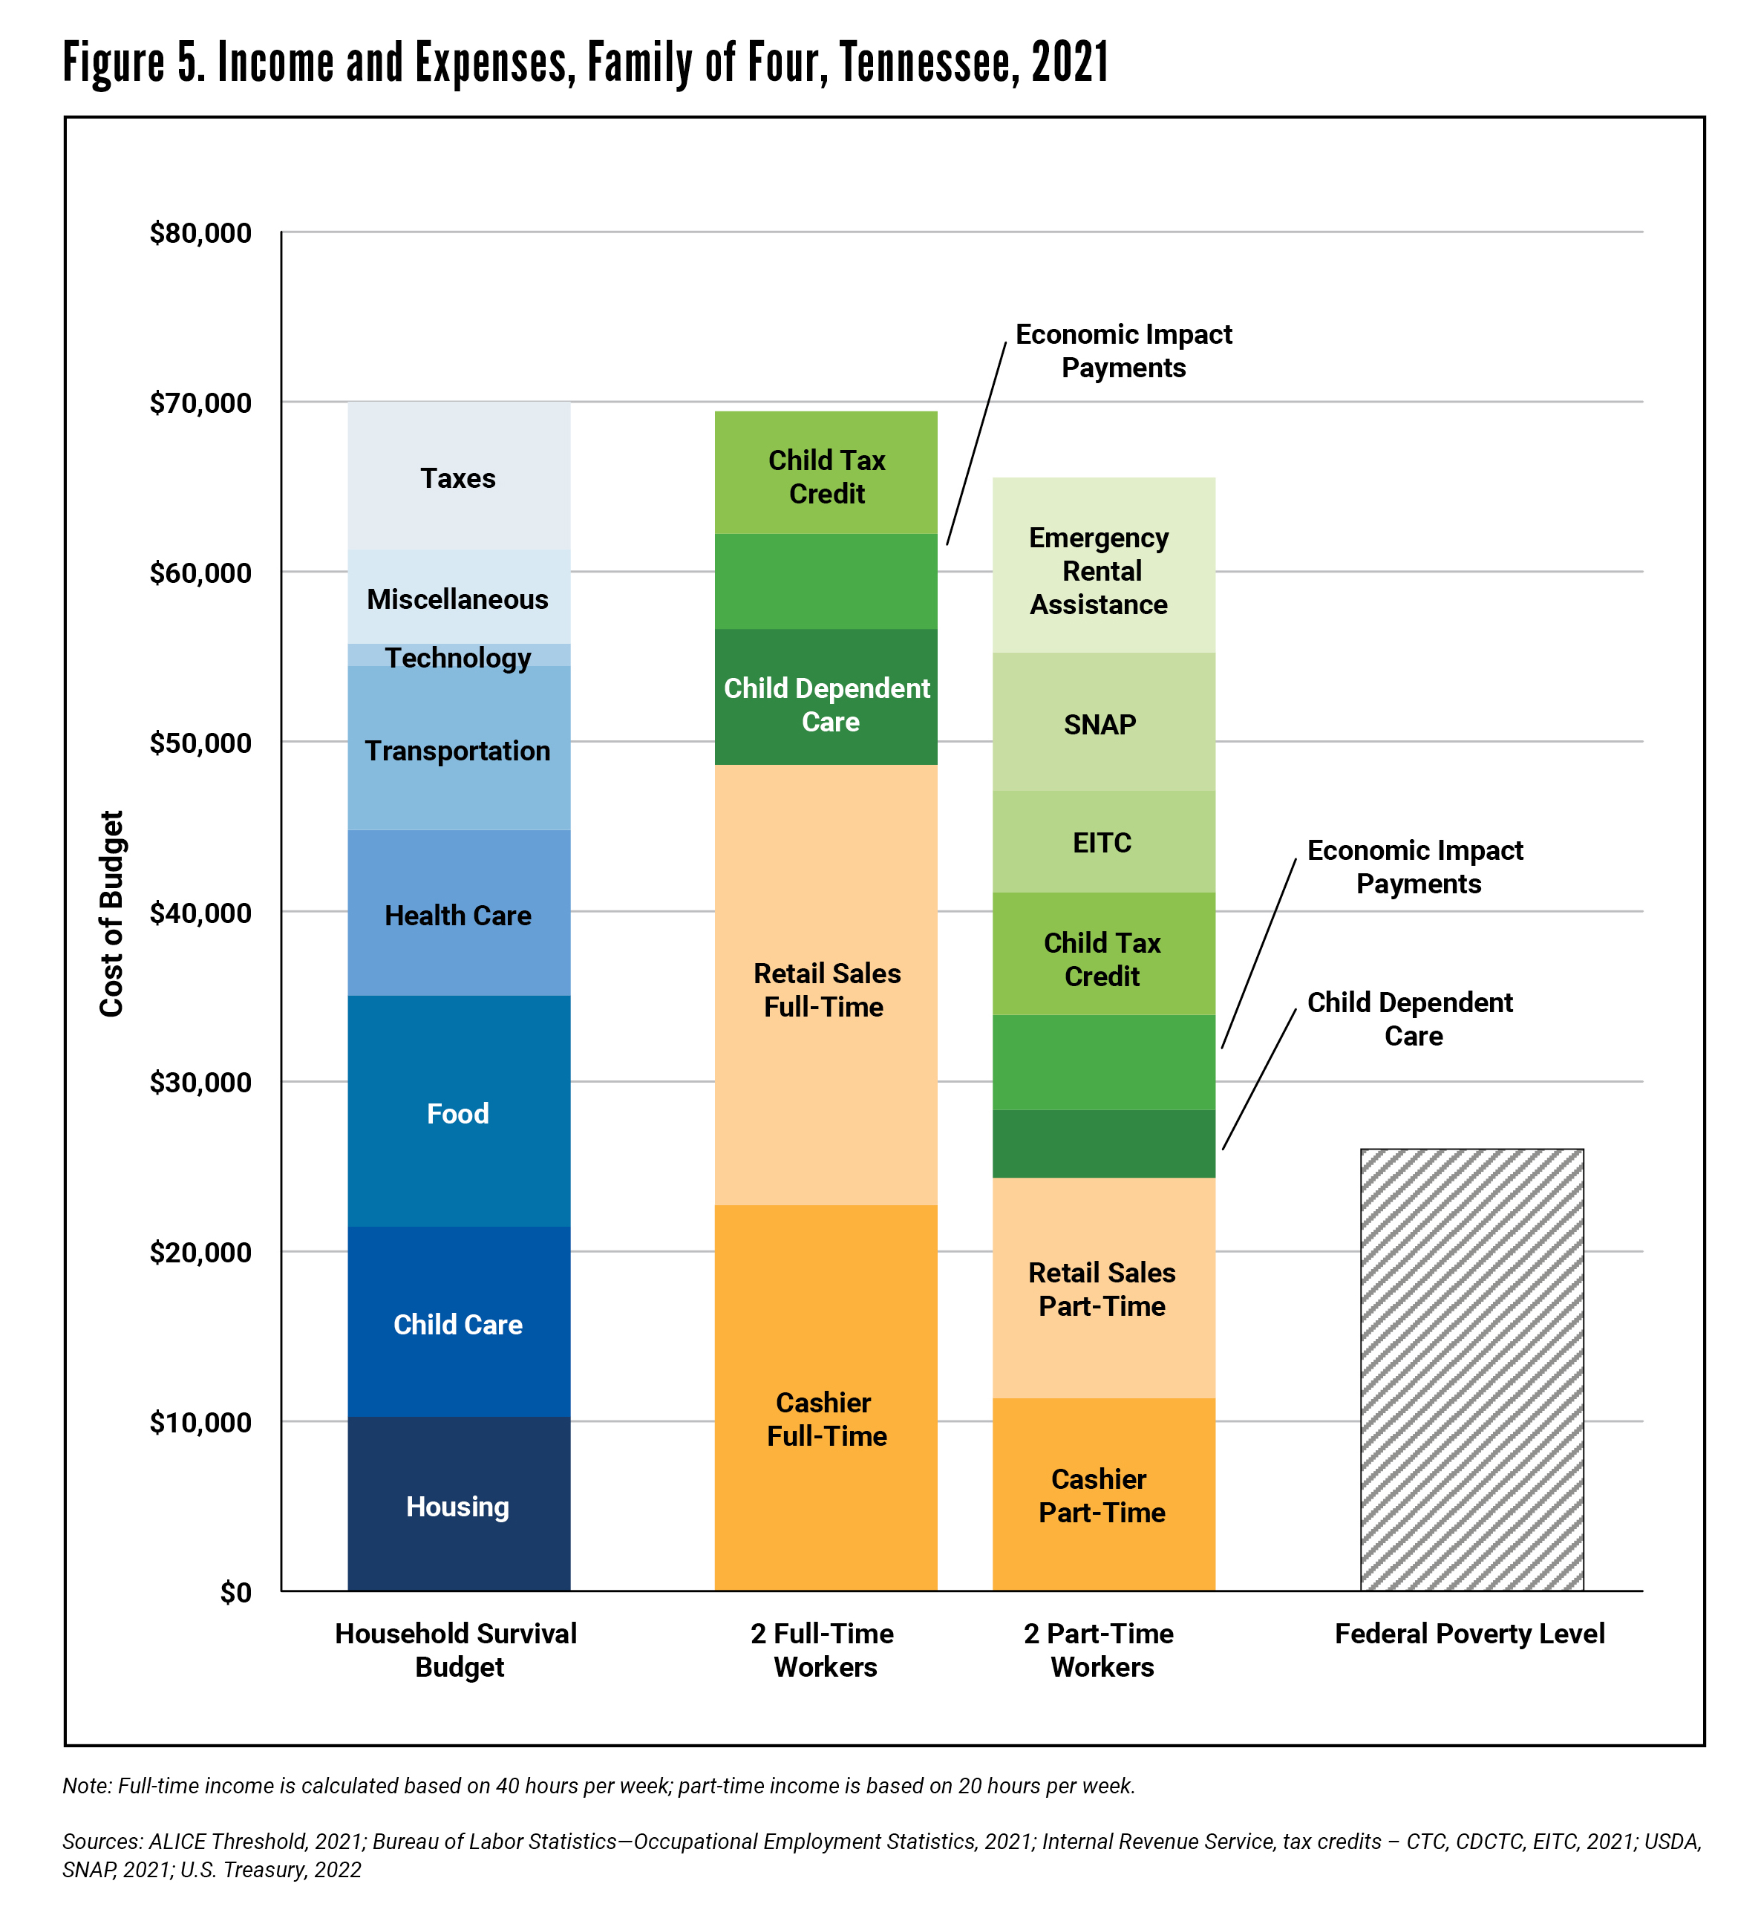
Cushioning the Blow – But Was it Enough?
Notes:
Of course, wages were only part of the story during the pandemic – with the variety of pandemic supports also playing a large role. While ALICE households often earn too much to qualify for assistance, nearly all ALICE households were eligible for pandemic assistance. From tax credits, to stimulus payments, to rental assistance, these supports provided strong relief and mitigated the pandemic’s negative financial impacts. ​
​
(Yet even with these temporary supports, many ALICE households still did not reach financial stability.) ​
​
For a family with two kids and two adults in Tennessee, the Household Survival Budget was $57,240 in 2021. With two full-time workers in two of Tennessee’s most common jobs – retail salesperson and cashier – (and multiple pandemic supports, that family's income still fell short of the Budget by $4,481 or 7%.
​

Slide 8
Warning Signs on the Horizon
Food Insufficiency
Learning Loss
Struggling to Pay Bills
Notes:
Ultimately, economic forces during the pandemic helped cushion its negative financial impact, as things could have been worse for many struggling families. But with inflation on the rise and pandemic supports waning, there are warning signs on the horizon that households struggling to make ends meet may already be losing ground. ​
​
One of these in TN is Food insufficiency. Rates of food insufficiency have remained elevated since the beginning of the pandemic. While the rate is 12% of all households in our states, is 40% for black respondents and 35% for respondents with disabilities in the 2020 Household Pulse Survey. ​
​
Another sign of stress on the horizon is Learning Loss. 71% of parents below the ALICE threshold say their child was prepared for the 2021 academic school year. National Center for Education Statistics reported declines in reading and mathematics across the nation, with Tennessee faring worse, with bigger drops than the majority of states, especially in reading.
​
Still another red flag for households in financial hardship is struggling to pay bills. According to the Household Pulse Survey of August 2020, 45% of households below the ALICE threshold in TN said it was somewhat or very difficult to pay for usual items such as good, rent, mortgage, car payments and medical expenses. The rate increased to 58% by November 2022.

Slide 9
Warning Signs on the Horizon
Only 39% of
Tennessee’s struggling households had emergency savings in 2021
Notes:
Throughout the pandemic, it was ALICE who helped us stay afloat. Yet according to the SHED survey, only 39% of (state)‘s financially struggling respondents had money saved up for a crisis as of November 2021. This, coupled with the warning signs we just discussed, leaves a large percentage vulnerable to future crises.​
​

Slide 10
United Ways of Tennessee Respond!
211 Supports ALICE Households
190K connections via phone call
192K total referrals made:
39.5K hunger and food insecurity
33.2K utility bill assistance
20.1K housing insecurity and homelessness
Notes:
211 is available across our state and supports all Tennesseans, but especially ALICE, by providing free and confidential access to health and human services.
Some highlights of statistics for this past year, 2022, are 190K phone calls, 192K referrals made, including nearly 40K connections to reduce hunger and food security, 33K to assistance paying utility bills, and more than 20K connections made to address housing insecurity and homelessness in our state.

Slide 11
United Ways of Tennessee Respond!
Tennessee Benefit Kitchen Supports ALICE Households--$2.5 million in first 4 months!
Food Stamps (SNAP)
Cash Assistqance (TANF)
Women Infants and Children (WIC)
Head Start
School Meals
Childcare Assistance
TennCare (Medicaid)
ACA (Affordable Care Act)
CHIP (Children’s Health Insurance Program
County Medical Services
Home Energy Assistance (HEAP)
Lifeline
Child Tax Credit
Childcare Tax Credit
Earned Income Tac Credit
Notes:
Tennessee Benefit Kitchen is an innovative new service launched November 1 of 2021 to support those living below the ALICE threshold. Every year millions of Americans leave $80 billion in unclaimed benefits on the table. By testing “benefits” to 211-211, people access a free screener that identifies eligible benefits and links to the application sites. In our first four months, Tennessean’s were connected to apply for $2.5 million in benefits, including $2.25 million in tax credits and more than $185K in food stamps.

Slide 12
Data For Action in Tennessee
Visit UnitedForALICE.org to dig deeper into the data.
Encourage the use of this data to create change.
Build awareness.
Notes:
So, what can we do? Now that we’ve seen how ALICE households fared financially during the pandemic, and what might be ahead for struggling households in our state, how can we use this information to create meaningful change?​
​
First, visit UnitedForALICE.org to read the state and the national Reports in full – and to engage with the data directly using the interactive, online dashboards. ​
​
Then, share this data throughout your own networks. Encourage your peers to use the data to develop policies and strategies that can have both immediate and long-term impacts on households living paycheck to paycheck. And build awareness anywhere you can – at home, with your families, friends, and neighbors – some of whom may actually be ALICE. Help us sound the alarm about financial hardship in Tennessee, because failing to do so places ALICE, our economy, and the well-being of our communities at great risk.​

