Slide 1
Tennessee’s Opioid Epidemic
Developed by: Afterschool Heals/ United We Heal Tennessee Taskforce

Slide 2
Opioids in the Tennessee News

Slide 3
What is an opioid?
A class of drug that includes heroin, synthetics opioids such as fentanyl, and pain relievers available by prescription such as oxycodone (OxyContin), hydrocodone (Vicodin), codeine, morphine, and many others.

Slide 4
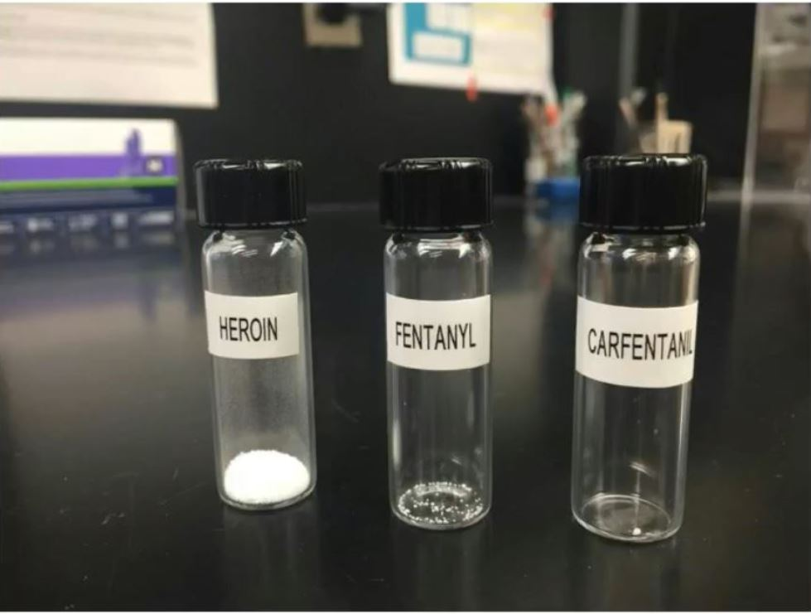
Lethality of heroin and prescription pain killers

Slide 5
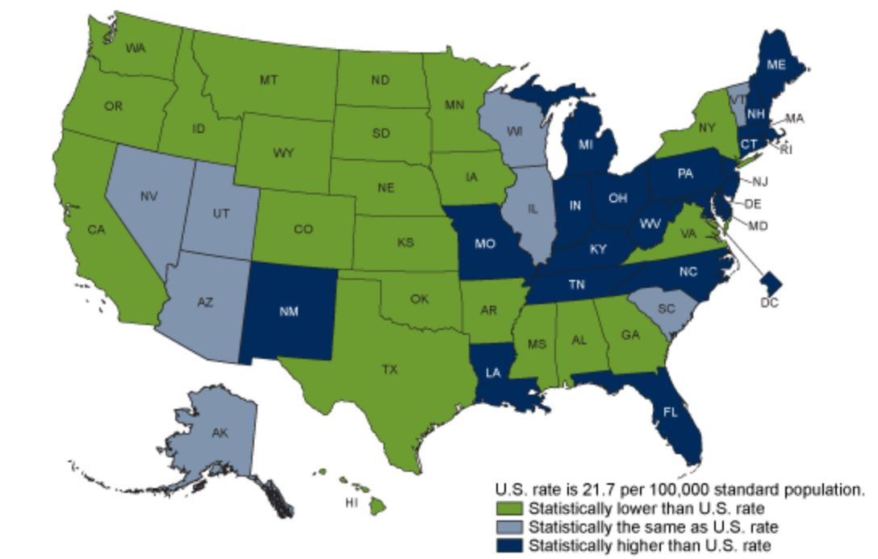
Age-adjusted drug overdose death rates, by state: United States, 2017
Source: https://www.cdc.gov/nchs/products/databriefs/db329.htm

Slide 6
How did prescription painkillers become a problem?
In the late 90’s pharmaceutical companies reassured physicians that patients could not become addicted to opioid pain relievers.
This led to higher prescription rates and misuse before anyone knew the highly addictive nature of the prescription pain killers.
Drug addiction is a complex disease, and quitting takes more than strong will.
Repeated drug use leads to brain changes that challenge an addicted person’s self-control and interferes with their ability to resist intense urges to take drugs.
Many patients, doctors, and families did not recognize the signs of addiction or did not know how to find needed help.
As patients adjust to the surges of dopamine (the “feel good” hormone) they physically crave more and/or stronger doses of drugs.

Slide 7
Nick Salazar didn’t think he was an addict…
“I thought, ‘I have a job so I’m OK. I’m not homeless, so I’m OK,’” recalled Salazar.
He didn’t think he was an addict because he took prescription pills, not heroin…
Then one day he was short on cash to buy pills. It was only going to be a one-time fix… But it wasn’t for one day. Heroin was cheaper.

Slide 8
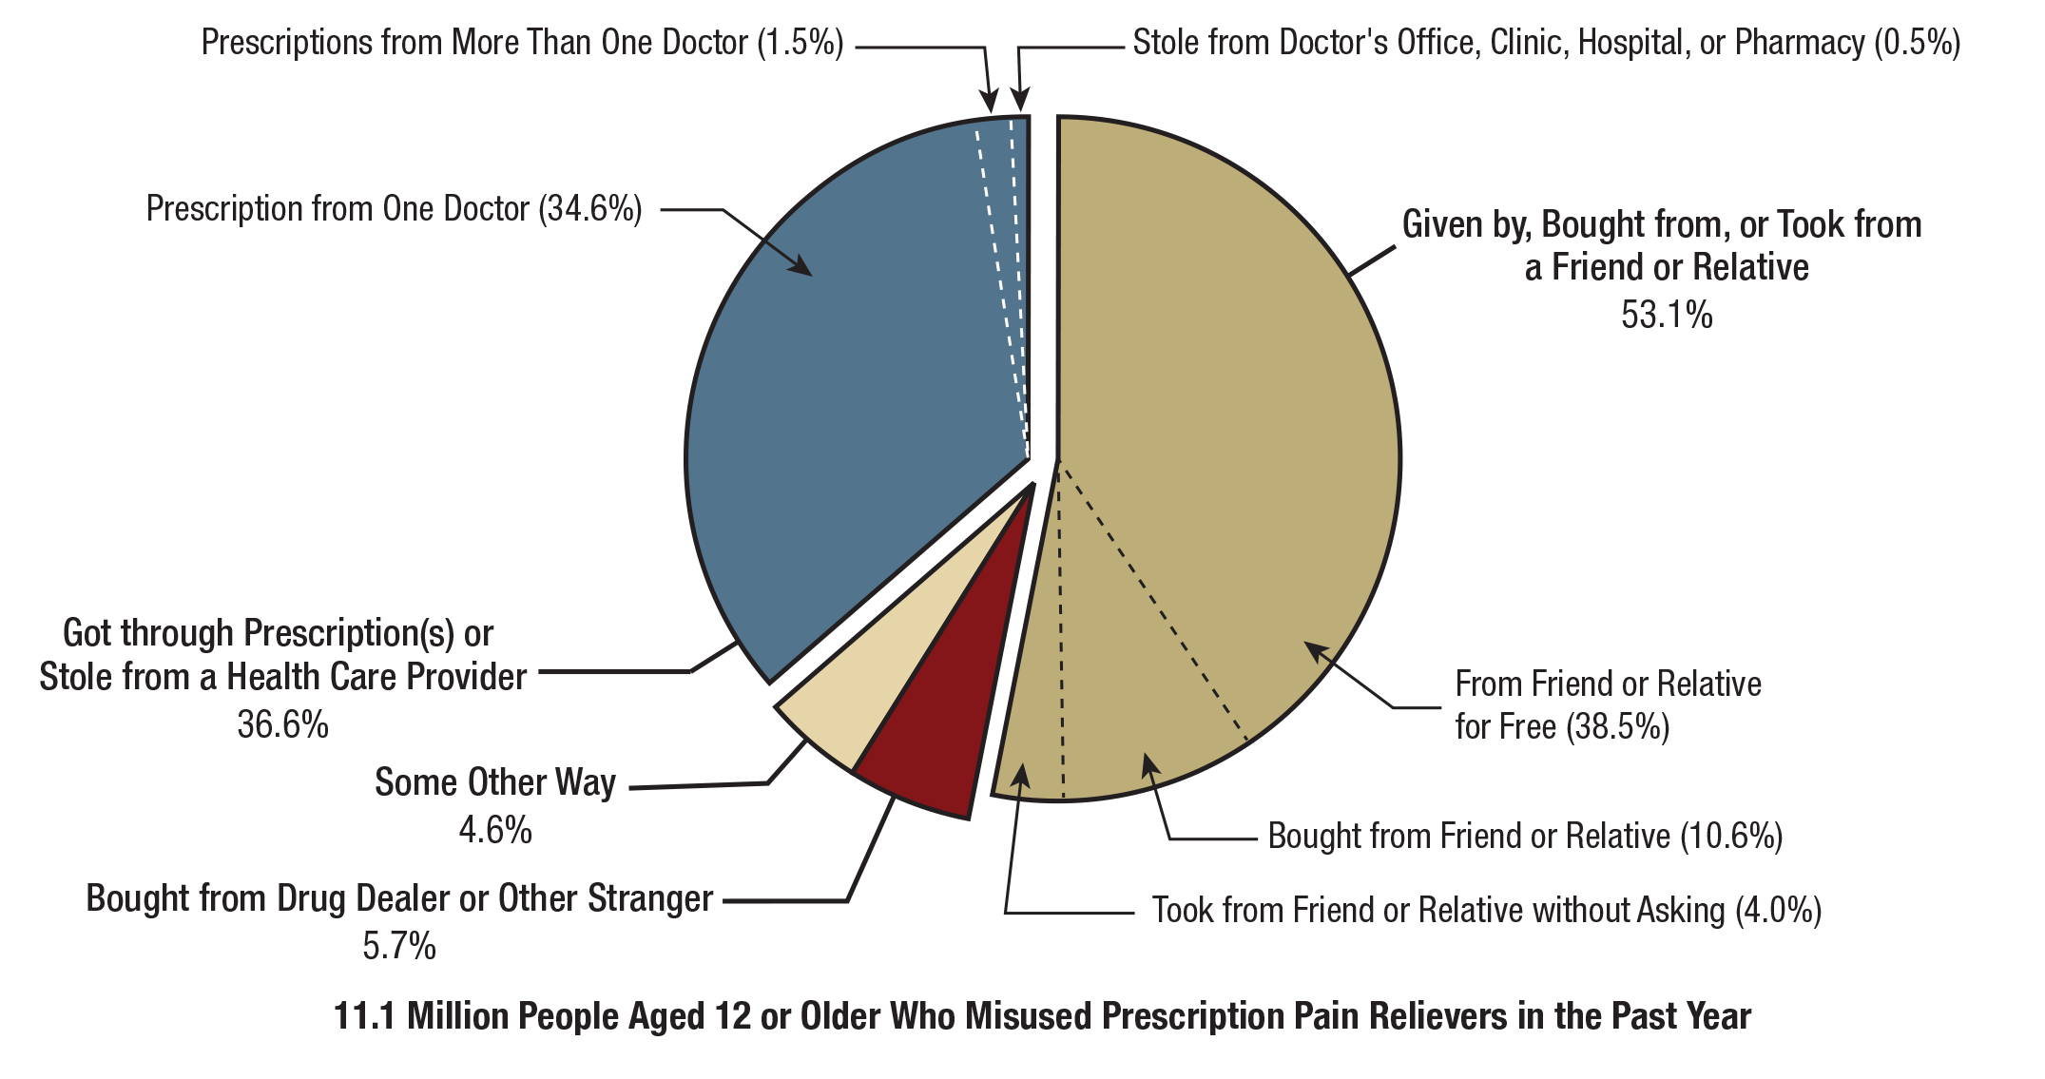
Source Where Pain Relievers Were Obtained for Most Recent Misuse among People Aged 12 or Older
Source: National Survey on Drug Use and Health, 2018

Slide 9
Drug Overdose Deaths Continue to Rise in Tennessee
All Drug Overdose Deaths
Drug Overdose Deaths Involving Opioids
15,001 Nonfatal Overdoses (2016)
6,879,698 Painkiller Prescriptions (2017)
Comparison: In 2017 TN had 1042 motor vehicle deaths
Source: Tennessee Department of Health, 2019

Slide 10
How the opioid epidemic is impacting children in Tennessee:
Prevalence of Neonatal Abstinence Syndrome (NAS) is three times higher in Tennessee than the national rate.
The number of Tennessee children in foster care has risen 10% the last two years.
Children dealing with traumatic experiences can face social, emotional, physical, and mental health challenges that last into adulthood. (often referred to as Adverse Childhood Experiences)

Slide 11
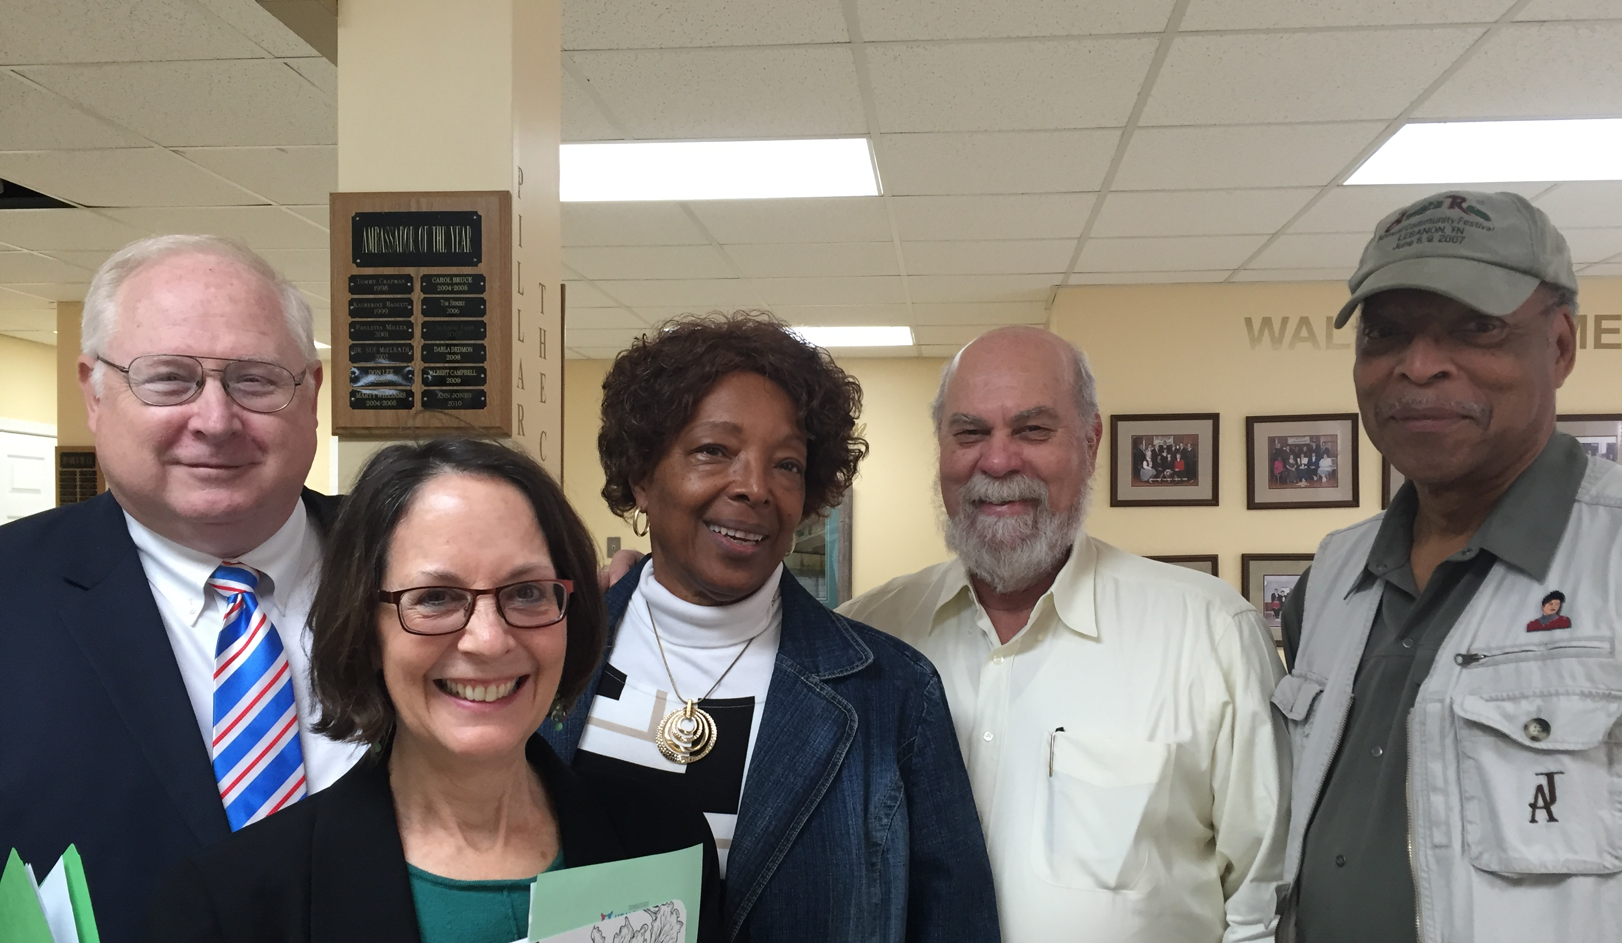
Prevention Efforts: What you can do
Join an Anti-Drug coalition
Partner on local events, such as drug take-back events
Share resources with families
Provide resources with staff/employees
Find an Anti-Drug coalition:
https://www.tn.gov/behavioral-health/substance-abuse-services.html

Slide 12
The role of employers in addressing prevention
Educate employees and supervisors
Develop a workplace drug and alcohol policy
Link employees to community resources
Offer employee assistance programs
Develop a return to work policy
Helpful Resource: Opioid Response Toolkit for Employers United Ways of Tennessee
https://uwtn.org/EmployerOpioidToolkit

Slide 13
The role of out-of-school time in addressing prevention
Healthy relationships
Safe environments
Character development
Prevention education
Link between community resources and families
Helpful Resource:
http://www.tnafterschool.org/about/afterschool-heals-tennessee/

Slide 14
Does Afterschool Really make a difference?
Studies show:
Youth who are not involved in constructive, supervised extracurricular activities are more likely to engage in risky behaviors such as school failure, drug use, and delinquency
When youth participate in afterschool programs, risky behaviors decrease and measures of success increase.
Yes!
Source: http://afterschoolalliance.org/documents/SubstanceAbuse_Factsheet.pdf

Slide 15
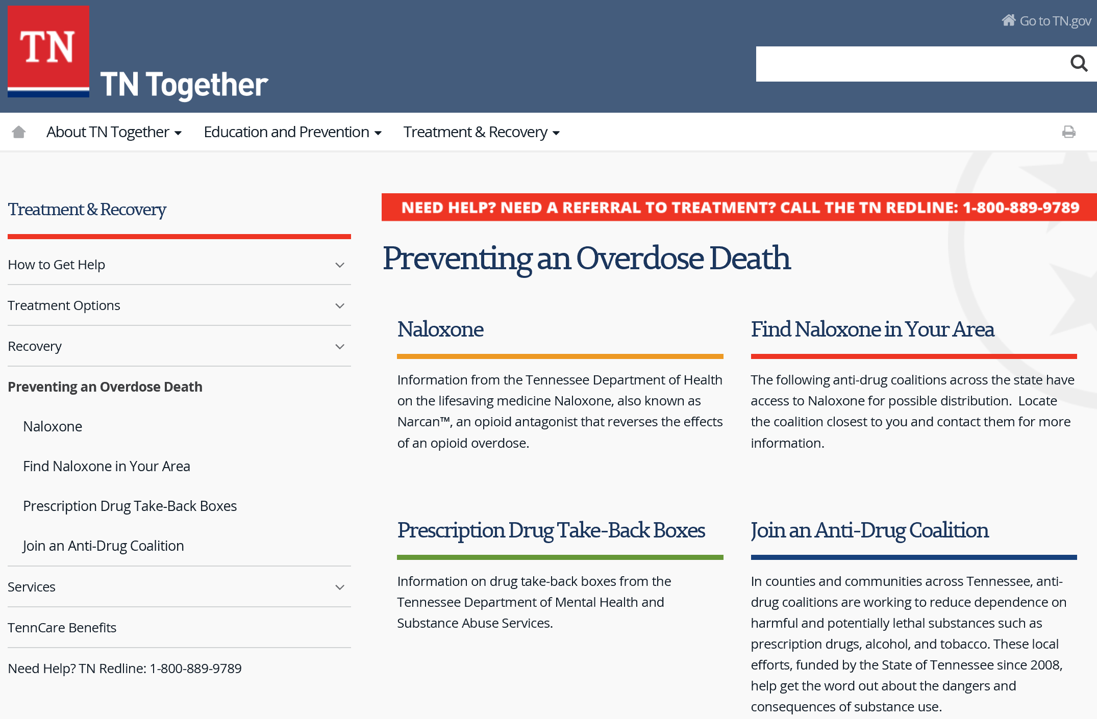
Helpful Resources for Everyone
https://www.tn.gov/opioids/treatment/preventing-an-overdose-death.html

Slide 16
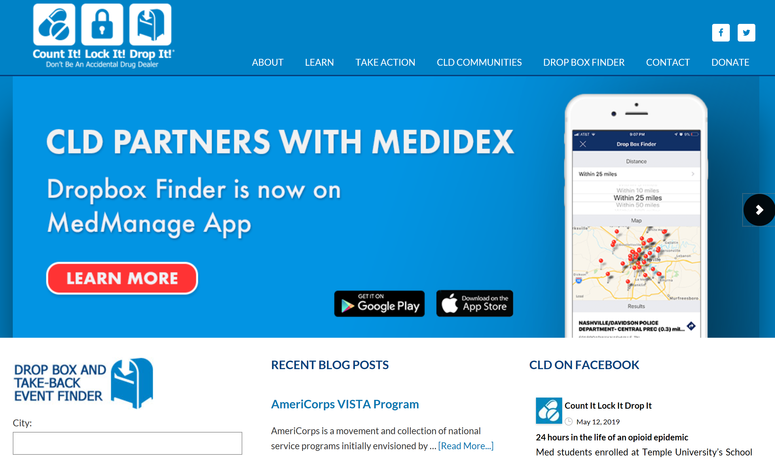
Helpful Resources for Everyone
https://countitlockitdropit.org/

Slide 17
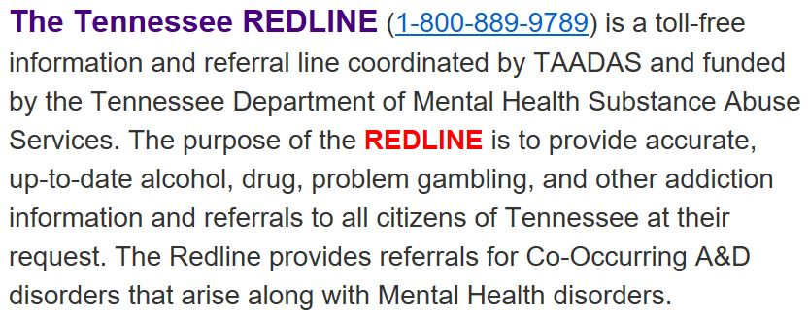
Helpful Resources for Everyone
https://taadas.org/our-programs-and-services/redline

Slide 18
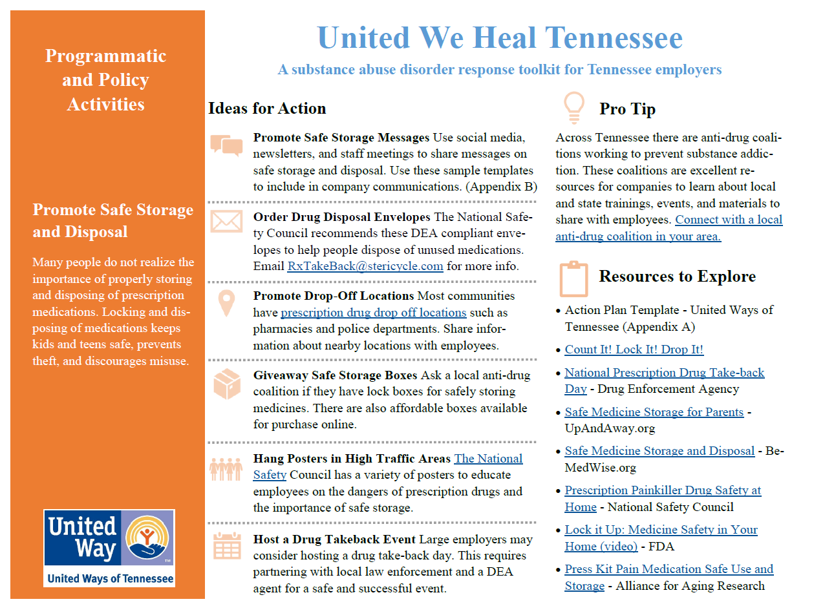
Helpful Resources for Employers
For More: https://uwtn.org/UnitedWeHealTN

Slide 19
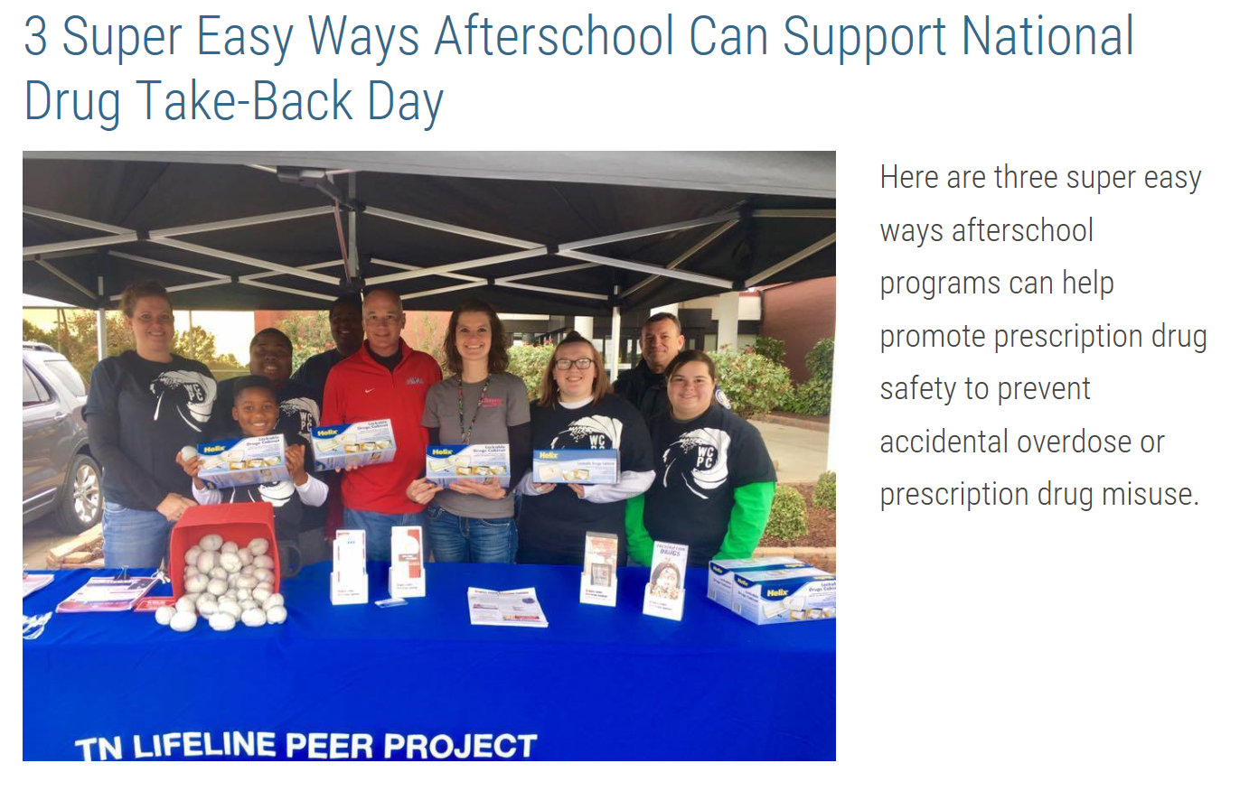
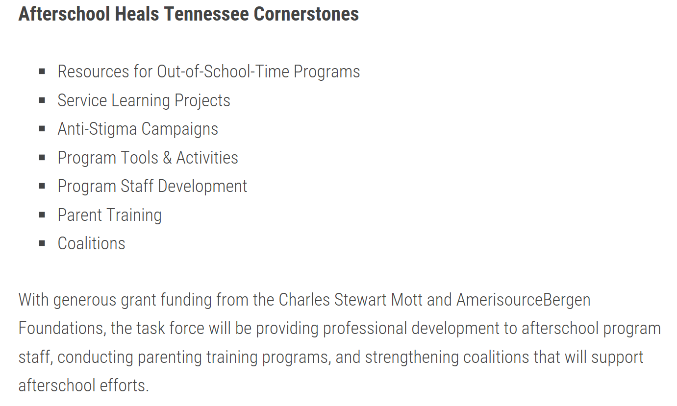
Helpful Resources for Afterschool
http://www.tnafterschool.org/about/afterschool-heals-tennessee/

Slide 20
Helpful Resources for Caregivers
https://www.upandaway.org/

Slide 21
Acknowledgements
Afterschool Heals/United We Heal Tennessee Taskforce
Laura Durham, Associate Director, TAADAS
Mary Graham, United Ways of Tennessee/Tennessee Afterschool Network
Sarah Murfree, MS Director, Prevention Coalition for Success (Rutherford)
Kelley Nave, Social Media Manger United Ways of Tennessee/Tennessee Afterschool Network
Kaysi Paul, Grants Manager, Prevention Coalition for Success (Rutherford)
Candi Rawlins – Executive Director, Tennessee Recreation and Parks Association
Debbie Rainey, United Way Williamson County
John Rust, Director of Field Operations, Tennessee Commission on Children and Youth
Sarah Sandin –Youth Initiatives Director, Metro Youth Drug Coalition (Knox)
Joy Shoun, Drug Abuse Initiatives Manager, UW of Greater Kingsport
Christina Baker Smith, Youth Engagement Manager, Tennessee Afterschool Network
Jim Snell, Executive Director, Volunteer Tennessee
Kim Tyner, Director, Williamson County Anti-Drug Coalition
Jacy Warrell, Tennessee Afterschool Network
Janelle Wood, Director Extended Learning Programs TN Department of Education

